Slide 2
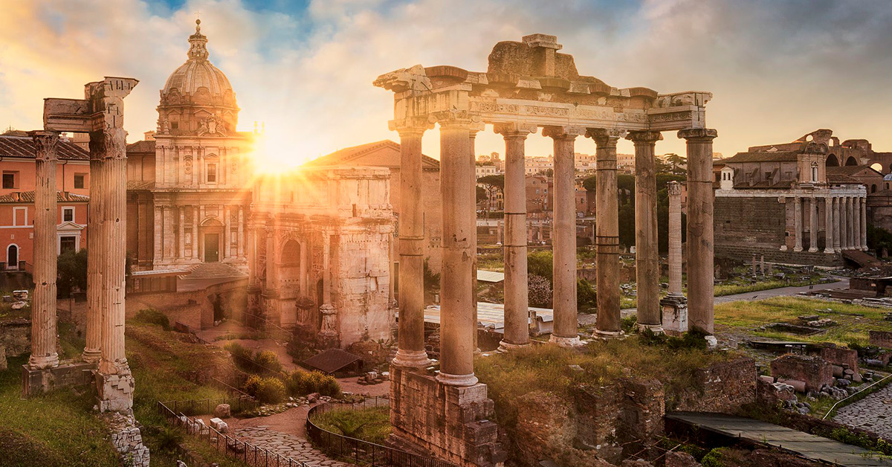
R O M A N S
Romans 9 - God’s Sovereignty

Slide 3
R O M A N S
A key turning point in Romans
Chapter 1-5: Justification
Chapter 5-8: Sanctification
Chapter 9…

Slide 4
R O M A N S
What does it mean?
^{Romans 9:10} … there was Rebekah also, when she had conceived twins by one man, our father Isaac; ¹¹ for though the twins were not yet born and had not done anything good or bad, so that God’s purpose according to His choice would stand, not because of works but because of Him who calls, ¹² it was said to her, “The older will serve the younger.” ¹³ Just as it is written, “Jacob I loved, but Esau I hated.”

Slide 5
“Double Predestination?”
God chooses in advance who will be eternally saved and who will be eternally judged
What does it mean?
^{Romans 9:10} … there was Rebekah also, when she had conceived twins by one man, our father Isaac; ¹¹ for though the twins were not yet born and had not done anything good or bad, so that God’s purpose according to His choice would stand, not because of works but because of Him who calls, ¹² it was said to her, “The older will serve the younger.” ¹³ Just as it is written, “Jacob I loved, but Esau I hated.”

Slide 6
That sounds kind of unfair…
“Double Predestination?”
God chooses in advance who will be eternally saved and who will be eternally judged
This means we don’t really choose about whether to believe in Christ for salvation- it’s predetermined
^{Romans 9:10} … there was Rebekah also, when she had conceived twins by one man, our father Isaac; ¹¹ for though the twins were not yet born and had not done anything good or bad, so that God’s purpose according to His choice would stand, not because of works but because of Him who calls, ¹² it was said to her, “The older will serve the younger.” ¹³ Just as it is written, “Jacob I loved, but Esau I hated.”

Slide 7
That sounds kind of unfair…
“Double Predestination?”
God chooses in advance who will be eternally saved and who will be eternally judged
This means we don’t really choose about whether to believe in Christ for salvation- it’s predetermined
^{Romans 9:14} What shall we say then? There is no injustice with God, is there? May it never be! ¹⁵ For He says to Moses, “I will have mercy on whom I have mercy, and I will have compassion on whom I have compassion.” ¹⁶ So then it does not depend on the man who wills or the man who runs, but on God who has mercy.

Slide 8
That sounds kind of unfair…
“Double Predestination?”
God chooses in advance who will be eternally saved and who will be eternally judged
This means we don’t really choose about whether to believe in Christ for salvation- it’s predetermined
^{Romans 9:17} For the Scripture says to Pharaoh, “For this very purpose I raised you up, to demonstrate My power in you, and that My name might be proclaimed throughout the whole earth.” ¹⁸ So then He has mercy on whom He desires, and He hardens whom He desires

Slide 9
“Double Predestination?”
Some are predestined to be irresistibly attracted to Christ, others are predestined to have their heart hardened by God, leading to damnation...
^{Romans 9:17} For the Scripture says to Pharaoh, “For this very purpose I raised you up, to demonstrate My power in you, and that My name might be proclaimed throughout the whole earth.” ¹⁸ So then He has mercy on whom He desires, and He hardens whom He desires

Slide 10
“Double Predestination?”
Some are predestined to be irresistibly attracted to Christ, others are predestined to have their heart hardened by God, leading to damnation...
^{Romans 9:19} You will say to me then, “Why does He still find fault? For who resists His will?”

Slide 11
“Double Predestination?”
Some are predestined to be irresistibly attracted to Christ, others are predestined to have their heart hardened by God, leading to damnation...
^{Romans 9:19} You will say to me then, “Why does He still find fault? For who resists His will?” ²⁰ On the contrary, who are you, O man, who answers back to God? The thing molded will not say to the molder, “Why did you make me like this,” will it?

Slide 12
“Double Predestination?”
Some are predestined to be irresistibly attracted to Christ, others are predestined to have their heart hardened by God, leading to damnation...
Some people are made for heaven,
and some people are made for Hell…
^{Romans 9:22} What if God, although willing to demonstrate His wrath and to make His power known, endured with much patience vessels of wrath prepared for destruction? ²³ And He did so to make known the riches of His glory upon vessels of mercy, which He prepared beforehand for glory,

Slide 13
A Biblical Dilemma
If everything that happens is God’s will, in what sense do our choices matter?
2 Biblical facts in tension:
1) Scripture teaches that God is Sovereign
2) And that humans have freewill choice / responsibility
If God’s will can be thwarted by man’s choice, in what sense is he sovereign?
So this creates a problem…

Slide 14
A Biblical Dilemma
?
2 Biblical facts in tension:
God is Sovereign
1) Scripture teaches that God is Sovereign
People can choose
2) And that humans have freewill choice / responsibility
So this creates a problem…

Slide 15
A Biblical Dilemma
?
God is Sovereign
People can choose
God’s sovereignty is one of most clearly taught concepts in the Bible
^{Isaiah 46:10} Declaring the end from the beginning, And from ancient times things which have not been done, Saying, 'My purpose will be established, And I will accomplish all My good pleasure’

Slide 16
A Biblical Dilemma
?
God is Sovereign
People can choose
Human choice is one of most clearly taught concepts in the Bible
^{Isaiah 46:10} Declaring the end from the beginning, And from ancient times things which have not been done, Saying, 'My purpose will be established, And I will accomplish all My good pleasure’

Slide 17
A Biblical Dilemma
?
God is Sovereign
People can choose
Human choice is one of most clearly taught concepts in the Bible
^{Matt 23:37} “Jerusalem, Jerusalem, who kills the prophets and stones those who are sent to her! How often I wanted to gather your children together, the way a hen gathers her chicks under her wings, and you were unwilling.”

Slide 18
A Biblical Dilemma
?
God is Sovereign
People can choose
Calvinist theologians emphasize God’s sovereignty
Arminian theologians emphasize free will choice
A centuries-old debate among Christians

Slide 19
A Biblical Dilemma
?
God is Sovereign
People can choose
This is a “non-essential” issue
But practically significant

Slide 20
A Biblical Dilemma
?
God is Sovereign
People can choose
We should approach this area with humility and unity

Slide 21
A Biblical resolution:
?
God is Sovereign
People can choose
^{Psalm 115:3} Our God is in the heavens; He does whatever he pleases…
God is sovereign… and yet he allows humans to make meaningful free will decisions

Slide 22
A Biblical resolution:
?
God is Sovereign
People can choose
^{Psalm 115:3} Our God is in the heavens; He does whatever he pleases…
¹⁶ the heavens are the heavens of the Lord, but the earth he has given to the sons of men.
God is sovereign… and yet he allows humans to make meaningful free will decisions

Slide 23
A Biblical resolution:
?
God is Sovereign
People can choose
← OR →
God is sovereign… and yet he allows humans to make meaningful free will decisions

Slide 24
A Biblical resolution:
?
God is Sovereign
People can choose
and decided that
God is sovereign… and yet he allows humans to make meaningful free will decisions

Slide 25
A Biblical resolution:
?
God is Sovereign
People can choose
and decided that
God is sovereign… and yet he allows humans to make meaningful free will decisions

Slide 26
R O M A N S
Is Romans 9 a prooftext for
double predestination and determinism?
There is an alternative way to read Romans 9…
The “golden rule” of Biblical interpretation: CONTEXT

Slide 27
The “golden rule” of Biblical interpretation: CONTEXT

Slide 28
R O M A N S
Our default assumed context:
Individualistic and Personal
The “golden rule” of Biblical interpretation: CONTEXT

Slide 29
R O M A N S
^{Romans 9:1} I am telling the truth in Christ, I am not lying, my conscience testifies with me in the Holy Spirit, ² that I have great sorrow and unceasing grief in my heart. ³ For I could wish that I myself were accursed, separated from Christ for the sake of my brethren, my kinsmen according to the flesh, ⁴ who are Israelites,

Slide 30
R O M A N S
Subject: Paul’s grief for the nation of Israel
^{Romans 9:1} I am telling the truth in Christ, I am not lying, my conscience testifies with me in the Holy Spirit, ² that I have great sorrow and unceasing grief in my heart. ³ For I could wish that I myself were accursed, separated from Christ for the sake of my brethren, my kinsmen according to the flesh, ⁴ who are Israelites,

Slide 31
R O M A N S
Subject: Paul’s grief for the nation of Israel
God’s plan for the rescue of mankind
Israel was God’s “chosen nation” through whom He would work
^{Romans 9:4} to whom belongs the adoption as sons, and the glory and the covenants and the giving of the Law and the temple service and the promises, ⁵ whose are the fathers, and from whom is the Christ according to the flesh, who is over all, God blessed forever. Amen.

Slide 32
R O M A N S
Subject: Paul’s grief for the nation of Israel
God’s plan for the rescue of mankind
Israel was God’s “chosen nation” through whom He would work
^{Romans 9:4} to whom belongs the adoption as sons, and the glory and the covenants and the giving of the Law and the temple service and the promises, ⁵ whose are the fathers, and from whom is the Christ according to the flesh, who is over all, God blessed forever. Amen.

Slide 33
R O M A N S
Subject: Paul’s grief for the nation of Israel
God’s plan for the rescue of mankind
Israel was God’s “chosen nation” through whom He would work
^{Romans 9:4} to whom belongs the adoption as sons, and the glory and the covenants and the giving of the Law and the temple service and the promises, ⁵ whose are the fathers, and from whom is the Christ according to the flesh, who is over all, God blessed forever. Amen.

Slide 34
R O M A N S
And yet much of Israel had denied Christ!
^{Matt 21:43} Jesus: “I tell you, the Kingdom of God will be taken away from you and given to a nation that will produce the proper fruit.”
The next phase of God’s plan: working through a “new nation” (those who follow Christ)
^{Romans 9:4} to whom belongs the adoption as sons, and the glory and the covenants and the giving of the Law and the temple service and the promises, ⁵ whose are the fathers, and from whom is the Christ according to the flesh, who is over all, God blessed forever. Amen.

Slide 35
R O M A N S
Objection!
No Fair!
God is Breaking His Promise to Israel!
The next phase of God’s plan: working through a “new nation” (those who follow Christ)
^{Romans 9:6} But it is not as though the word of God has failed…
¹⁴ What shall we say then? There is no injustice with God, is there?

Slide 36
THIS IS THE CONTEXT
In Romans 9, Paul is making a case from the Old Testament that God has the right to change Israel’s status and work through the Church for a period of time
Not about personal salvation
^{Romans 9:6} But it is not as though the word of God has failed…
¹⁴ What shall we say then? There is no injustice with God, is there?

Slide 37
THIS IS THE CONTEXT
In Romans 9, Paul is making a case from the Old Testament that God has the right to change Israel’s status and work through the Church for a period of time
Not about personal salvation
^{Romans} 3^{:23}
For everyone has sinned; we all fall short of God’s glorious standard. ²⁴ Yet God freely and graciously declares that we are righteous. He did this through Christ Jesus when he freed us from the penalty for our sins. ²⁵ For God presented Jesus as the sacrifice for sin. People are made right with God when they believe that Jesus sacrificed his life, shedding his blood.

Slide 38
THIS IS THE CONTEXT
In Romans 9, Paul is making a case from the Old Testament that God has the right to change Israel’s status and work through the Church for a period of time
Not about personal salvation
^{Romans} 3^{:23}
For everyone has sinned; we all fall short of God’s glorious standard. ²⁴ Yet God freely and graciously declares that we are righteous. He did this through Christ Jesus when he freed us from the penalty for our sins. ²⁵ For God presented Jesus as the sacrifice for sin. People are made right with God when they believe that Jesus sacrificed his life, shedding his blood.

Slide 39
THIS IS THE CONTEXT
In Romans 9, Paul is making a case from the Old Testament that God has the right to change Israel’s status and work through the Church for a period of time
This is the key to interpreting this passage correctly
Paul makes his case from 5 well known Old Testament Stories

Slide 40
Scene 1
God initially made the promise to Abraham
^{Romans 9:6} But it is not as though the word of God has failed. For they are not all Israel who are descended from Israel; ⁷ nor are they all children because they are Abraham’s descendants, but: “through Isaac your descendants will be named.”

Slide 41
Scene 1
God initially made the promise to Abraham
^{Romans 9:6} But it is not as though the word of God has failed. For they are not all Israel who are descended from Israel; ⁷ nor are they all children because they are Abraham’s descendants, but: “through Isaac your descendants will be named.”

Slide 42
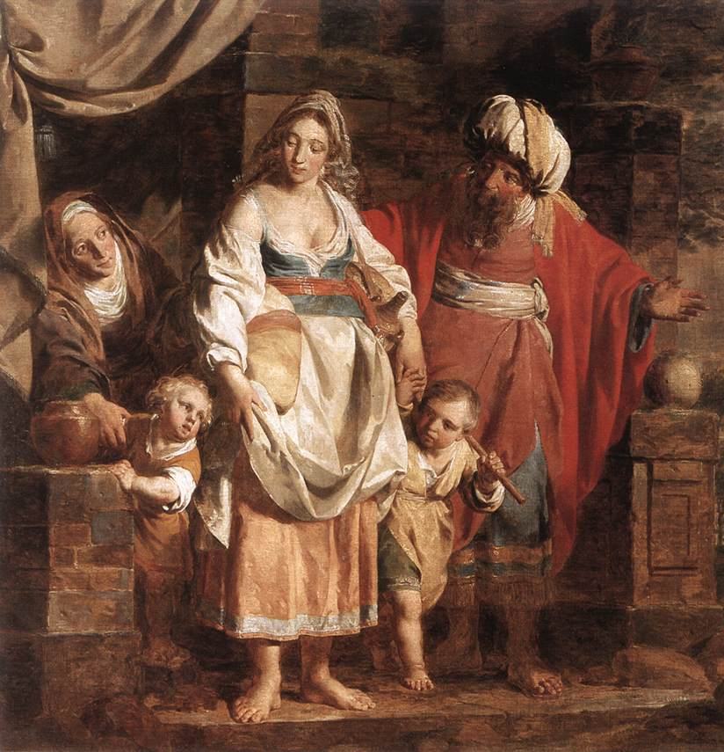
Scene 1
God initially made the promise to Abraham
Isaac → Jacob → Nation of Israel
Ishmael → Ishmaelites
Genesis 21:12
^{Romans 9:6} But it is not as though the word of God has failed. For they are not all Israel who are descended from Israel; ⁷ nor are they all children because they are Abraham’s descendants, but: “through Isaac your descendants will be named.”

Slide 43
Scene 1
God initially made the promise to Abraham
Isaac → Jacob → Nation of Israel
Ishmael → Ishmaelites
Genesis 21:12
^{Romans 9:6} But it is not as though the word of God has failed. For they are not all Israel who are descended from Israel; ⁷ nor are they all children because they are Abraham’s descendants, but: “through Isaac your descendants will be named.”

Slide 44
Scene 1
Paul’s point: not every physical descendent of Abraham is a recipient of God’s promise to work through his nation
Isaac → Jacob → Nation of Israel
Ishmael → Ishmaelites
God will choose NOT to work through some of Abraham’s decedents
(relevant to the context!)
Genesis 21:12
^{Romans 9:6} But it is not as though the word of God has failed. For they are not all Israel who are descended from Israel; ⁷ nor are they all children because they are Abraham’s descendants, but: “through Isaac your descendants will be named.”

Slide 45
Scene 1
Paul’s point: not every physical descendent of Abraham is a recipient of God’s promise to work through his nation
Isaac → Jacob → Nation of Israel
Ishmael → Ishmaelites
^{Romans 9:8} That is, it is not the children of the flesh who are children of God, but the children of the promise are regarded as descendants. ⁹ For this is the word of promise: “At this time I will come, and Sarah shall have a son.”

Slide 46
Scene 1
No one’s personal salvation is in view. God is choosing which child will inherit His promise of national blessing
Isaac → Jacob → Nation of Israel
Ishmael → Ishmaelites
^{Romans 9:8} That is, it is not the children of the flesh who are children of God, but the children of the promise are regarded as descendants. ⁹ For this is the word of promise: “At this time I will come, and Sarah shall have a son.”

Slide 47
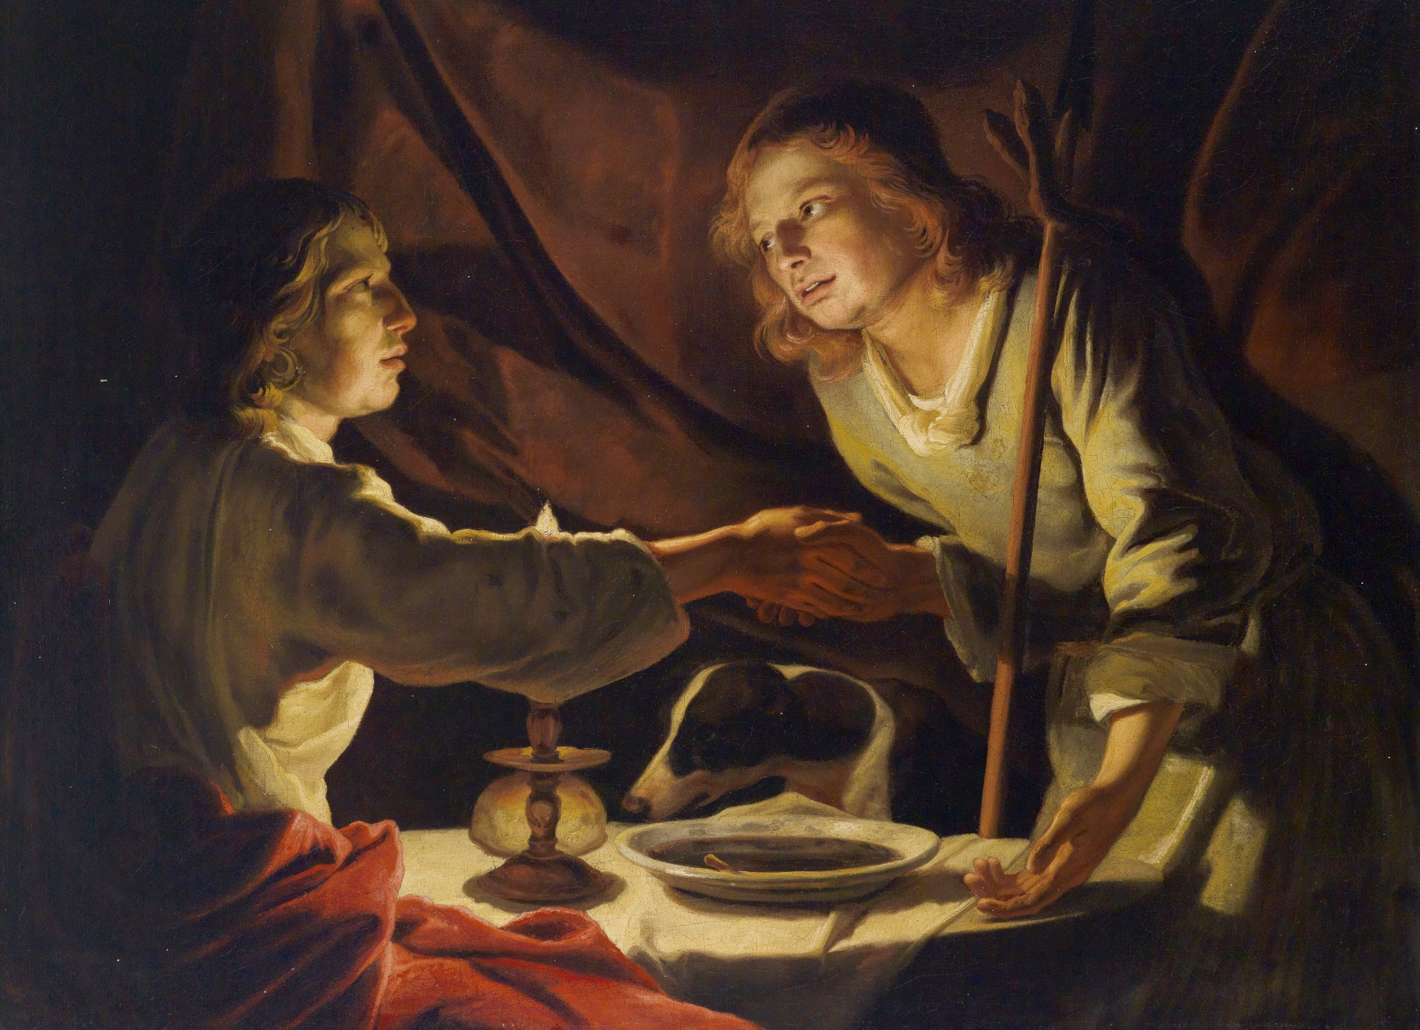
Scene 2
Which one will God’s promise of a nation that he will use be passed down to?
Jacob → Nation of Israel
Esau → Edomites
^{Romans 9:10} And not only this, but there was Rebekah also, when she had conceived twins by one man, our father Isaac;

Slide 48
Scene 2
Paul is just tracing the national election of Israel down through history
Jacob → Nation of Israel
Esau → Edomites
^{Romans 9:10} And not only this, but there was Rebekah also, when she had conceived twins by one man, our father Isaac;

Slide 49
Scene 2
Paul is just tracing the national election of Israel down through history
Jacob → Nation of Israel
Esau → Edomites
^{Romans 9:11} for though the twins were not yet born and had not done anything good or bad, so that God’s purpose according to His choice would stand, not because of works but because of Him who calls, ¹² it was said to her, “The older will serve the younger.”

Slide 50
Scene 2
Paul is just tracing the national election of Israel down through history
Jacob → Nation of Israel
Esau → Edomites
^{Romans 9:11} for though the twins were not yet born and had not done anything good or bad, so that God’s purpose according to His choice would stand, not because of works but because of Him who calls, ¹² it was said to her, “The older will serve the younger.”

Slide 51
Scene 2
Does this mean that God fated Esau to hell while yet unborn??
Jacob → Nation of Israel
Esau → Edomites
Genesis 25:23
^{Romans 9:11} for though the twins were not yet born and had not done anything good or bad, so that God’s purpose according to His choice would stand, not because of works but because of Him who calls, ¹² it was said to her, “The older will serve the younger.”

Slide 52
Scene 2
Does this mean that God fated Esau to hell while yet unborn??
^{Genesis 25:23} And the Lord told her, “The sons in your womb will become two nations. From the very beginning, the two nations will be rivals. One nation will be stronger than the other; and your older son will serve your younger son.”
Genesis 25:23
^{Romans 9:11} for though the twins were not yet born and had not done anything good or bad, so that God’s purpose according to His choice would stand, not because of works but because of Him who calls, ¹² it was said to her, “The older will serve the younger.”

Slide 53
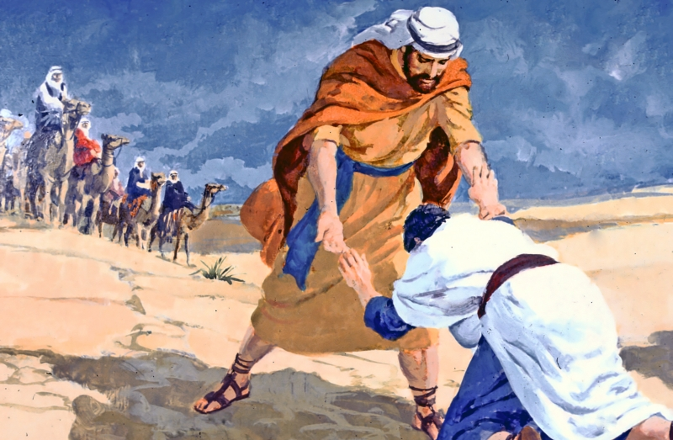
Scene 2
Does this mean that God fated Esau to hell while yet unborn??
This is about NATIONS
And God’s sovereign choice to work through the nation he pleases
Genesis 25:23
^{Romans 9:11} for though the twins were not yet born and had not done anything good or bad, so that God’s purpose according to His choice would stand, not because of works but because of Him who calls, ¹² it was said to her, “The older will serve the younger.”

Slide 54
Scene 2
So God hated baby Esau in the womb??
^{Rom 9:13} Just as it is written, “Jacob I loved, but Esau I hated.”

Slide 55
Scene 2
So God hated baby Esau in the womb??
^{Mal 1:1} The oracle of the word of the Lord to Israel through Malachi. ² “I have loved you,” says the Lord. But you say, “How have You loved us?” “Was not Esau Jacob’s brother?” declares the Lord. “Yet I have loved Jacob; ³ but I have hated Esau, and I have made his mountains a desolation and appointed his inheritance for the jackals of the wilderness.”
Malachi 1:1
^{Rom 9:13} Just as it is written, “Jacob I loved, but Esau I hated.”

Slide 56
Scene 2
^{Luke 14:26} “If anyone comes to Me, and does not hate his own father and mother and wife and children and brothers and sisters, yes, and even his own life, he cannot be My disciple.
So God hated baby Esau in the womb??
“Loved/Hated” = expression:
“favored more than”
^{Matt 10:37} “He who loves father or mother more than Me is not worthy of Me; and he who loves son or daughter more than Me is not worthy of Me.
Malachi 1:1
^{Rom 9:13} Just as it is written, “Jacob I loved, but Esau I hated.”

Slide 57
Scene 2
So God hated baby Esau in the womb??
Point: God sovereignly chose which nation he would preserve and work through to fulfill His promise/plan
^{Rom 9:13} Just as it is written, “Jacob I loved, but Esau I hated.”

Slide 58
Point: God sovereignly chose which nation he would preserve and work through to fulfill His promise/plan
^{Romans 9:14} What shall we say then? There is no injustice with God, is there? May it never be!

Slide 59
Many Rabbis taught that their national election was based on the merit of the patriarchs. Paul’s point is that it is based only on God’s sovereign mercy.
^{Romans 9:11} for though the twins were not yet born and had not done anything good or bad, so that God’s purpose according to His choice would stand, not because of works but because of Him who calls …
Point: God sovereignly chose which nation he would preserve and work through to fulfill His promise/plan
^{Romans 9:15} For He says to Moses, “I will have mercy on whom I have mercy, and I will have compassion on whom I have compassion.” ¹⁶ So then it does not depend on the man who wills or the man who runs, but on God who has mercy.

Slide 60
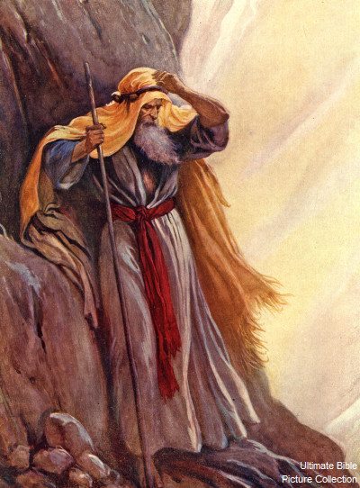
Scene 3
^{Romans 9:15} For He says to Moses, “I will have mercy on whom I have mercy, and I will have compassion on whom I have compassion.” ¹⁶ So then it does not depend on the man who wills or the man who runs, but on God who has mercy.

Slide 61
Scene 3
Does this mean that God picks people for heaven and we have no part in it?
Exodus 33:19
^{Romans 9:15} For He says to Moses, “I will have mercy on whom I have mercy, and I will have compassion on whom I have compassion.” ¹⁶ So then it does not depend on the man who wills or the man who runs, but on God who has mercy.

Slide 62
Scene 3
Does this mean that God picks people for heaven and we have no part in it?
Point: God’s preservation of Israel was an act of sheer mercy
Point: Even the best man in the OT couldn’t influence God’s national strategy
Exodus 33:19
^{Romans 9:15} For He says to Moses, “I will have mercy on whom I have mercy, and I will have compassion on whom I have compassion.” ¹⁶ So then it does not depend on the man who wills or the man who runs, but on God who has mercy.

Slide 63
So God hardens people’s hearts so they can’t come to Christ and be saved?
^{2 Peter 3:9} The Lord … is patient toward you, not wishing for any to perish but for all to come to repentance.
^{1 Timothy 2:3} God our Savior, ⁴ who desires all men to be saved and to come to the knowledge of the truth.
^{Romans 9:17} For the Scripture says to Pharaoh, “For this very purpose I raised you up, to demonstrate My power in you, and that My name might be proclaimed throughout the whole earth.” ¹⁸ So then He has mercy on whom He desires, and He hardens whom He desires.

Slide 64
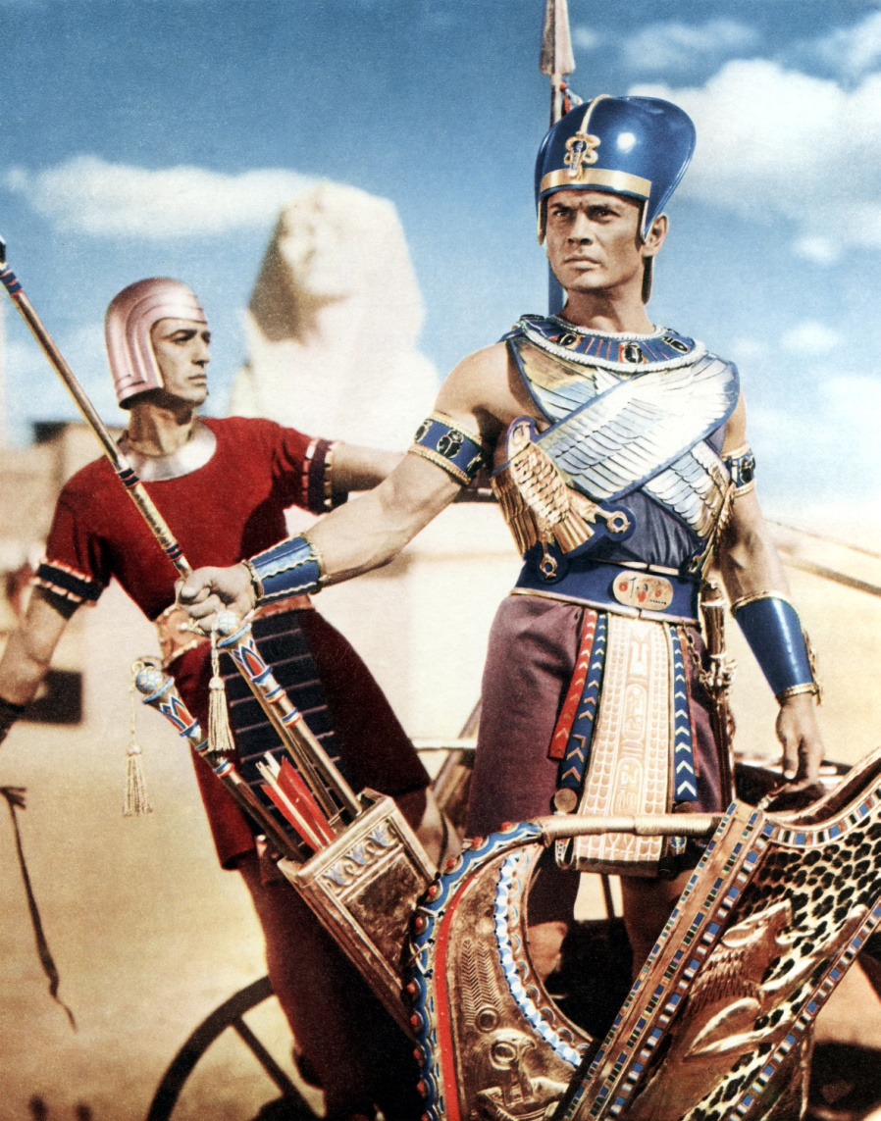
Scene 4
So God hardens people’s hearts so they can’t come to Christ and be saved?
Will Pharoah be able to thwart God’s plan to work through the nation?
Exodus 9:16
^{Romans 9:17} For the Scripture says to Pharaoh, “For this very purpose I raised you up, to demonstrate My power in you, and that My name might be proclaimed throughout the whole earth.” ¹⁸ So then He has mercy on whom He desires, and He hardens whom He desires.

Slide 65
Scene 4
So God hardens people’s hearts so they can’t come to Christ and be saved?
Will Pharoah be able to thwart God’s plan to work through the nation?
Point: Even the worst enemy in the OT couldn’t thwart God’s national strategy
Exodus 9:16
In fact God used Pharaoh's very hostility to advance His plan!
^{Romans 9:17} For the Scripture says to Pharaoh, “For this very purpose I raised you up, to demonstrate My power in you, and that My name might be proclaimed throughout the whole earth.” ¹⁸ So then He has mercy on whom He desires, and He hardens whom He desires.

Slide 66
Objection: So if we can’t influence His plan to use nations, then it’s not fair for Him to punish us by taking our role away
^{Romans 9:19} You will say to me then, “Why does He still find fault? For who resists His will?”

Slide 67
Does this mean that some people are made for Heaven, and some people are made for Hell?
Objection: So if we can’t influence His plan to use nations, then it’s not fair for Him to punish us by taking our role away
^{Rom 9:20} On the contrary, who are you, O man, who answers back to God? The thing molded will not say to the molder, “Why did you make me like this,” will it? ²¹ Or does not the potter have a right over the clay, to make from the same lump one vessel for honorable use and another for common use? ²² What if God, although willing to demonstrate His wrath and to make His power known, endured with much patience vessels of wrath prepared for destruction? ²³ And He did so to make known the riches of His glory upon vessels of mercy, which He prepared beforehand for glory,

Slide 68
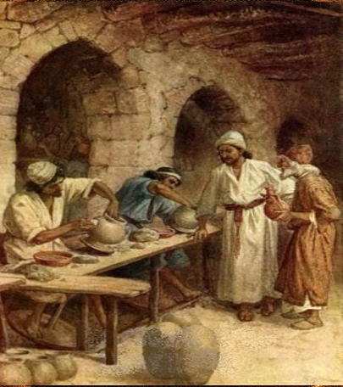
Scene 5
^{Jeremiah 18:1} The Lord gave another message to Jeremiah. He said, ² “Go down to the potter’s shop, and I will speak to you there.” ³ So I did as he told me and found the potter working at his wheel. ⁴ But the jar he was making did not turn out as he had hoped, so he crushed it into a lump of clay again and started over.

Slide 69
Scene 5
^{Jeremiah 18:5} Then the Lord gave me this message: ⁶ “O Israel, can I not do to you as this potter has done to his clay? As the clay is in the potter’s hand, so are you in my hand. ⁷ If I announce that a certain nation or kingdom is to be uprooted, torn down, and destroyed, ⁸ but then that nation renounces its evil ways, I will not destroy it as I had planned.

Slide 70
Scene 5
This is about God’s choice to advance His plan through a nation
^{Jeremiah 18:9} And if I announce that I will plant and build up a certain nation or kingdom,¹⁰ but then that nation turns to evil and refuses to obey me, I will not bless it as I said I would.

Slide 71
Scene 5
This is about God’s choice to advance His plan through a nation
Warning: Israel, your role is conditioned on your obedience to Me
^{Jeremiah 18:9} And if I announce that I will plant and build up a certain nation or kingdom,¹⁰ but then that nation turns to evil and refuses to obey me, I will not bless it as I said I would.

Slide 72
Scene 5
Does this mean that some people are made for Heaven, and some people are made for Hell?
Point: God has the right to change Israel’s status if they are unresponsive to Him
And they had denied the Messiah!
^{Jeremiah 18:9} And if I announce that I will plant and build up a certain nation or kingdom,¹⁰ but then that nation turns to evil and refuses to obey me, I will not bless it as I said I would.

Slide 73
Scene 5
Does this mean that some people are made for Heaven, and some people are made for Hell?
Israel is being remade into 2 vessels: one “common” use…
^{Rom 9:21} Or does not the potter have a right over the clay, to make from the same lump one vessel for honorable use and another for common use?

Slide 74
Scene 5
Does this mean that some people are made for Heaven, and some people are made for Hell?
Israel is being remade into 2 vessels: one “common” use…
And one for Glory!
^{Romans 9:23} …vessels of mercy, which He prepared beforehand for glory, ²⁴ even us, whom He also called, not from among Jews only, but also from among Gentiles.

Slide 75
Scene 5
Does this mean that some people are made for Heaven, and some people are made for Hell?
Israel is being remade into 2 vessels: one “common” use…
And one for Glory!
God is making a NEW Nation, made of believing Jews and people from every nation, to carry out his work in the world.
^{Romans 9:23} …vessels of mercy, which He prepared beforehand for glory, ²⁴ even us, whom He also called, not from among Jews only, but also from among Gentiles.

Slide 76
Conclusion:
Romans 9 does not teach double predestination or determinism
It is a defense of God’s right to include you and I into his plan as “children of God”

Slide 77
Praise God for His Sovereignty!

Slide 78
Praise God for His incredible power!

Slide 79
Praise God for His plan to pursue and rescue mankind!

Slide 80
Praise God that He has a plan for your life!

Slide 81
And praise God that He gives us the freedom to make meaningful choices
^{Romans 10:9} that if you confess with your mouth Jesus as Lord, and believe in your heart that God raised Him from the dead, you will be saved

Slide 82
^{Romans 11:33} Oh, the depth of the riches both of the wisdom and knowledge of God! How unsearchable are His judgments and unfathomable His ways! ³⁴ For who has known the mind of the Lord, or who became His counselor? ³⁵ Or who has first given to him that it might be paid back to him again? ³⁶ For from Him and through Him and to Him are all things. To Him be the glory forever. Amen.

Slide 83
R O M A N S
Next Week…

