Slide 1
Serving
During the challenging years

Slide 2
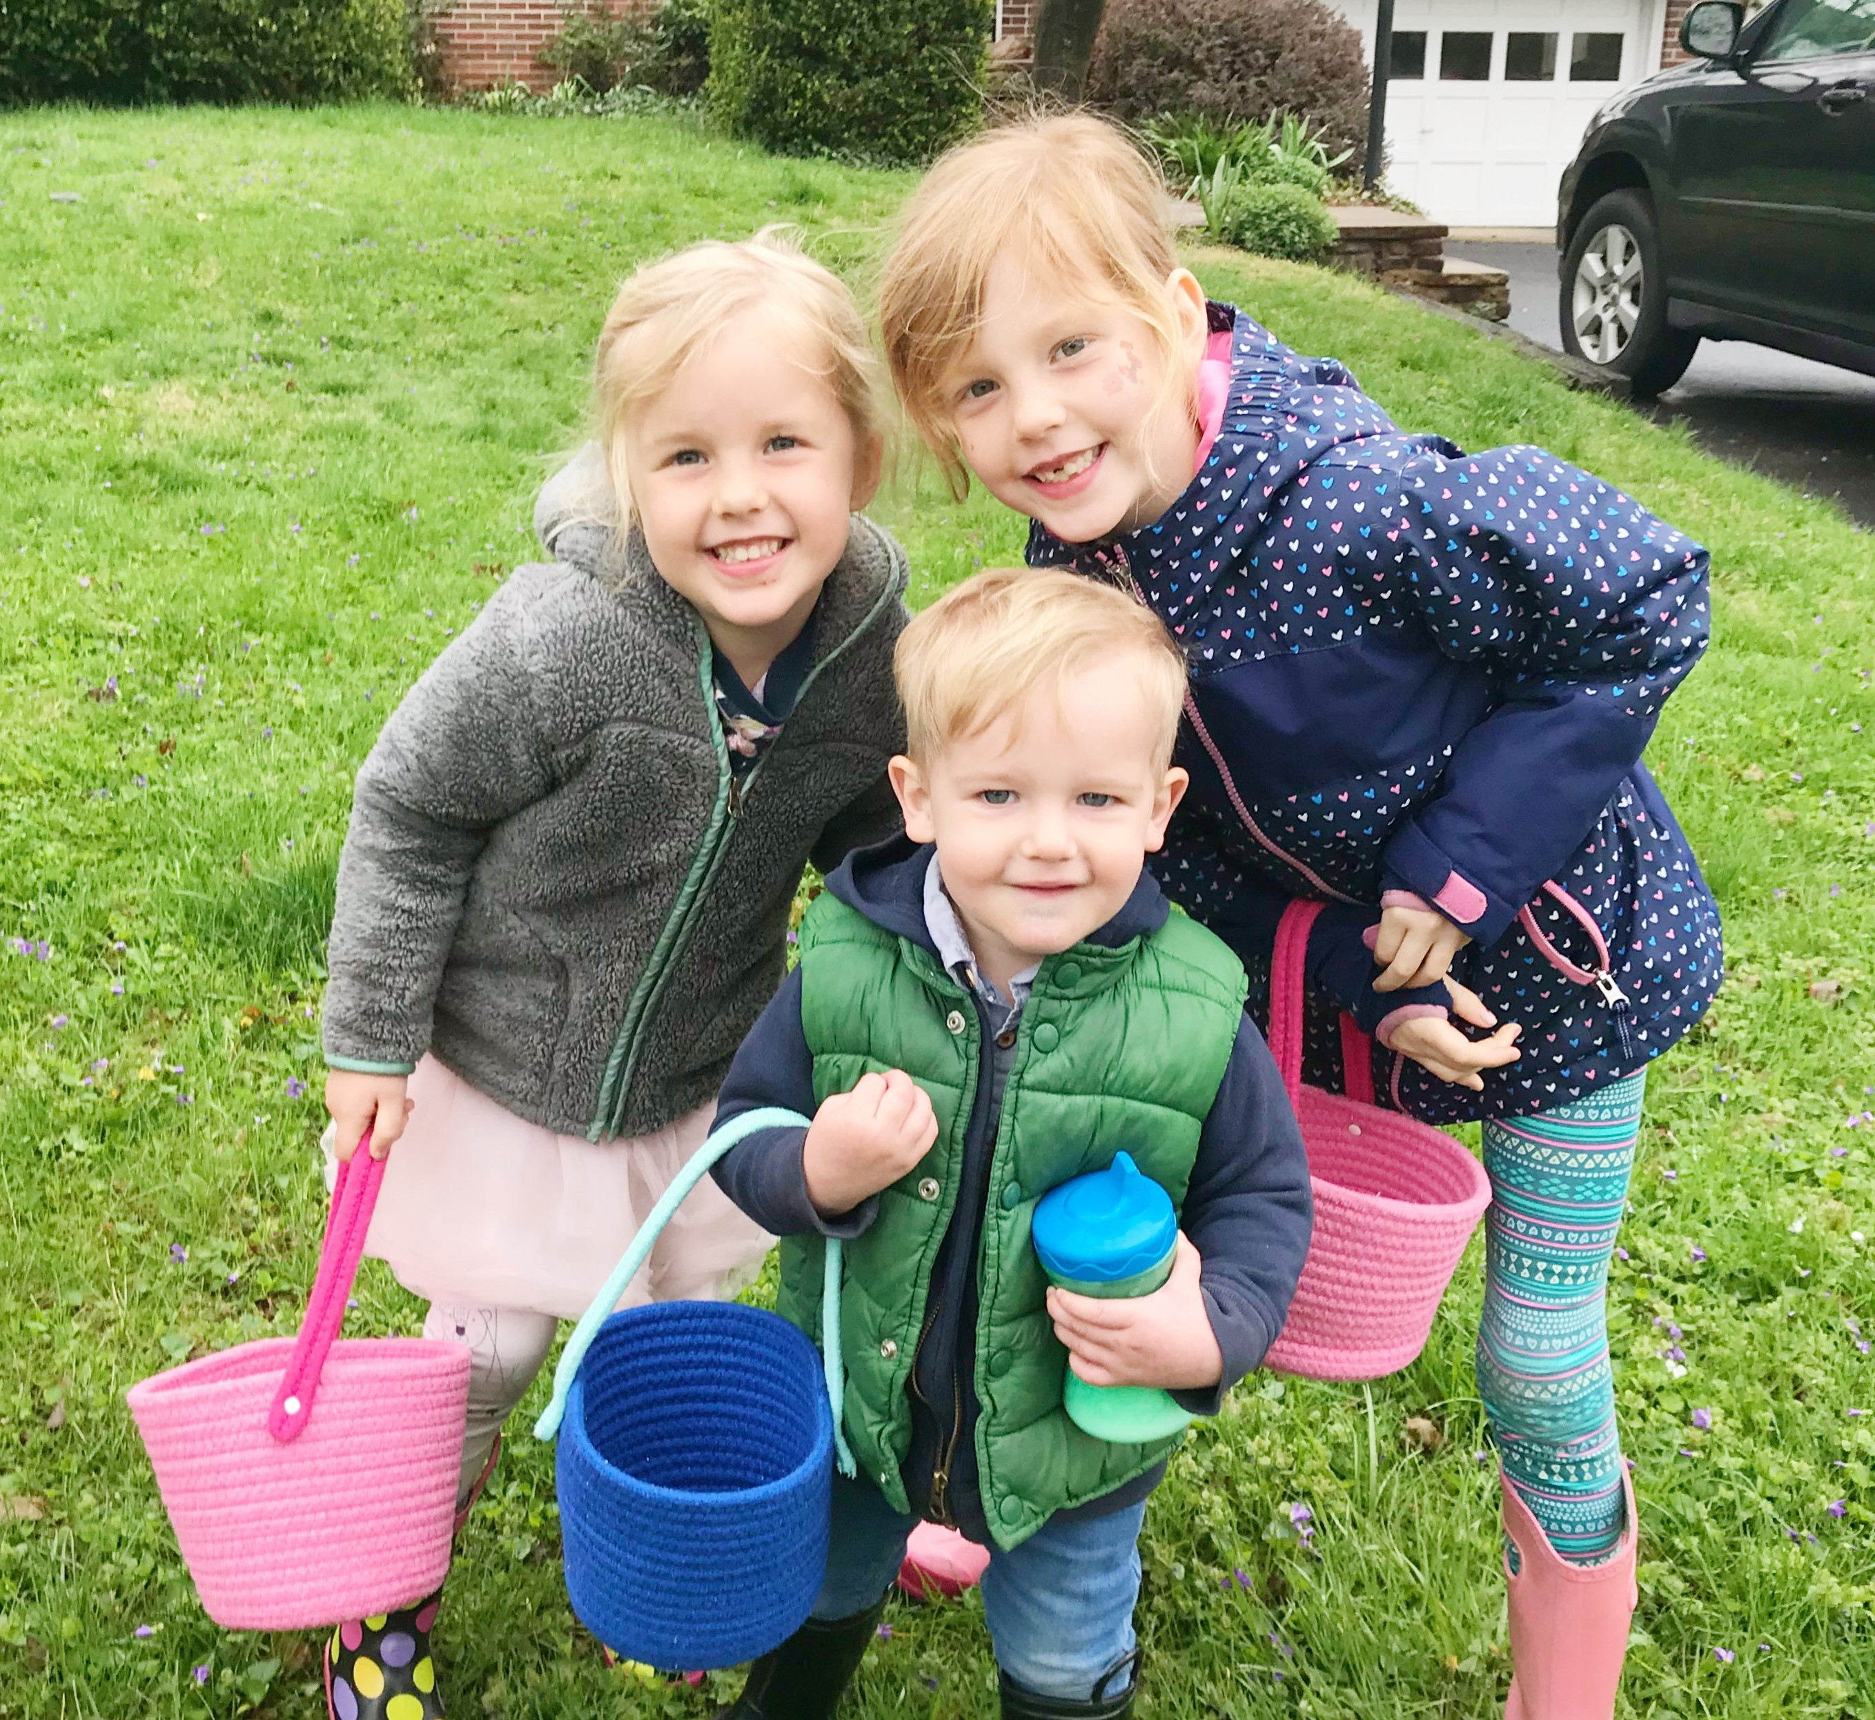

Slide 3
Challenging Years?
How do I define challenging years?
Parenting young children
Life transitions/adding children/change in circumstances
Qualification – Maybe you have older children?

Slide 4
Notes:
Remember when going out to eat was something you did for fun. Now it is a sick form of torture.

Slide 5
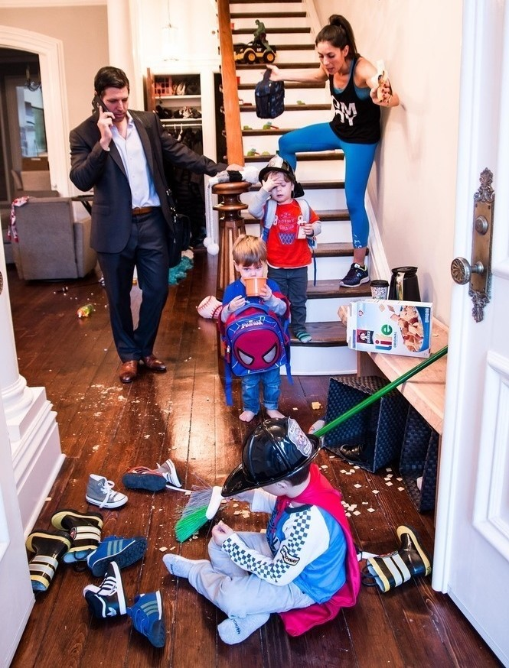
Notes:
Why do I turn into the meanest person who ever existed trying to get out the door?

Slide 6
Notes:
Costco story!

Slide 7
Notes:
Bumbo turkey, spouse, meals!

Slide 8
Notes:
And oh… the sleepless fog that doesn’t lift with sleep.

Slide 9
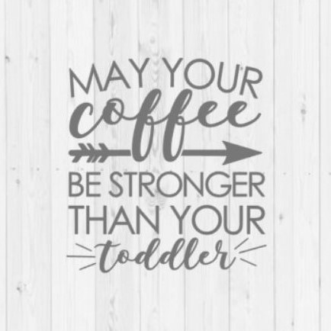
Challenging!
Major life Change
Personal Sacrifice
Coffee!

Slide 10
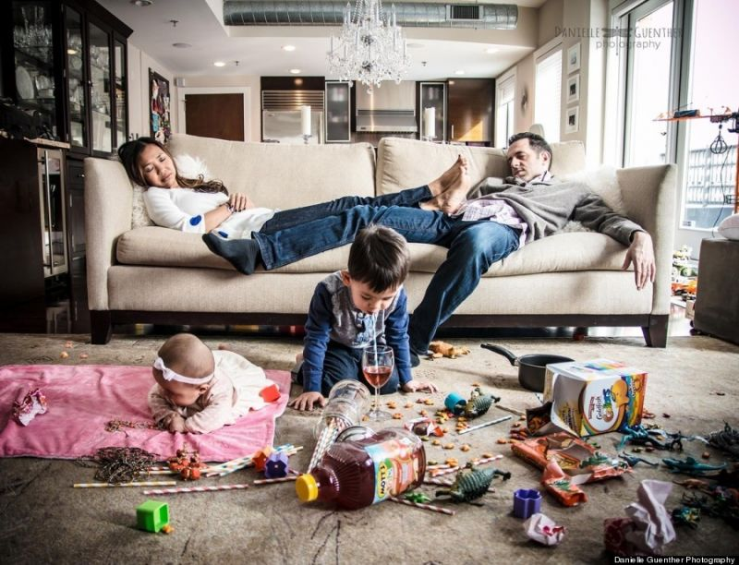
Serving?

Slide 11
Serving
Serve, verb
perform duties or services for (another person or an organization).
Human Virtue
- Community Service
- “Better to give than receive”
- “Taking care of you makes me happy too!”

Slide 12
Serving
Serving God
-Forgiven
-Filled by his love
-Desire to give it away

Slide 13
Serving
Serving God
-Forgiven
-Filled by his love
-Desire to give it away
Experience
-Stepping out to serve when you don't feel like it
-Feels good, fulfilling
Notes:
But then…Boom stick says positive and things are about the really change!

Slide 14
Hairdresser story…

Slide 15
Hairdresser story…
- Not intuitive
Not the path of least resistance
A persuaded deliberate choice

Slide 16
Hebrews 6:9-12
"Dear friends, even though we are talking this way, we really don’t believe it applies to you. We are confident that you are meant for better things, things that come with salvation. ¹⁰ For God is not unjust. He will not forget how hard you have worked for him and how you have shown your love to him by caring for other believers, as you still do.

Slide 17
Hebrews 6:9-12
¹¹ Our great desire is that you will keep on loving others as long as life lasts, in order to make certain that what you hope for will come true. ¹² Then you will not become spiritually dull and indifferent. Instead, you will follow the example of those who are going to inherit God’s promises because of their faith and endurance."
Notes:
Isn’t this our goal?! That as we grow older with the lord our love for others grows too. He says it’s a safeguard for our faith! It is connected to our relationship with God.

Slide 18
Challenging!
This stage provides ample opportunity for difficut circumstances to be an excuse to love self more and others less
"My kid just…So I can’t…”
Notes:
This is where I want to describe the inner battle of the mind. The struggle.

Slide 19
Challenging!
This stage provides ample opportunity for difficut circumstances to be an excuse to love self more and others less
"My kid just…So I can’t…”
Qualify!

Slide 20
Challenging!
It's the inner thought life…
"I just can't"
"I just don't want to"
"Nothing in me can give out right now, I'm so ___________. ( tired, over it, uncomfortable)

Slide 21
The path of least resistance
Natural for all of us!

Slide 22
The path of least resistance
Natural for all of us!
My Experience
- Expert comfort seeker Concerned watching others struggle through parenthood Worried about myself and tendencies

Slide 23
The path of least resistance
-
Leads away from God
Leads away from fulfillment
- Leads away from our life turning out the way we want it too
“…keep on loving others as long as life lasts… Then you will not become spiritually dull and indifferent”
Hebrews 6:11-12

Slide 24
The path of least resistance
-
Leads away from God
Leads away from fullfillment
- Leads away from our life turning out the way we want it too
“…keep on loving others as long as life lasts… Then you will not become spiritually dull and indifferent”
Hebrews 6:11-12
The difficulties of this stage are not intended to take us away from God – but closer to him!

Slide 25
The path of least resistance
Service is culturally acceptable but so is the opposite!
Self Love - The belief that I have the ability to fill myself up and by acting on it, I will provide what is lacking

Slide 26
The path of least resistance
# Selflove

Slide 27
The path of least resistance
#selfcare

Slide 28
The path of least resistance
The “things” in and of themselves are not necessarily bad.
-Lame
-Ineffective

Slide 29
Mortifying the Flesh with Fullness
“On the most basic of levels, I desire fullness, and fleshly lusts seduce me by attaching themselves to this basic desire. They exploit the empty spaces in me, and they promise that fullness will be mine if I give into their demands. When my soul sits empty and is aching for something to fill it, such deceptive promises are extremely difficult to resist.”

Slide 30
Liberation from Self Love
“Compared to greater endeavors, self-love is mundane and tiresome. Consequently, the more thoroughly I can be done with such tedium, the freer my soul will be to soar at its God-intended heights.
– Milton Vincent, A Gospel Primer for Christians

Slide 31
The Moral Peril of Meritocracy - By David Brooks, NYT, April 7, 2019
“Many of the people I admire lead lives that have a two-mountain shape. They got out of school, began their career, started a family and identified the mountain they thought they were meant to climb — I’m going to be an entrepreneur, a doctor, a cop. They did the things society encourages us to do, like make a mark, become successful, buy a home, raise a family, pursue happiness.

Slide 32
The Moral Peril of Meritocracy - By David Brooks, NYT, April 7, 2019
These hustling years are also powerfully shaped by our individualistic and meritocratic culture. People operate under this assumption: I can make myself happy. If I achieve excellence, lose more weight, follow this self-improvement technique, fulfillment will follow.

Slide 33
The Moral Peril of Meritocracy - By David Brooks, NYT, April 7, 2019
But in the lives of the people I’m talking about — the ones I really admire — something happened that interrupted the linear existence they had imagined for themselves. Something happened that exposed the problem with living according to individualistic, meritocratic values.

Slide 34
The Moral Peril of Meritocracy - By David Brooks, NYT, April 7, 2019
Some of them achieved success and found it unsatisfying. They figured there must be more to life, some higher purpose. Others failed. They lost their job or endured some scandal. Suddenly they were falling, not climbing, and their whole identity was in peril. Yet another group of people got hit sideways by something that wasn’t part of the original plan.

Slide 35
The Moral Peril of Meritocracy - By David Brooks, NYT, April 7, 2019
They had a cancer scare or suffered the loss of a child. These tragedies made the first-mountain victories seem, well, not so important. Life had thrown them into the valley, as it throws most of us into the valley at one point or another. They were suffering and adrift. Some people are broken by this kind of pain and grief. They seem to get smaller and more afraid, and never recover. They get angry, resentful and tribal.

Slide 36
The Moral Peril of Meritocracy - By David Brooks, NYT, April 7, 2019
They had a cancer scare or suffered the loss of a child. These tragedies made the first-mountain victories seem, well, not so important. Life had thrown them into the valley, as it throws most of us into the valley at one point or another. They were suffering and adrift. Some people are broken by this kind of pain and grief. They seem to get smaller and more afraid, and never recover. They get angry, resentful and tribal.
Challenging circumstances change us!

Slide 37
The Moral Peril of Meritocracy - By David Brooks, NYT, April 7, 2019
“But other people are broken open. The theologian Paul Tillich wrote that suffering upends the normal patterns of life and reminds you that you are not who you thought you were. The basement of your soul is much deeper than you knew. Some people look into the hidden depths of themselves and they realize that success won’t fill those spaces. Only a spiritual life and unconditional love from family and friends will do.

Slide 38
The path of Great resistance
What is the path of great resistance?
What are the "greater endeavors?"
How can we allow this path through the valley change us?

Slide 39
The path of Great resistance
“Come to me, all you who are weary and burdened, and I will give you rest. ²⁹ Take my yoke upon you and learn from me, for I am gentle and humble in heart, and you will find rest for your souls. ³⁰ For my yoke is easy and my burden is light.”
Matthew 11:28

Slide 40
The path of Great resistance
“Come to me, all you who are weary and burdened, and I will give you rest. ²⁹ Take my yoke upon you and learn from me, for I am gentle and humble in heart, and you will find rest for your souls. ³⁰ For my yoke is easy and my burden is light.”
Matthew 11:28
The challenges either:
-Point to our need for soul rest
-Remind us of our need to connect with the God who gave us soul rest
Notes:
Literally a come to Jesus moment. God is actually offering to quiet our discontentment. God is offering us an answer to one of our biggest questions? He is offering a relationship with him, forgiven and promises eternity with him.
All people are first mountain people, seeing what they can do to make themselves happy. Finding yourself in constant persuit over and over leads to the reality that maybe you need help to get the peace or fulfillment your looking for.

Slide 41
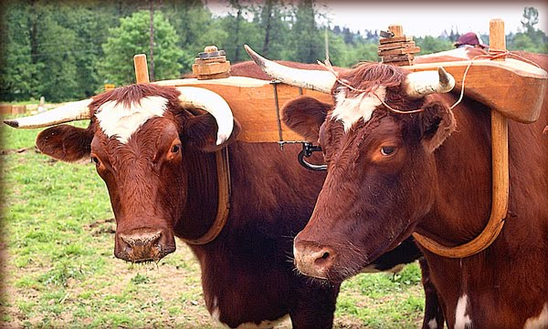
The path of Great resistance
“Come to me, all you who are weary and burdened, and I will give you rest. ²⁹ Take my yoke upon you and learn from me, for I am gentle and humble in heart, and you will find rest for your souls. ³⁰ For my yoke is easy and my burden is light.”
Matthew 11:28

Slide 42
The path of Great resistance
“Come to me, all you who are weary and burdened, and I will give you rest. ²⁹ Take my yoke upon you and learn from me, for I am gentle and humble in heart, and you will find rest for your souls. ³⁰ For my yoke is easy and my burden is light.”
Matthew 11:28
Partner in this!

Slide 43
The path of Great resistance
“Come to me, all you who are weary and burdened, and I will give you rest. ²⁹ Take my yoke upon you and learn from me, for I am gentle and humble in heart, and you will find rest for your souls. ³⁰ For my yoke is easy and my burden is light.”
Matthew 11:28
Yoke = Connect with God
Burden = Love others through you!

Slide 44
The path of Great resistance
¹¹ No discipline is enjoyable while it is happening—it’s painful! But afterward there will be a peaceful harvest of right living for those who are trained in this way.
Hebrews 12:11

Slide 45
The path of Great resistance
¹¹ No discipline is enjoyable while it is happening—it’s painful! But afterward there will be a peaceful harvest of right living for those who are trained in this way.
Hebrews 12:11
Trained: gegymnasmenois, to exercise vigorously, in any way, either the body or the mind

Slide 46
The path of Great resistance
¹¹ No discipline is enjoyable while it is happening—it’s painful! But afterward there will be a peaceful harvest of right living for those who are trained in this way.
Hebrews 12:11
Exercise the mind
Trust in God
Trust in myself
Trained: gegymnasmenois, to exercise vigorously, in any way, either the body or the mind

Slide 47
The path of Great resistance
While Jesus was in the Temple, he watched the rich people dropping their gifts in the collection box. ² Then a poor widow came by and dropped in two small coins.³ “I tell you the truth,” Jesus said, “this poor widow has given more than all the rest of them. ⁴ For they have given a tiny part of their surplus, but she, poor as she is, has given everything she has.” Luke 21:1-4

Slide 48
The path of Great resistance
While Jesus was in the Temple, he watched the rich people dropping their gifts in the collection box. ² Then a poor widow came by and dropped in two small coins.³ “I tell you the truth,” Jesus said, “this poor widow has given more than all the rest of them. ⁴ For they have given a tiny part of their surplus, but she, poor as she is, has given everything she has.” Luke 21:1-4
Serving Before Kids | Serving After kids
“I will take 2 out of my 75 free hours in a week and give them away”

Slide 49
The path of Great resistance
While Jesus was in the Temple, he watched the rich people dropping their gifts in the collection box. ² Then a poor widow came by and dropped in two small coins.³ “I tell you the truth,” Jesus said, “this poor widow has given more than all the rest of them. ⁴ For they have given a tiny part of their surplus, but she, poor as she is, has given everything she has.” Luke 21:1-4
Serving Before Kids | Serving After kids
“I will take 2 out of my 75 free hours in a week and give them away” | “I have 4 minutes between chaos, do I invest in myself or give them away?”

Slide 50
The path of Great resistance
While Jesus was in the Temple, he watched the rich people dropping their gifts in the collection box. ² Then a poor widow came by and dropped in two small coins.³ “I tell you the truth,” Jesus said, “this poor widow has given more than all the rest of them. ⁴ For they have given a tiny part of their surplus, but she, poor as she is, has given everything she has.” Luke 21:1-4
Do I trust God, that his burden to love others through me will fill me up?

Slide 51
The path of Great resistance
¹¹ No discipline is enjoyable while it is happening—it’s painful! But afterward there will be a peaceful harvest of right living for those who are trained in this way.
Hebrews 12:11

Slide 52
The path of Great resistance
¹¹ No discipline is enjoyable while it is happening—it’s painful! But afterward there will be a peaceful harvest of right living for those who are trained in this way.
Hebrews 12:11
-Character Change

Slide 53
The path of Great resistance
¹¹ No discipline is enjoyable while it is happening—it’s painful! But afterward there will be a peaceful harvest of right living for those who are trained in this way.
Hebrews 12:11
³ We can rejoice, too, when we run into problems and trials, for we know that they help us develop endurance. ⁴ And endurance develops strength of character, and character strengthens our confident hope of salvation.
Romans 5:3-4
-Character Change

Slide 54
The path of Great resistance
¹¹ No discipline is enjoyable while it is happening—it’s painful! But afterward there will be a peaceful harvest of right living for those who are trained in this way.
Hebrews 12:11
-Character Change
-Impact

Slide 55
The path of Great resistance
¹¹ No discipline is enjoyable while it is happening—it’s painful! But afterward there will be a peaceful harvest of right living for those who are trained in this way.
Hebrews 12:11
-Character Change
-Impact
-Fulfillment

Slide 56
Saved for Good works
“Being naturally lazy, I do not normally thrill at the prospect of work; but the more I embrace the saving work of God on my behalf, the more I find myself embracing the works for which God saved me. And as I am "working hard" at doing these works for the good of others, I experience the truth of Jesus' words: "It is more blessed to give than to receive."

Slide 57
Saved for Good works
I also find myself saying with Christ, “My food is to do the will of Him who sent me and to accomplish His work." Indeed, gospel-motivated works do for the soul what food does for the body. They bring refreshment, enjoyment, blessing, and strengthening to the doer of the deeds, even more so than to the receiver.

Slide 58
The Moral Peril of Meritocracy - By David Brooks, NYT, April 7, 2019
Perhaps most of the people who have emerged from a setback stay in their same jobs, with their same lives, but they are different. It’s not about self anymore; it’s about relation, it’s about the giving yourself away. Their joy is in seeing others shine. In their book “Practical Wisdom,” Barry Schwartz and Kenneth Sharpe tell the story of a hospital janitor named Luke.

Slide 59
The Moral Peril of Meritocracy - By David Brooks, NYT, April 7, 2019
In Luke’s hospital there was a young man who’d gotten into a fight and was now in a permanent coma. The young man’s father sat with him every day in silent vigil, and every day Luke cleaned the room. But one day the father was out for a smoke when Luke cleaned it. Later that afternoon, the father found Luke and snapped at him for not cleaning the room. The first-mountain response is to see your job as cleaning rooms.

Slide 60
The Moral Peril of Meritocracy - By David Brooks, NYT, April 7, 2019
Luke could have snapped back: I did clean the room. You were out smoking. The second-mountain response is to see your job as serving patients and their families. In that case you’d go back in the room and clean it again, so that the father could have the comfort of seeing you do it. And that’s what Luke did.

Slide 61
The Moral Peril of Meritocracy - By David Brooks, NYT, April 7, 2019
If the first mountain is about building up the ego and defining the self, the second is about shedding the ego and dissolving the self. If the first mountain is about acquisition, the second mountain is about contribution. On the first mountain we shoot for happiness, but on the second mountain we are rewarded with joy. What’s the difference?

Slide 62
The Moral Peril of Meritocracy - By David Brooks, NYT, April 7, 2019
Happiness involves a victory for the self. It happens as we move toward our goals. You get a promotion. You have a delicious meal. Joy involves the transcendence of self. When you’re on the second mountain, you realize we aim too low. We compete to get near a little sunlamp, but if we lived differently, we could feel the glow of real sunshine. On the second mountain you see that happiness is good, but joy is better.

Slide 63
What does this look like?

Slide 64
What does this look like?
Qualify!
-Sampling
Inadequate

Slide 65
What does this look like?
Serving your Kids
Discipline
Change your agenda or plans (flexibility)
Change their agenda or plans (flexibility)
Sacrifice personal peace
Putting away our phone
Proactive vs. reactive towards our kids
Repent and forgive
- Teaching them how to serve

Slide 66
What does this look like?
Serving your Spouse
Sacrificial love vs. transactions
- Thinking through their needs
- Forgive/overlook offense
Sex
Empowering vs. Managing
Prioritizing the relationship
- Help for them to be able to serve

Slide 67
What does this look like?
Serving Outside Your Family
If you love only those who love you, what reward is there for that? Even corrupt tax collectors do that much.
Matthew 5:46

Slide 68
What does this look like?
Serving Outside Your Family
- Initiate in our friendships
- Make new friends
- Show up, consider someone else
- Pray, Teach, Study the Bible with someone
- Host (dinners, happy hours, bible studies, playgroups)
- Say yes to steps of faith in front of you
- Vacation, retreat, camp with other families

Slide 69
Conclusions
Are you persuaded on how to actually get filled up?
Do you have regular time with a close friend/s who know your tendencies?
- What are your non-negotiables?
In spite of how your day is going or how you feel? Marriage, family, ministry.

Slide 70
The Moral Peril of Meritocracy - By David Brooks, NYT, April 7, 2019
On the first mountain, personal freedom is celebrated — keeping your options open, absence of restraint. But the perfectly free life is the unattached and unremembered life. Freedom is not an ocean you want to swim in; it is a river you want to cross so that you can plant yourself on the other side. So the person on the second mountain is making commitments.

Slide 71
The Moral Peril of Meritocracy - By David Brooks, NYT, April 7, 2019
People who have made a commitment to a town, a person, an institution or a cause have cast their lot and burned the bridges behind them. They have made a promise without expecting a return. They are all in. I can now usually recognize first- and second-mountain people. The former have an ultimate allegiance to self; the latter have an ultimate allegiance to some commitment.”

Slide 72
My Experience
“My suffering was good for me, for it taught me to pay attention to your decrees.”
Ps 119:71
-Exposed my need for God
Deepened my dependency and trust in God
Character change – more disciplined
Fulfillment

Slide 73
Discussion
Questions or comments?
What has helped you continue to love others during the challenging years?
How have you experienced fulfillment through serving?
What are your non- negotiables?
Notes:
Personal stories
Non-negotiables
Failures

