Slide 1
Enjoying Parenting
Scott Risley

Slide 2
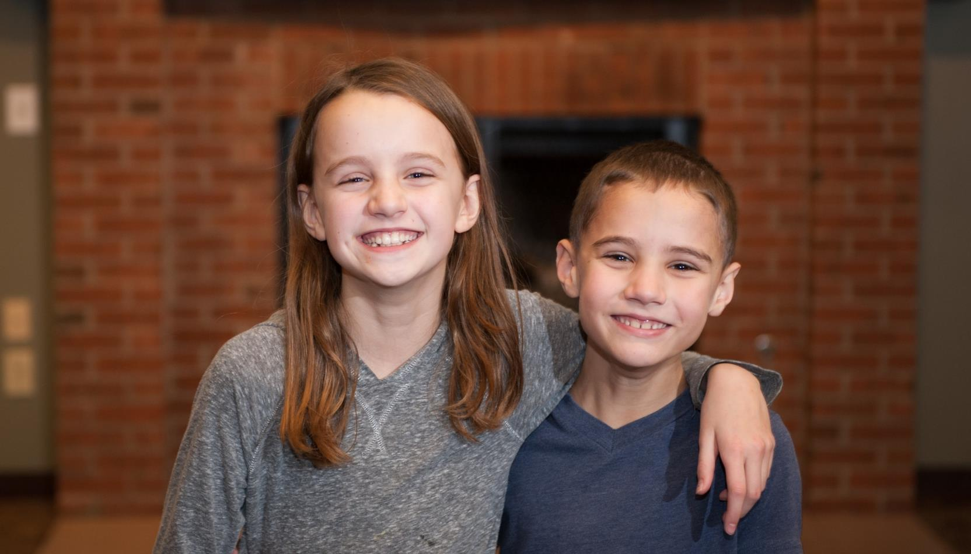

Slide 3
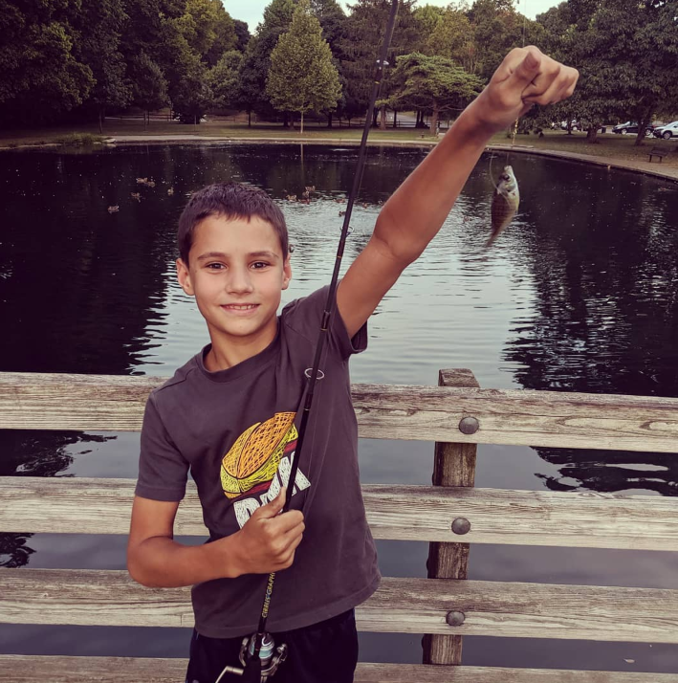
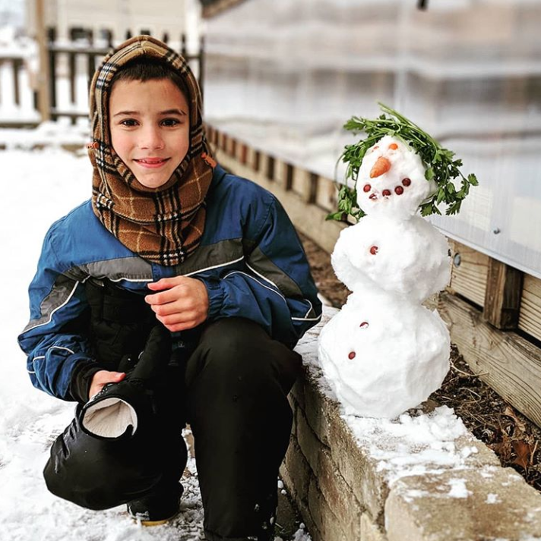

Slide 4
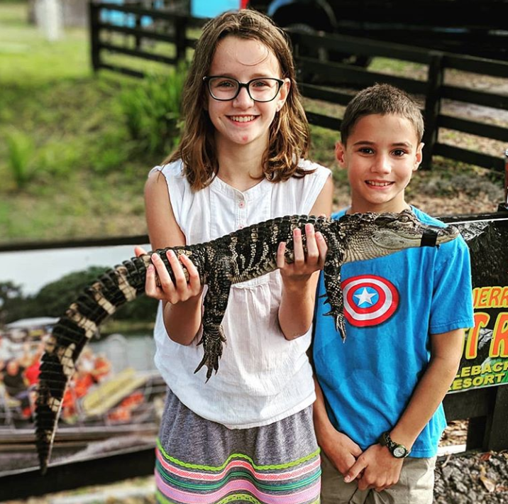
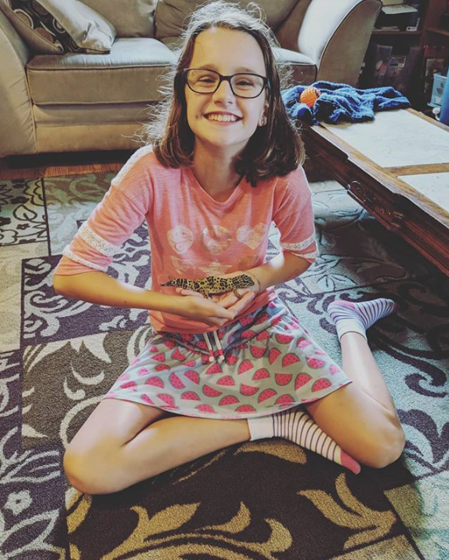

Slide 5
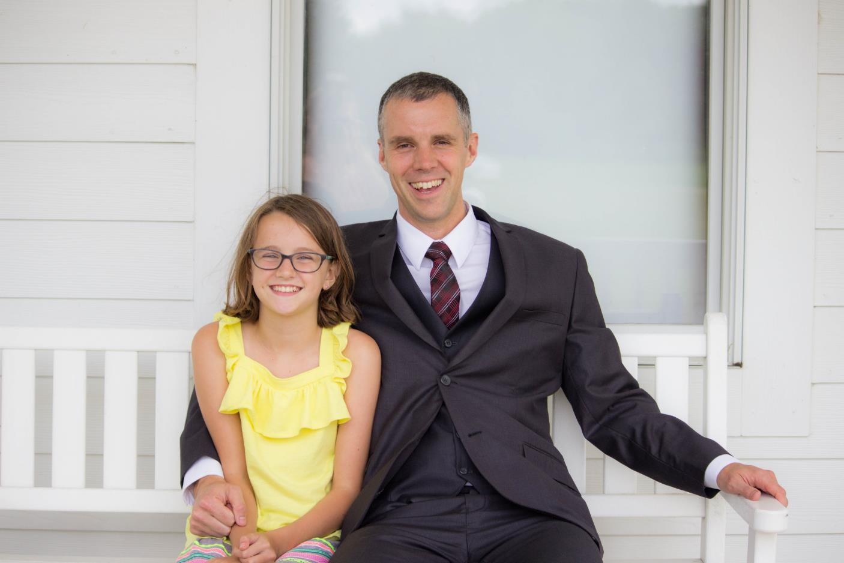

Slide 6
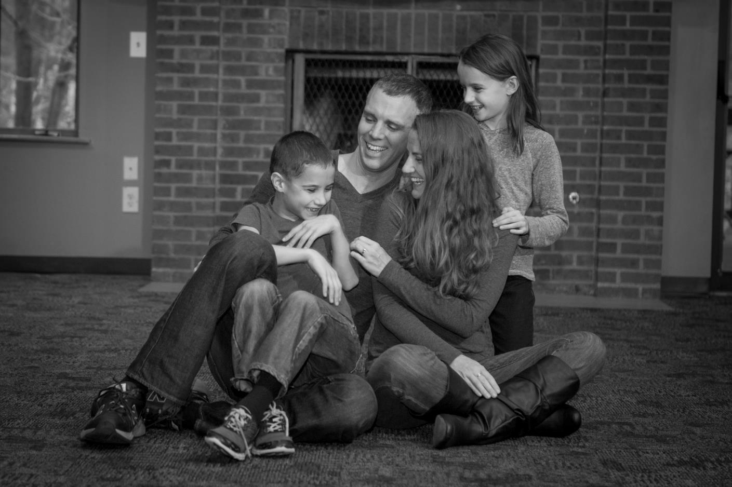

Slide 7
God delights in his children
Matt. 3:17 – “This is my dearly loved Son, who brings me great joy.”
Matt 17:5 – “This is my dearly loved Son, who brings me great joy. Listen to him.”

Slide 8
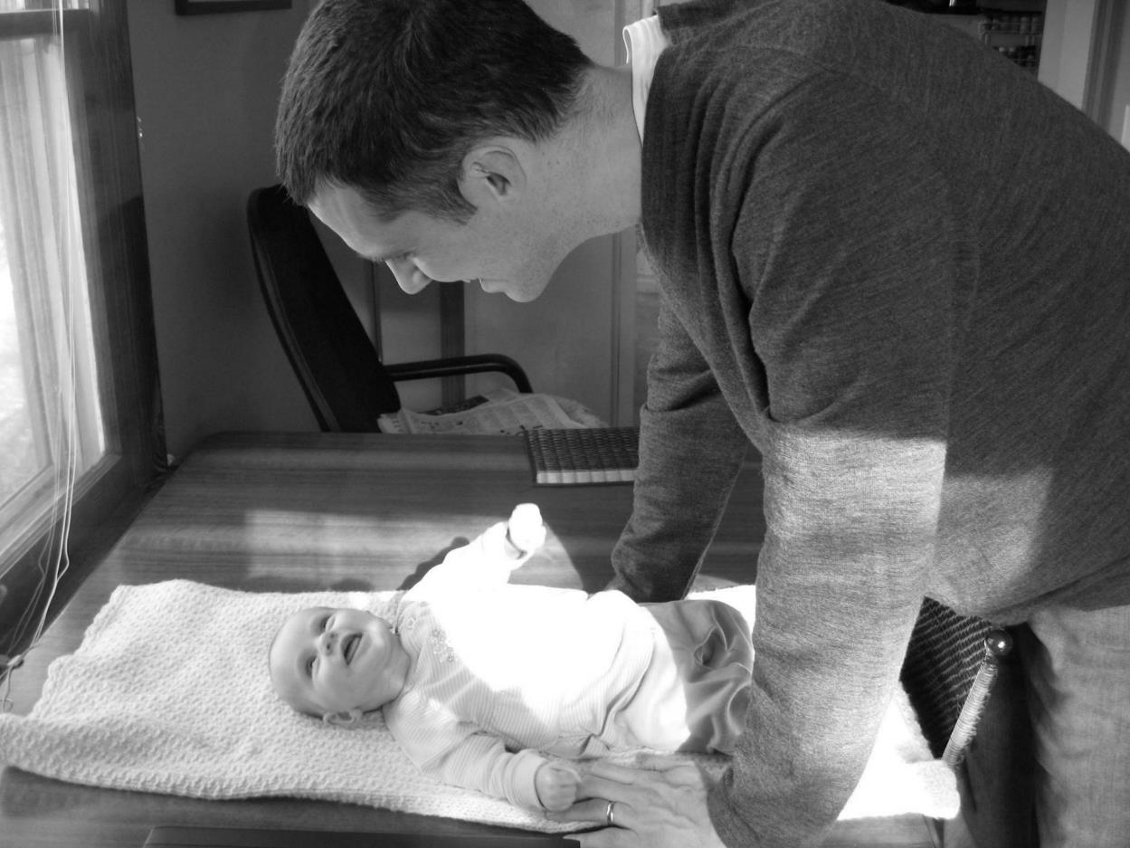

Slide 9
Having seen him as a helpless baby
Having watched him grow
Having watched his mind develop
Having watched his choices to obey the Father
Having accepted his mission of the cross
For Yahweh delights in his people (Ps 149:4)

Slide 10
Ajith Fernando
Fernando, The Family Life of a Christian Leader, 138
How important it is for children to know that their parents find them delightful and long to see them. This is the way our heavenly Father looks at us…
If that is the way the heavenly Father views his children, we have a model for the way earthly parents should view their children.

Slide 11
Ajith Fernando
Fernando, The Family Life of a Christian Leader, 138
And because God gave us words as the major way to communicate truth, we must express our delight over our children in words…
Our children should frequently hear such warm words of affirmation from our lips.

Slide 12
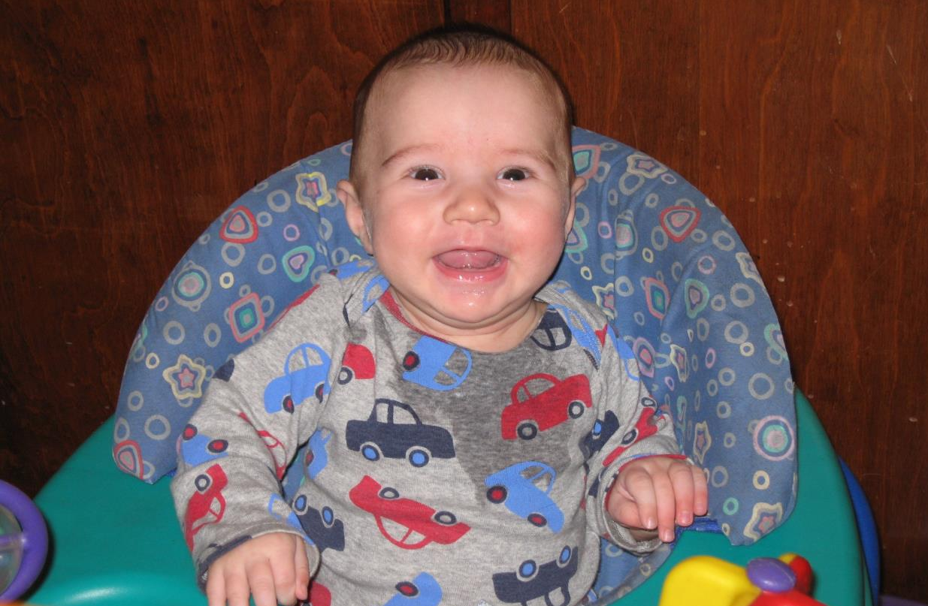
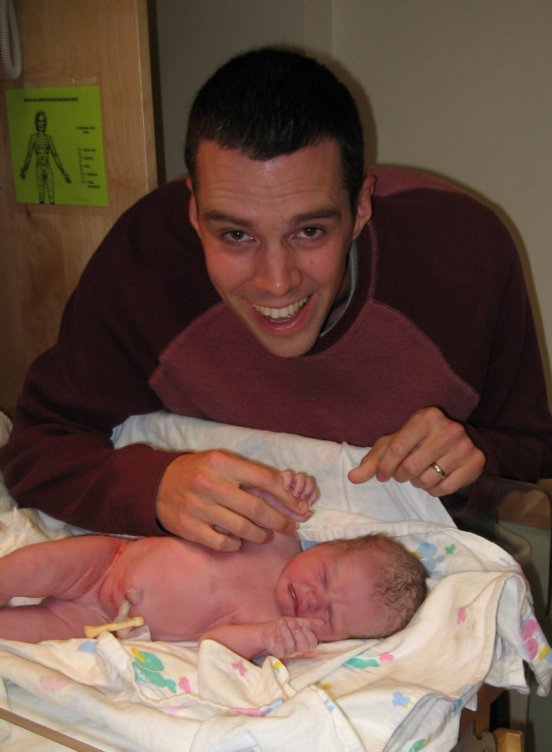
Joy over simply having a child

Slide 13
Joy over simply having a child
Sarah declared, “God has brought me laughter. All who hear about this will laugh with me.” (Gen 21:6)
Children are a gift from the Lord (Ps. 127:3)
Gratitude

Slide 14
Ajith Fernando
Fernando, The Family Life of a Christian Leader, 137
The arrival of a child brings huge changes in the life of a family.
There are new financial challenges and new strains on the parents, especially the mother.
But we must never fall into the trap of thinking of this as a burden that damages our lives.

Slide 15
Ajith Fernando
Fernando, The Family Life of a Christian Leader, 137
That attitude will somehow get communicated to our children and do great harm to them. Anything of great value in life is costly.
That is how we look at parenting. It is a great privilege, and we dearly love our children and would not exchange them for anything in this world, even though raising them is a strain.

Slide 16
Joy over simply having a child
Sarah declared, “God has brought me laughter. All who hear about this will laugh with me.” (Gen 21:6)
Children are a gift from the Lord (Ps. 127:3)
Gratitude
And the joy of giving our kids back to God (Hannah, Abraham)

Slide 17
The Single Greatest Factor in Enjoying Your Children?
Prov. 10:1 – A wise child brings joy to a father; a foolish child brings grief to a mother.

Slide 18
The Single Greatest Factor in Enjoying Your Children?
Prov. 10:1 – A wise child brings joy to a father; a foolish child brings grief to a mother.
Repeated in ~15 different verses in Proverbs
Prov. 1:8 – My child, listen when your father corrects you. Don’t neglect your mother’s instruction.

Slide 19
The Single Greatest Factor in Enjoying Your Children?
Prov. 15:20 – Sensible children bring joy to their father; foolish children despise their mother.

Slide 20
The Single Greatest Factor in Enjoying Your Children?
Prov. 17:21, 25 – It is painful to be the parent of a fool; there is no joy for the father of a rebel.
Foolish children bring grief to their father and bitterness to the one who gave them birth

Slide 21
The Single Greatest Factor in Enjoying Your Children?
Prov. 19:13 – A foolish child is a calamity to a father; a quarrelsome wife is as annoying as constant dripping.
Kidner: “Hell or Heaven at Home”
Need to work on the marriage too if you want to enjoy your children

Slide 22
You’re trying to teach your kids to build on the right foundation
Raising Great Kids
Strong Marriage
Relationship with God

Slide 23
The Single Greatest Factor in Enjoying Your Children?
Prov. 29:17 – Discipline your children, and they will give you peace of mind and will make your heart glad.

Slide 24
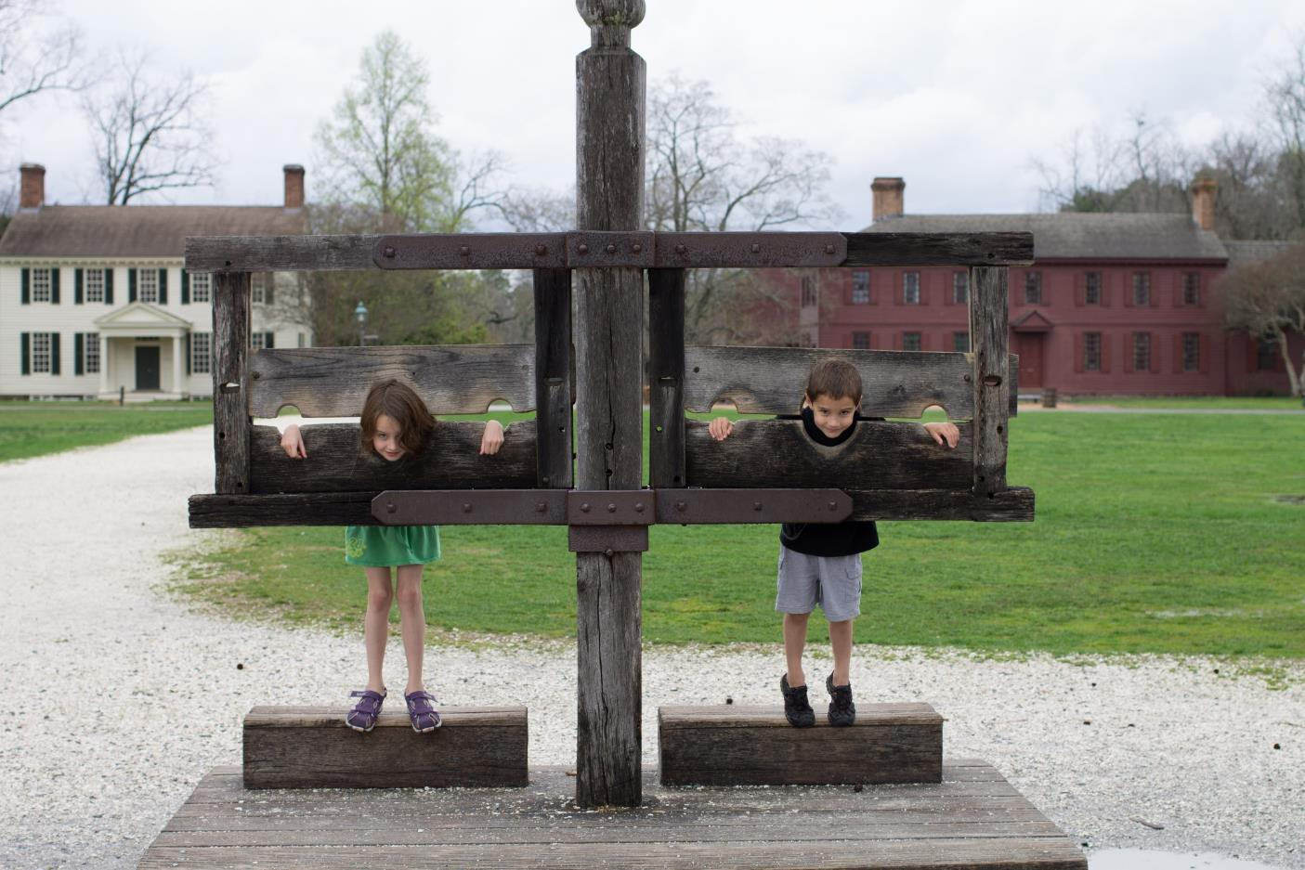

Slide 25
Need to discipline at times
Out of control kids are not going to be very enjoyable

Slide 26
The Single Greatest Factor in Enjoying Your Children?
Prov. 23:24-26 – The father of godly children has cause for joy. What a pleasure to have children who are wise.
So give your father and mother joy! May she who gave you birth be happy.

Slide 27
The Single Greatest Factor in Enjoying Your Children?
Prov. 23:24-26 – O my son, give me your heart. May your eyes take delight in following my ways.
Show your kids the way to live
“O my son, give me your heart”
This path to the heart starts very young

Slide 28
The Single Greatest Factor in Enjoying Your Children?
Prov. 4:3-4
3 For I too was a son to my father, still tender, and cherished by my mother.
4 Then he taught me, and he said to me, “Take hold of my words with all your heart”
Prov 23:24-26 – O my son, give me your heart. May your eyes take delight in following my ways.
Show your kids the way to live
“O my son, give me your heart”
This path to the heart starts very young

Slide 29
Ajith Fernando
Fernando, The Family Life of a Christian Leader, 146
There are few things that express love to our children more than spending time with them. This is the way parents impart values to their children…

Slide 30
Ajith Fernando
Fernando, The Family Life of a Christian Leader, 146
Parents sometimes say that they have quality time with their children rather than a large quantity of time.
With children, quality requires quantity…

Slide 31
Ajith Fernando
Fernando, The Family Life of a Christian Leader, 146
Children spending hours in front of a television or computer may bring some relief to parents, but there is no substitute for personal parental interaction with their children.
Computer games and television should never be used as convenient and cheap babysitters!

Slide 32
Ajith Fernando
Fernando, The Family Life of a Christian Leader, 146
My friend Dr. Lalith Mendis, who was once a medical college lecturer and is now a pastor, has a special interest in developmental issues of children.

Slide 33
Ajith Fernando
Fernando, The Family Life of a Christian Leader, 146
He tells me that there is a close connection between the time parents spend talking to their children and the healthy development of the children, especially in the area of speech.

Slide 34
Ajith Fernando
Fernando, The Family Life of a Christian Leader, 146
He says that often the cause for a speech defect is that the mother does not give sufficient time for speech interaction with the child.
There are key aspects in person-to-person conversation that are missing in television and digital conversation.

Slide 35
Enjoying Our Kids Forever
Ps. 16:11 – In Your presence is fullness of joy; In Your right hand there are pleasures forever.

Slide 36
Enjoyment Killers
Guilt (character weaknesses, bad attitude at times, mistakes you’ve made)
Anxiety (milestones, crazy fears, projecting today’s problem out forever)
Busyness
Marriage problems
Sickness and other trials

Slide 37
Practical Tips
Adjust your expectations
Everything you do is going to be slower

Slide 38
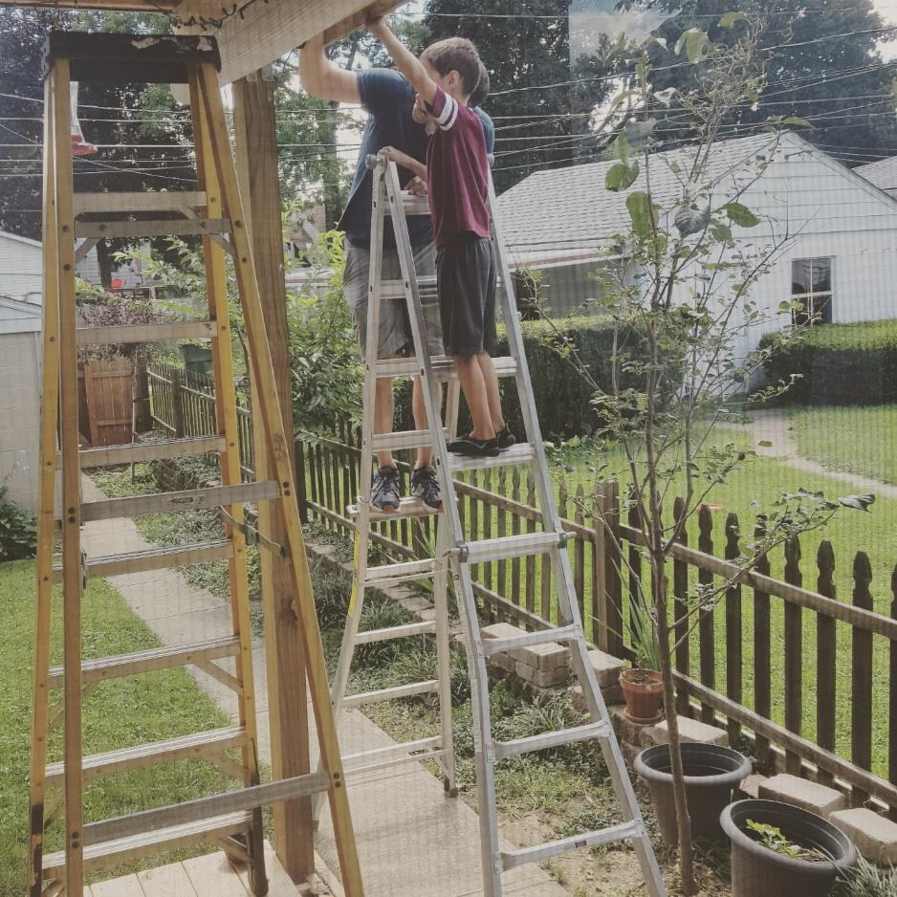

Slide 39
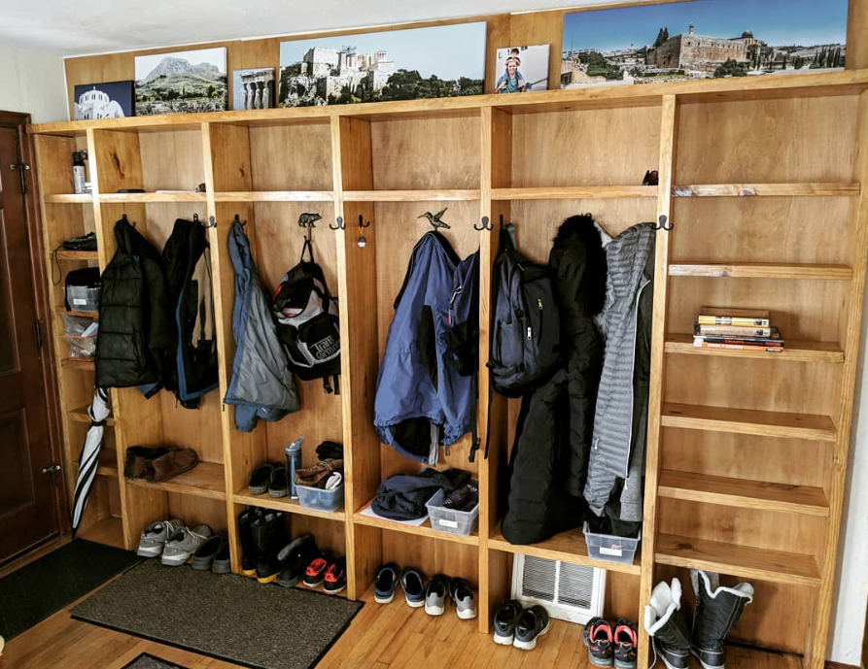

Slide 40
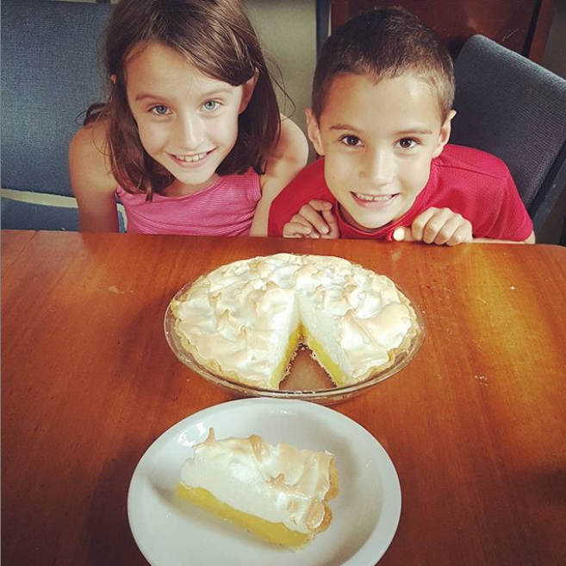

Slide 41
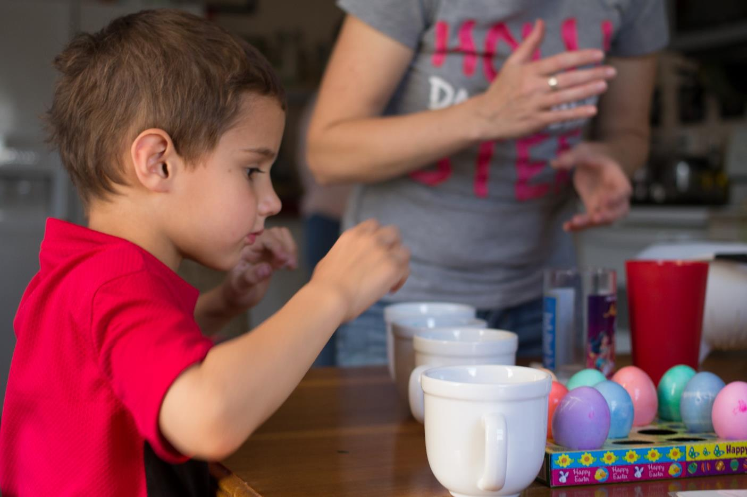

Slide 42
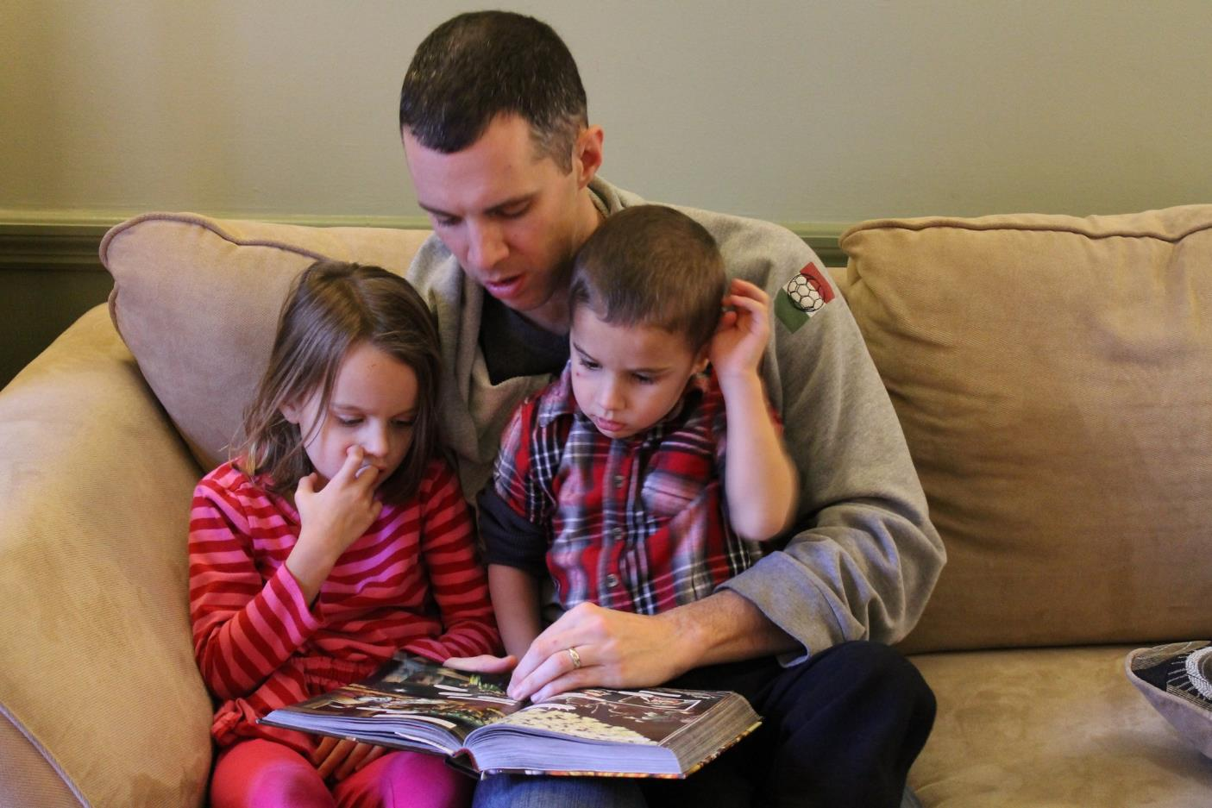

Slide 43
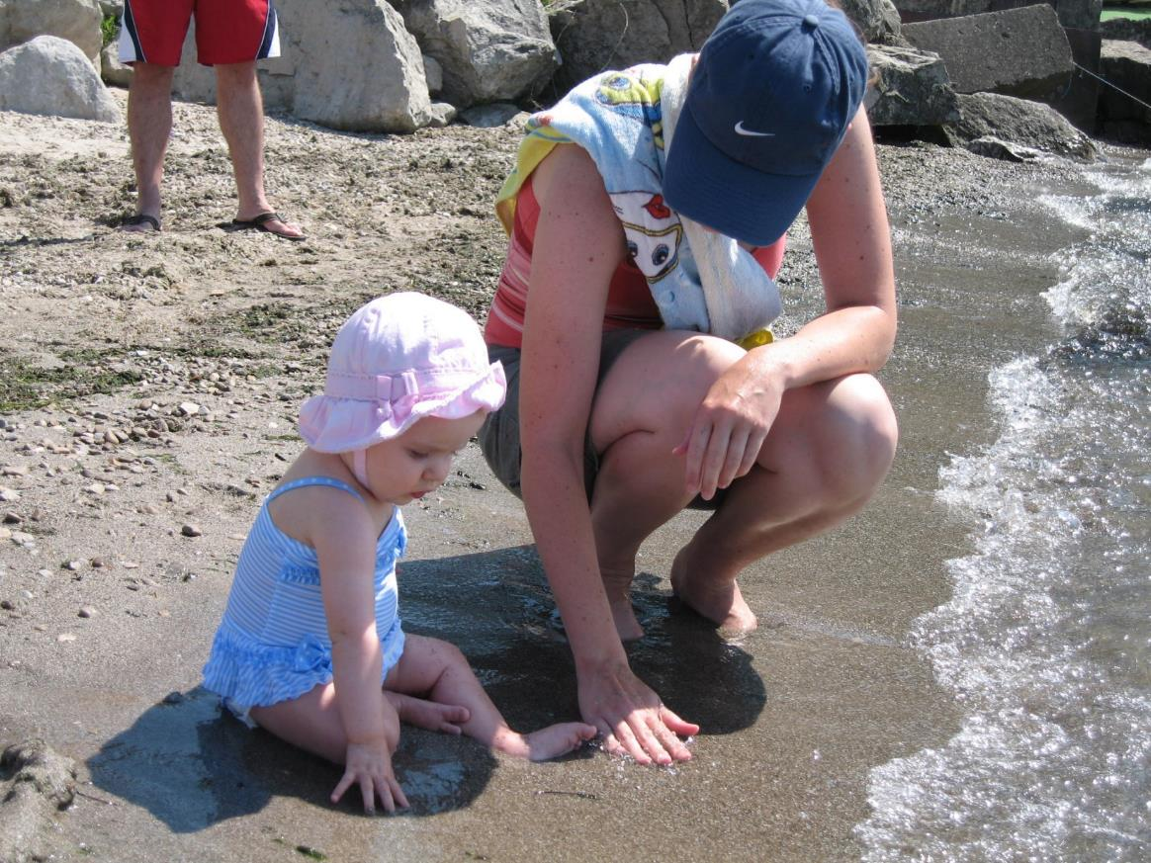

Slide 44
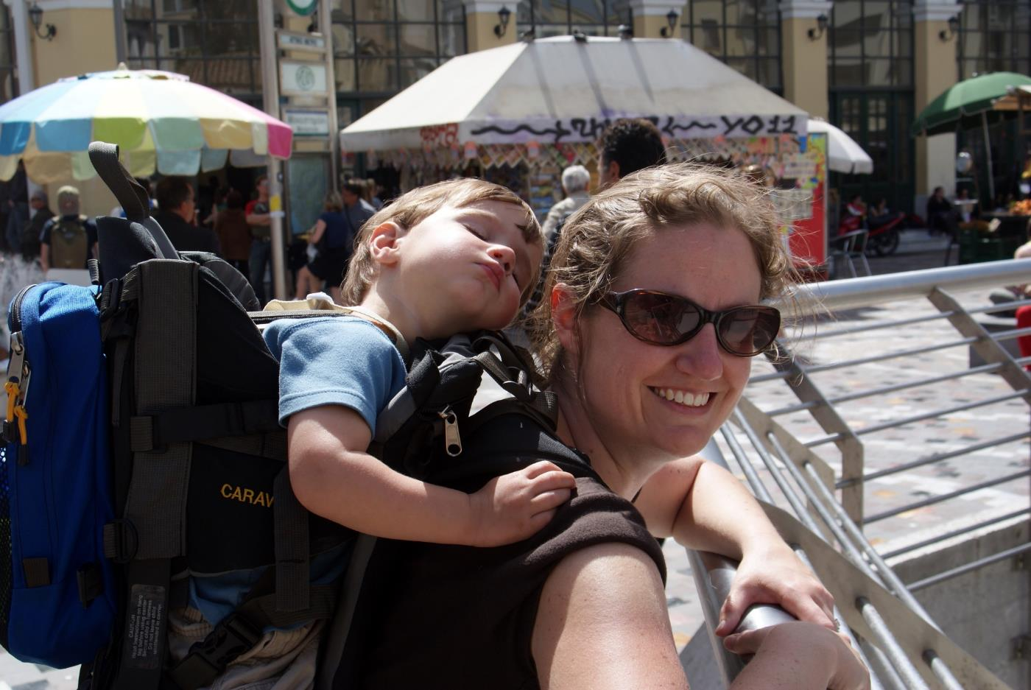

Slide 45
Practical Tips
Adjust your expectations
Everything you do is going to be slower
May need to do less of your adult hobbies and adjust your work schedule for a time

Slide 46
Practical Tips
Tag team with your spouse
There are times when you are worn out, especially when kids are little.
Dad giving mom some down time
We’ve learned to take turns on vacation

Slide 47
Practical Tips
Learn to enjoy low stimulation activities
“What did you enjoy most this past week?”

Slide 48
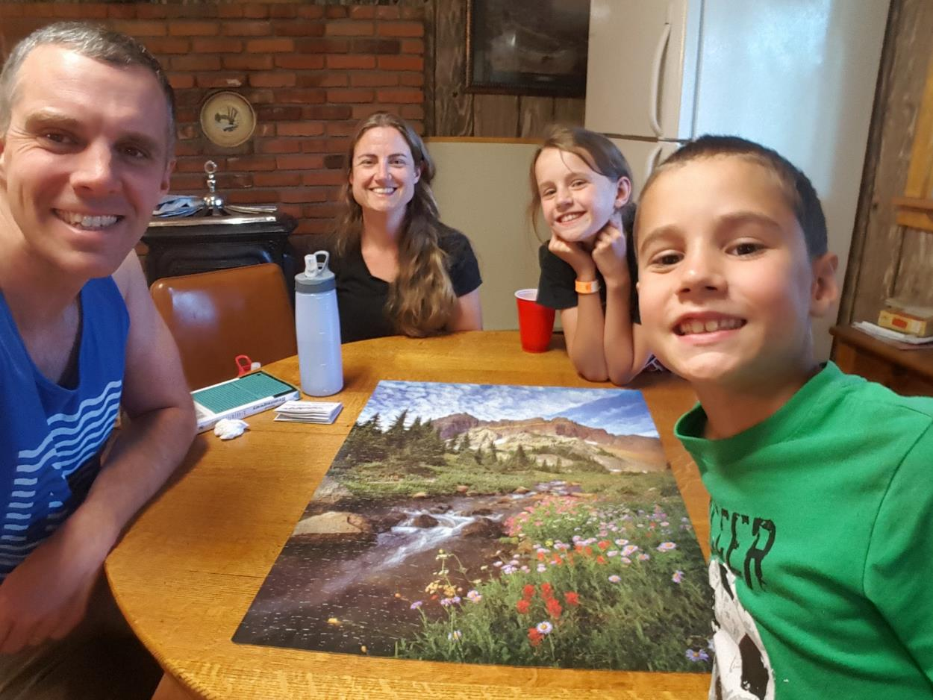

Slide 49
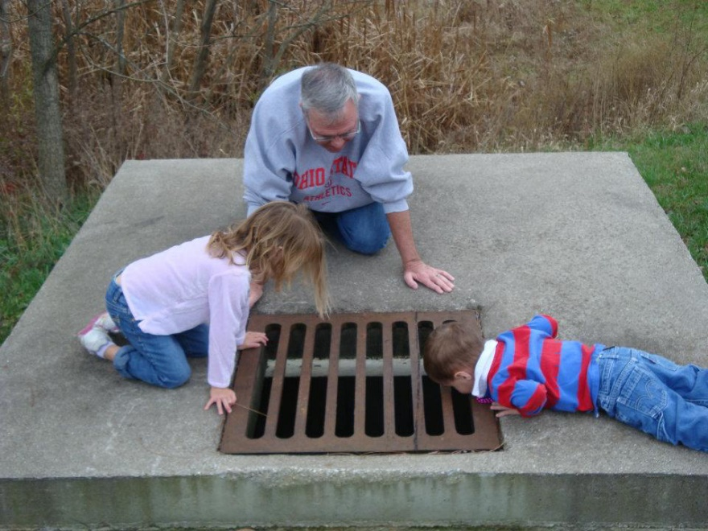

Slide 51
Practical Tips
Learn to enjoy low stimulation activities
“What did you enjoy most this past week?”
Try to limit screen time – for you and them

Slide 52
Practical Tips
Get a regular date time with kids
So you both know that time is going to happen
May be kind of boring at first for you
You will both start to view this as one of your favorite times of the week

Slide 53
Practical Tips
Get a regular date time with kids
Some things we’ve tried
Walks
Eating out – allows for talking
Active stuff: Playing tennis, shooting hoops, tossing baseball, fishing
Reading
Board games or chess

Slide 54
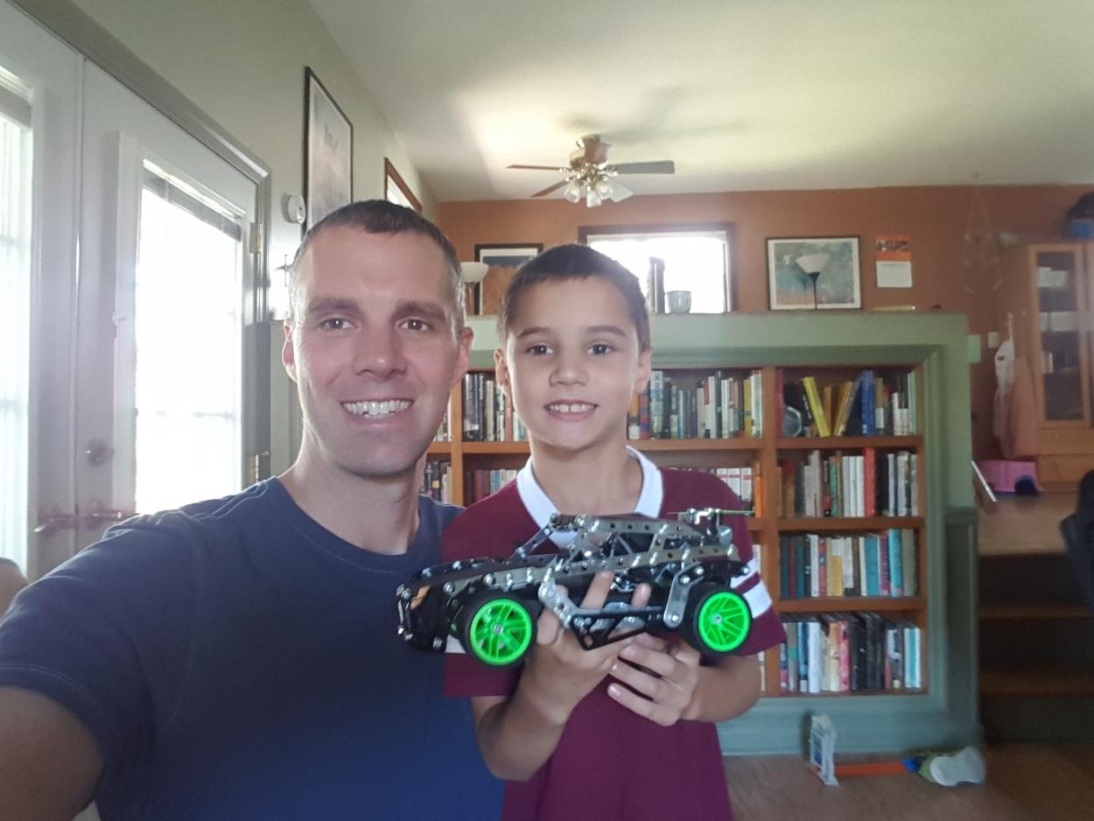

Slide 55
Practical Tips
Enjoying vacations
Some bad experiences with way too small cabins
We had to learn to camp and hike

Slide 56
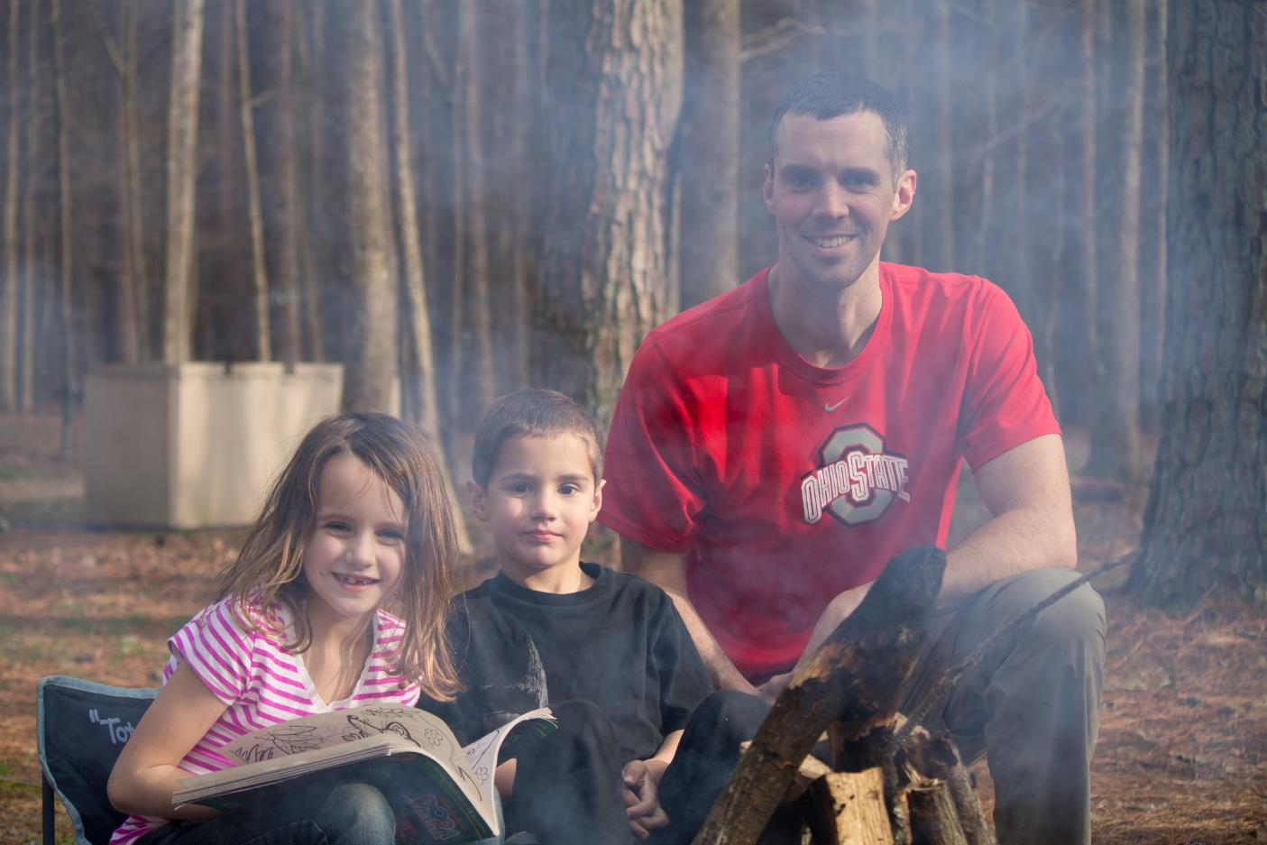

Slide 57
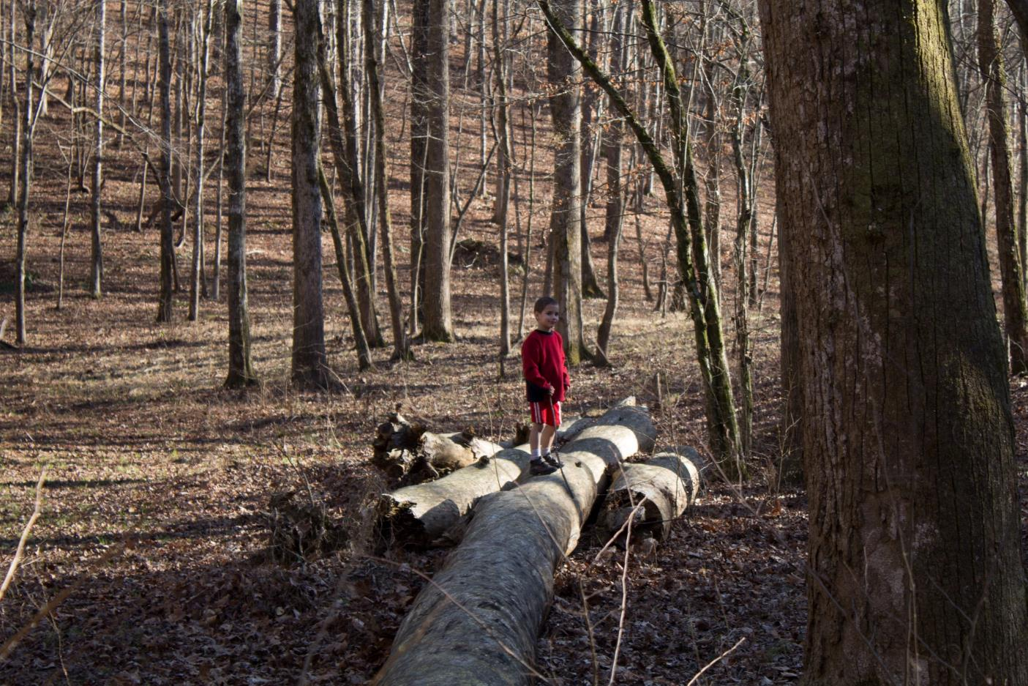

Slide 60
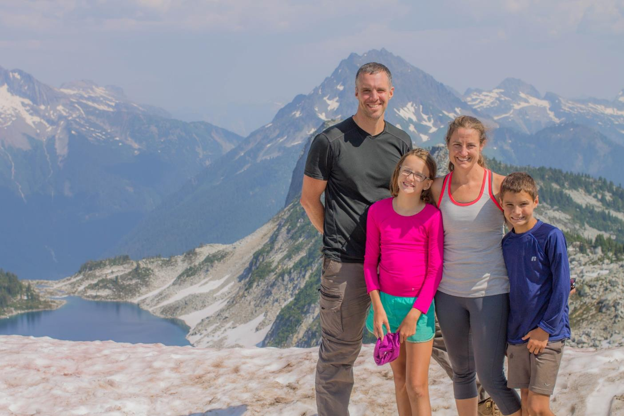

Slide 61
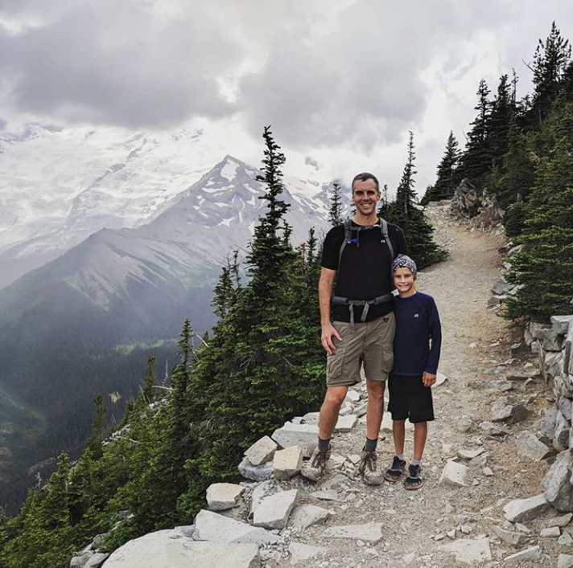

Slide 62
Practical Tips
Enjoying vacations
Some bad experiences with way too small cabins
We had to learn to camp and hike
Good snacks for hiking
Setting the timer
Start with good experiences at shorter distances
You don’t have to go far away

Slide 63
Practical Tips
Enjoying vacations
Some trips with friends and extended family, but some with just us
Be frugal but splurge a little too
Pray that God will provide if you don’t have the money to take a trip together

Slide 64
Practical Tips
Regular traditions…

Slide 65
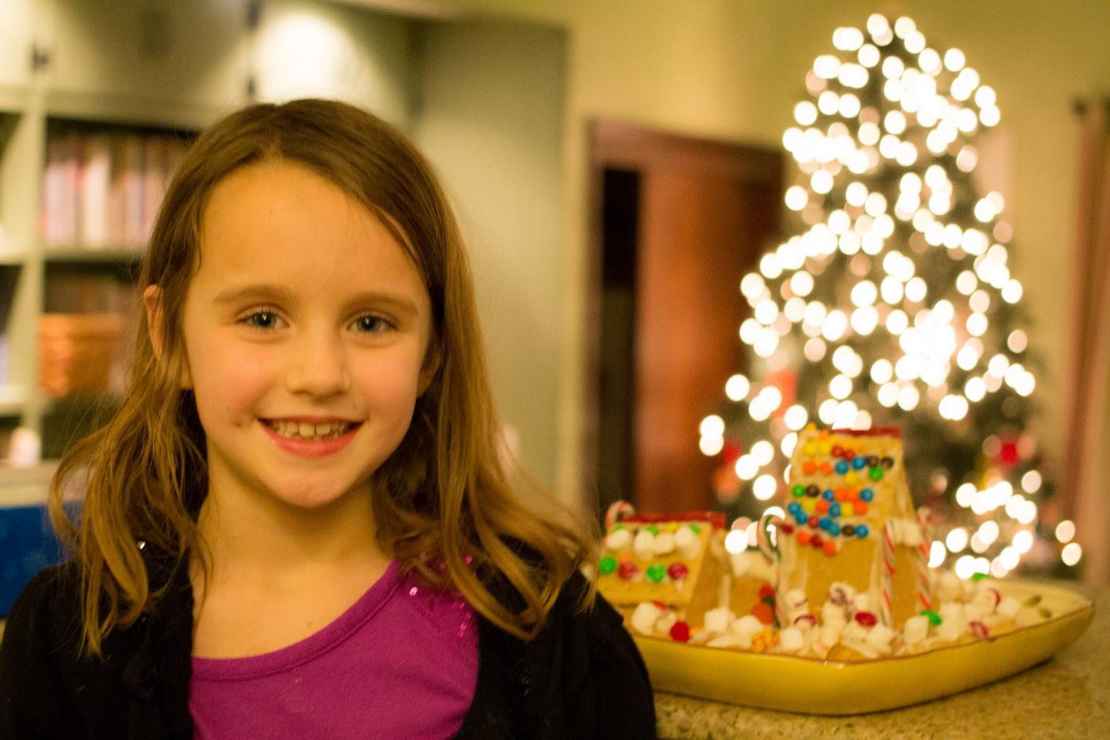

Slide 66
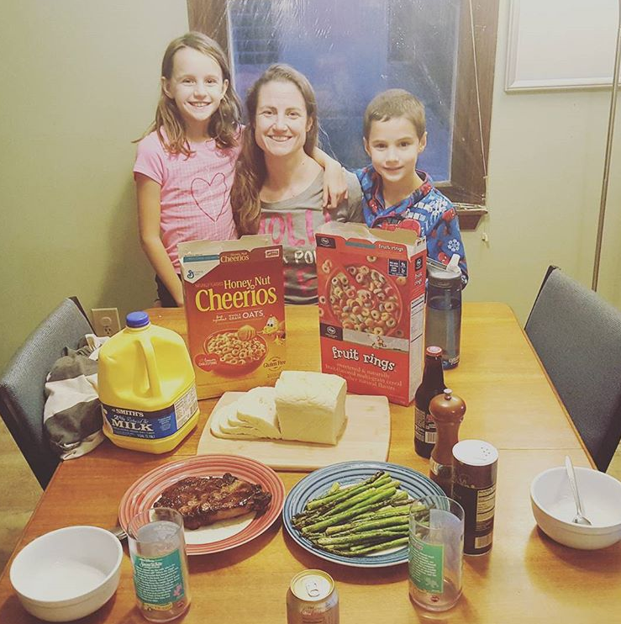

Slide 67
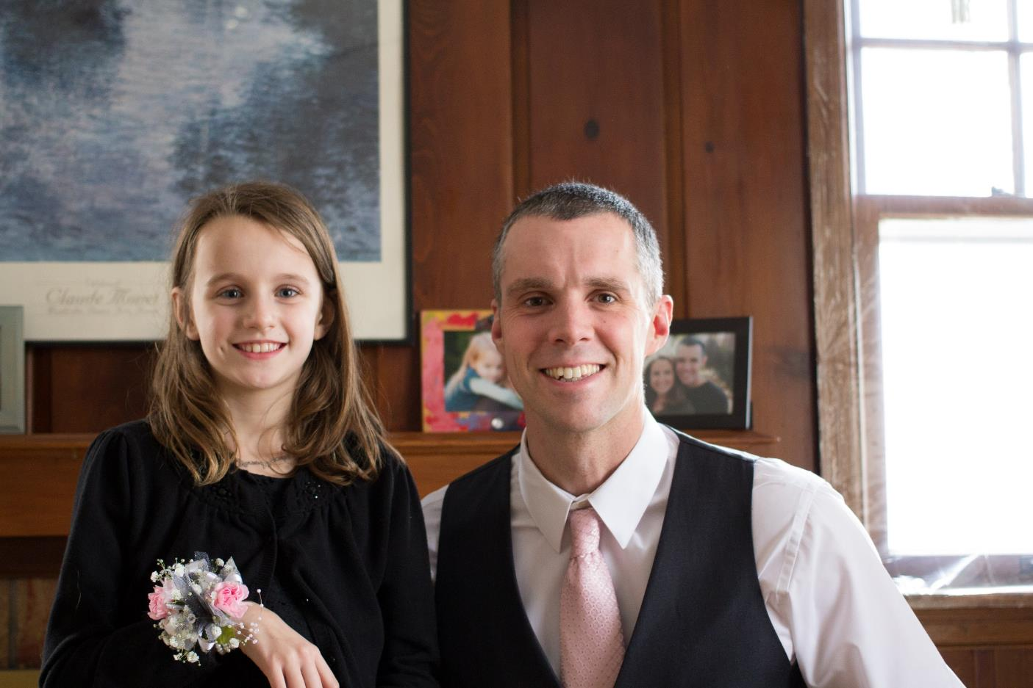

Slide 68
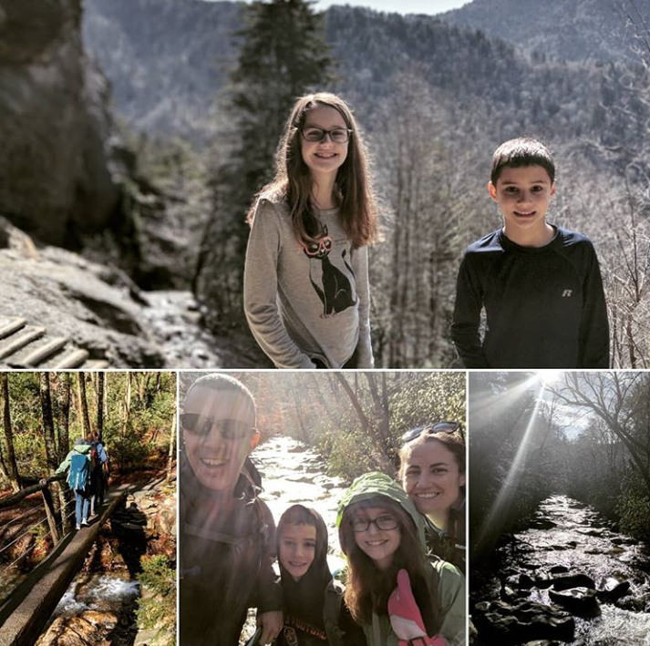

Slide 69
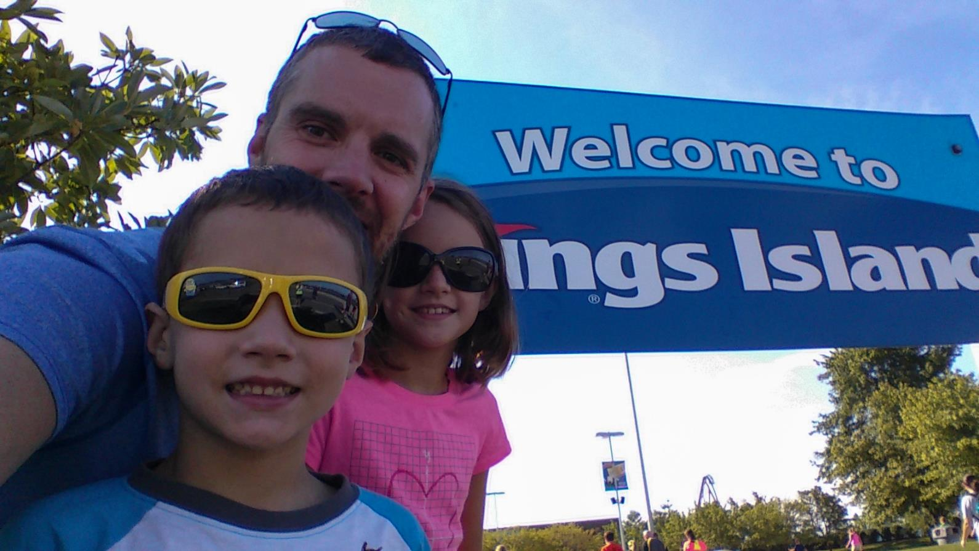

Slide 71
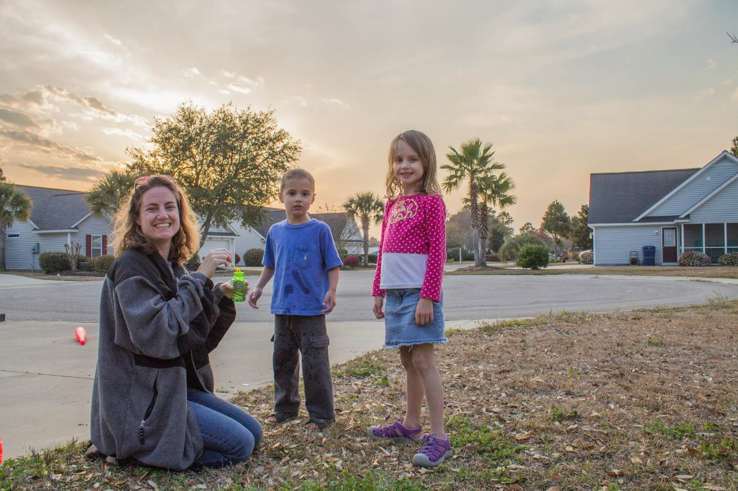

Slide 72
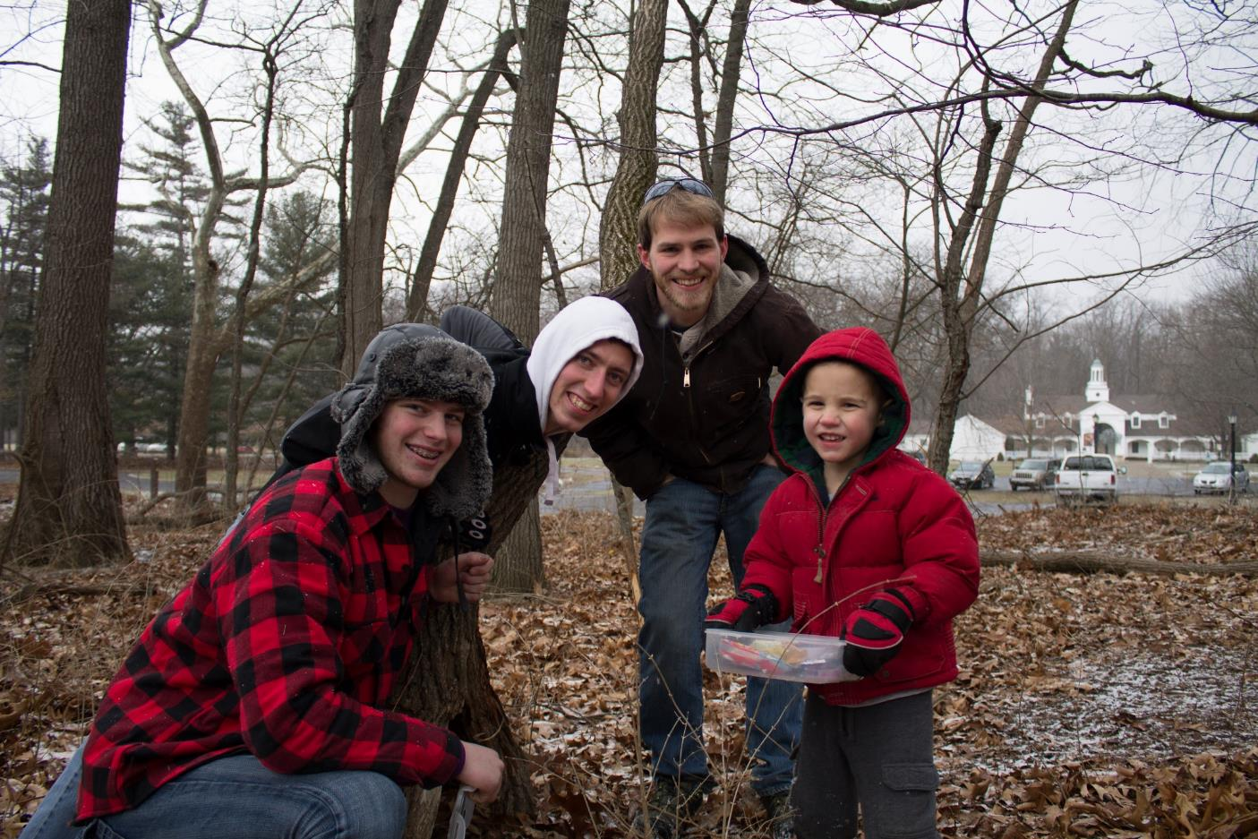

Slide 73
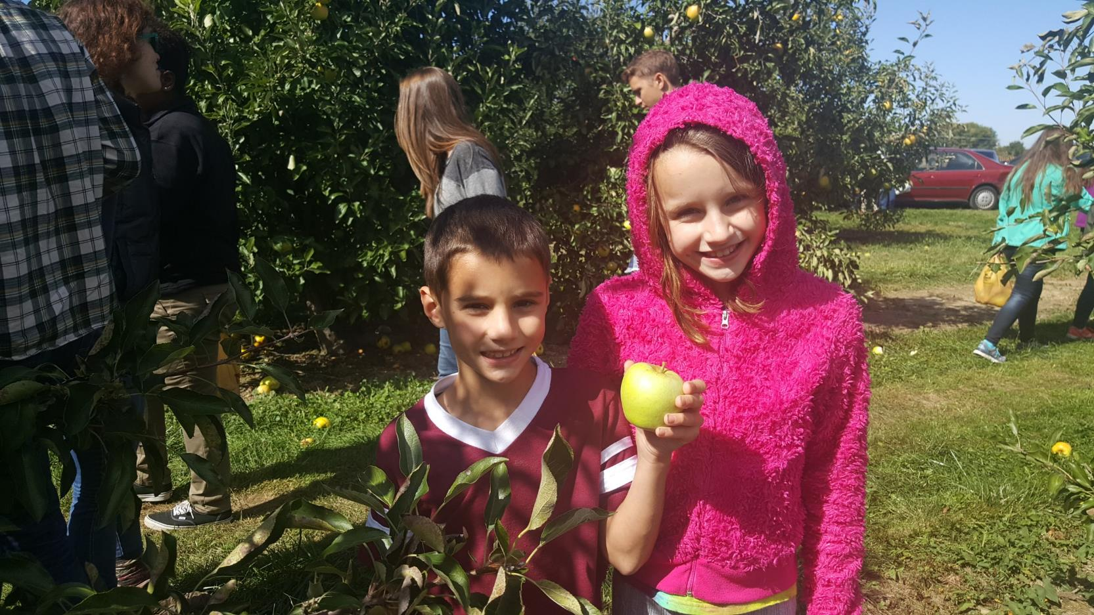

Slide 74
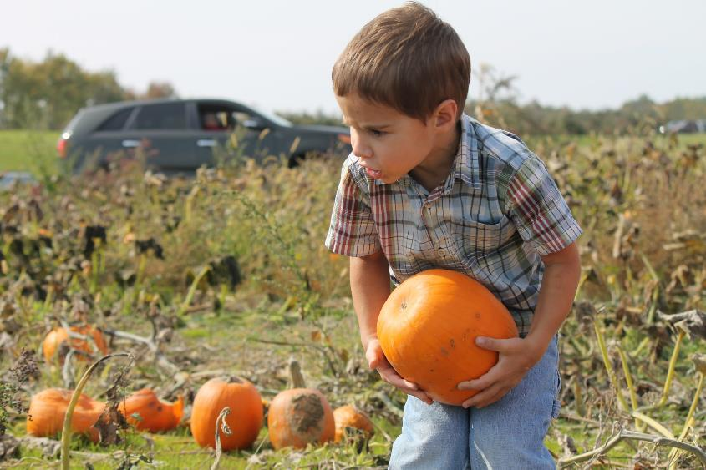
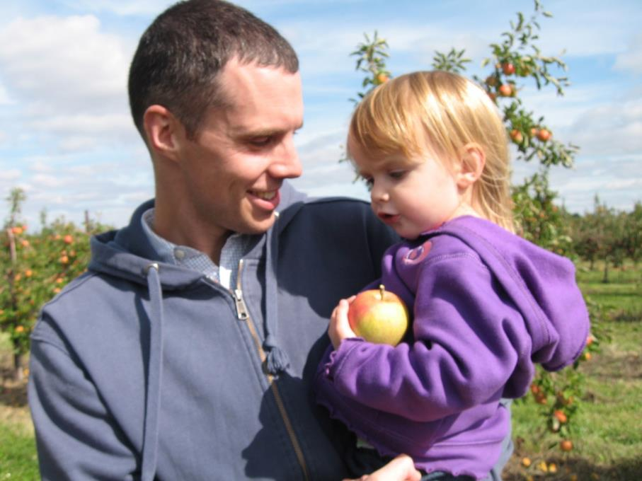

Slide 75
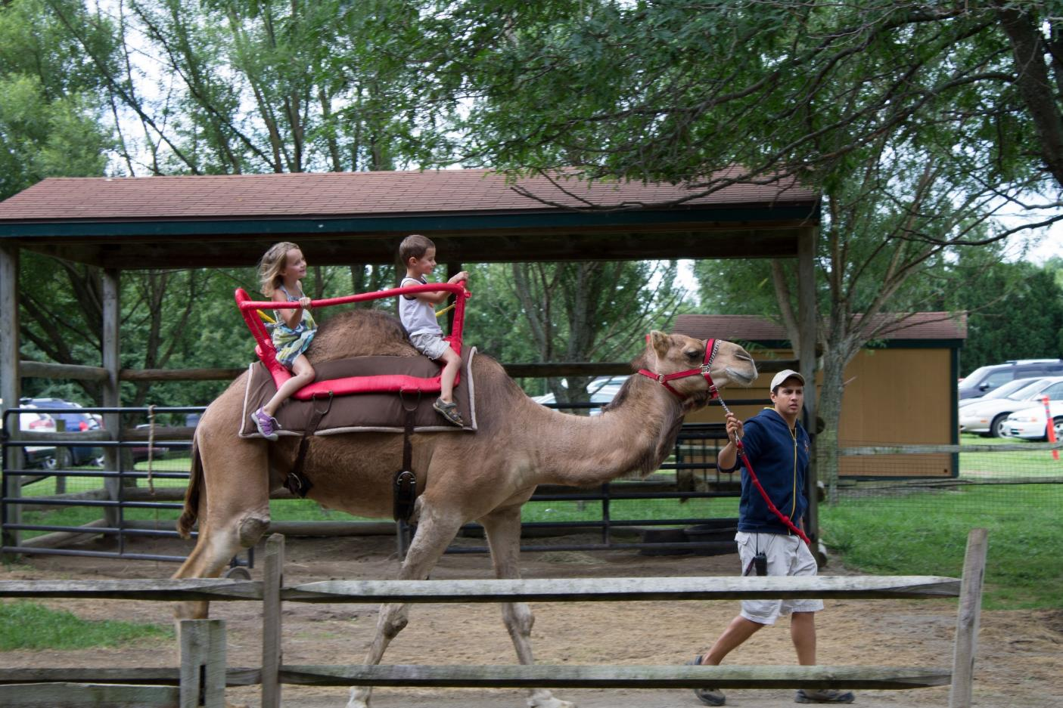

Slide 78
Conclusions
Children are a gift from God
God delights in his children, and he tells them that all the time
We should do the same
Don’t let the strain of parenting crowd out the joy available
Do everything you can to present each child complete in Christ

Slide 79
Enjoying Parenting
Questions?
Comments?
Experiences?
smrisley@gmail.com

