Slide 1
A Passion for People
Paul and the Thessalonians
1 Thessalonians 2:17-3:13

Slide 2
I Thessalonians 2:17-3:13
Last week: how Paul engaged when he was with them
Gospel was at the heart of his relationship with them
His motivation was pleasing God
Both nurtured and challenged them

Slide 3
I Thessalonians 2:17-3:13
This week: how Paul thought about them when he was separated from them

Slide 4
I Thessalonians 2:17-3:13
17 But we, brothers and sisters, having been orphaned from you by absence for a short while—in person, not in spirit—were all the more eager with great desire to see your face. 18 For we wanted to come to you—I, Paul, more than once—and Satan hindered us. 19 For who is our hope, or joy or crown of pride, in the presence of our Lord Jesus at His coming? Or is it not indeed you? 20 For you are our glory and joy
3:1 Therefore, when we could no longer endure it, we thought best to be left behind, alone at Athens, 2 and we sent Timothy, our brother and God’s fellow worker in the gospel of Christ, to strengthen and encourage you for the benefit of your faith, 3 so that no one would be disturbed by these afflictions.

Slide 5
I Thessalonians 2:17-3:13
For you yourselves know that we have been destined for this. 4 For even when we were with you, we kept telling you in advance that we were going to suffer affliction; and so it happened, as you know. 5 For this reason, when I could no longer endure it, I also sent to find out about your faith, for fear that the tempter might have tempted you, and our labor would be for nothing.
6 But now that Timothy has come to us from you, and has brought us good news of your faith and love, and that you always think kindly of us, longing to see us just as we also long to see you 7 for this reason, brothers and sisters, in all our distress and

Slide 6
I Thessalonians 2:17-3:13
affliction we were comforted about you through your faith; 8 for now we really live, if you stand firm in the Lord. 9 For what thanks can we give to God for you in return for all the joy with which we rejoice because of you before our God, 10 as we keep praying most earnestly night and day that we may see your faces, and may complete what is lacking in your faith? 11 Now may our God and Father Himself, and our Lord Jesus, direct our way to you; 12 and may the Lord cause you to increase and overflow in love for one another, and for all people, just as we also do for you; 13 so that He may establish your hearts blameless in holiness before our God and Father at the coming of our Lord Jesus with all His saints.

Slide 7
I Thessalonians 2:17-3:13
Three principles that characterized his relationship with them
Committed to be with them
Committed to their spiritual well being
Took great joy in their spiritual progress

Slide 8
I Thessalonians 2:17-3:13
Committed to be with them
2:17 But we, …were all the more eager with great desire to see your face. 18 For we wanted to come to you—I, Paul, more than once—and Satan hindered us.

Slide 9
I Thessalonians 2:17-3:13
Committed to be with them
2:17 But we, …were all the more eager with great desire to see your face. 18 For we wanted to come to you—I, Paul, more than once—and Satan hindered us.
All the more eager: to hasten to do a thing, to exert oneself,
With great desire: a fierce passion

Slide 10
I Thessalonians 2:17-3:13
Committed to be with them
2:17 But we, …were all the more eager with great desire to see your face. 18 For we wanted to come to you—I, Paul, more than once—and Satan hindered us.
3:10 as we keep praying most earnestly night and day that we may see your faces, and may complete what is lacking in your faith?

Slide 11
I Thessalonians 2:17-3:13
Committed to be with them
2:17 But we, …were all the more eager with great desire to see your face. 18 For we wanted to come to you—I, Paul, more than once—and Satan hindered us.
3:10 as we keep praying most earnestly night and day that we may see your faces, and may complete what is lacking in your faith?

Slide 12
I Thessalonians 2:17-3:13
The amount of time respondents engaged with friends socially in-person has steadily decreased.
2003 – 60 minutes a day or 30 hours a month
2020 – 20 minutes a day or 10 hours a month
The decline is the sharpest for young people ages 15 to 24. For this age group, time spent in person with friends has reduced by nearly 70% over almost two decades, from roughly 150 minutes per day in 2003 to 40 minutes per day in 2020.
The U.S. Surgeon General’s Advisory on the Healing Effects of Social Connection and Community, 2023 pg. 13.
Face to Face relating
Unspoken value
Face to face relating is on the decline

Slide 13
I Thessalonians 2:17-3:13
Lots of reasons for the decline
Technology: https://dwellcc.org/screentimerefresh/day6
So much lost
Communication mostly body language
Joy of common experience
Drift of negative thoughts
Age
Fear
Technology
Mobile culture
Affluence
Radical individualism
Laziness

Slide 14
I Thessalonians 2:17-3:13
Face to face relating
Will take intentionality and work
Plan for it or it won’t happen

Slide 15
I Thessalonians 2:17-3:13
Committed to their spiritual well-being
3:2 and we sent Timothy, our brother and God’s fellow worker in the gospel of Christ, to strengthen and encourage you for the benefit of your faith

Slide 16
I Thessalonians 2:17-3:13
Committed to their spiritual well-being
3:2 and we sent Timothy, our brother and God’s fellow worker in the gospel of Christ, to strengthen and encourage you for the benefit of your faith

Slide 17
I Thessalonians 2:17-3:13
Committed to their spiritual well-being
3:2 and we sent Timothy, our brother and God’s fellow worker in the gospel of Christ, to strengthen and encourage you for the benefit of your faith (3:5,6,7,8,10)
First heard/received message in midst of persecution and it was continuing
Not apathetic but emotionally impacted by their spiritual condition

Slide 18
I Thessalonians 2:17-3:13
Committed to their spiritual well-being
Takes costly action
3:1 Therefore, when we could no longer endure it, we thought best to be left behind, alone at Athens, 2 and we sent Timothy

Slide 19
I Thessalonians 2:17-3:13
Committed to their spiritual well-being
Prays for them
3:12 and may the Lord cause you to increase and overflow in love for one another, and for all people, just as we also do for you; 13 so that He may establish your hearts blameless in holiness before our God and Father at the coming of our Lord Jesus with all His saints.

Slide 20
I Thessalonians 2:17-3:13
He took great joy in their spiritual progress
2:19&20: For who is our hope, or joy or crown of pride, in the presence of our Lord Jesus at His coming? Or is it not indeed you? 20 For you are our glory and joy.
3:8 for now we really live, if you stand firm in the Lord.
3:9 for what thanks can we render to God for you in return for all the joy with which we rejoice before our God on your account,

Slide 21
I Thessalonians 2:17-3:13
He took great joy in their spiritual progress
Not self-adulation
2 John 4: I was very glad to find some of your children walking in the truth….
3 John 4: I have no greater joy than this, to hear of my children walking in the truth.

Slide 22
I Thessalonians 2:17-3:13
He took great joy in their spiritual progress
Too easy to be envious/jealous of others success
James 4:17 But where there is jealousy and selfish ambition exist, there is disorder and every evil thing.

Slide 23
I Thessalonians 2:17-3:13
What to do?
Admit to God & possibly others
Why am I surprised (Rom 7:17)
Go back to key verses (Eph 2:10, I Cor 12 and Romans 12)
Key readings: “The Audience of One,” The Call, No Little People
If possible – take steps to see them succeed

Slide 24
I Thessalonians 2:17-3:13
Three principles that characterized his relationship with them
Committed to be with them
Committed to their spiritual well being
Took great joy in their spiritual progress

Slide 25
I Thessalonians 2:17-3:13
What if?
One person in a friendship…
If both people in a friendship…
The majority of people in a spiritual community…

Slide 26
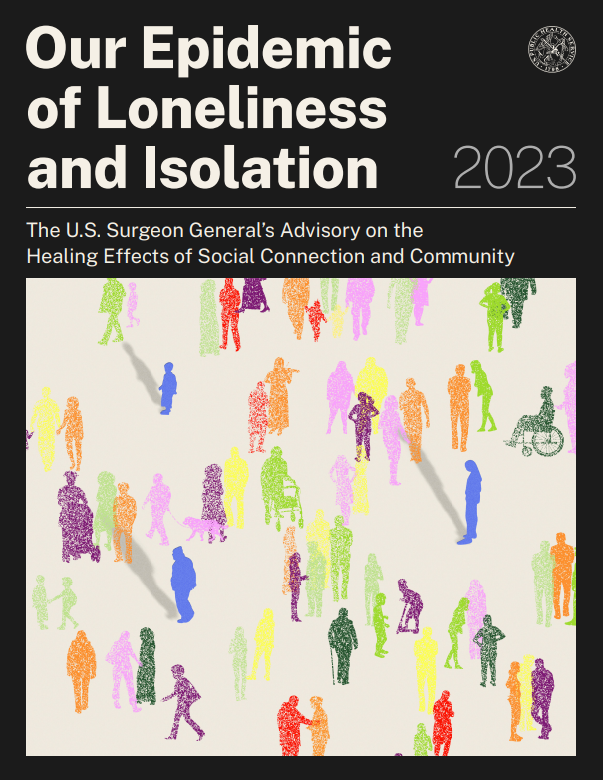
I Thessalonians 2:17-3:13
We live in a world of lonely people
“People began to tell me they felt isolated,
invisible, and insignificant. Even when
they couldn’t put their finger on the word
“lonely,” time and time again, people of all
ages and socioeconomic backgrounds,
from every corner of the country, would

Slide 27
I Thessalonians 2:17-3:13
tell me, “I have to shoulder all of life’s
burdens by myself,” or “if I disappear
tomorrow, no one will notice.”
It was a lightbulb moment for me; social
disconnection was for more common
than I had realized.”

