Slide 1
Parenting and Technology
XCF 2018

Slide 2
Parenting and Technology
Teen depression, anxiety, and social media
Brian Runk
Dangers of internet porn: how to protect your child
Brad Dufault
Building healthy relationships with your teen
Joe Botti
Q&A: Email runkb@xenos.org with questions

Slide 3
Decline of Free Play and the Rise of Mental Disorders
Peter Grey
The Decline of Play
https://www.youtube.com/watch?v=Bg-GEzM7iTk

Slide 4
Anxiety and Depression
Longitudinal studies of overall happiness, anxiety, and outlook.
(MMPI- 1938-present, MMPI-A 1951-present)
Approximately 85 percent of young people in the most recent samples have anxiety and depression scores greater than the average scores for the same age group in the 1950s.
Scores indicate that 5 to 8 times as many young people today (2011) have scores above the cutoff for a likely diagnosis of clinically significant anxiety or depressive disorder than was the case a half a century ago.
Rates of anxiety and depression among children and adolescents were far lower during the Great Depression, World War II, the cold war, and the turbulent 1960s and early 1970s than they are today. The changes seem to have much more to do with the way young people view the world than with the way the world actually is.
(Peter Grey, Decline in Free Play and the Rise of Psychopathy in Children and Adolesence)

Slide 5
Narcissism
You would think that having narcissism would be counter for to a person having anxiety and depression. Someone who feels “too good about themselves”.
Individuals who score high on this scale tend to exploit others for personal gain, tend to value self-aggrandizement over cooperation, are more likely than others to commit white collar crimes, rank themselves unduly high in leadership abilities, and tend to lash out angrily in response to criticism.
The level rose sufficiently so that by 2007 nearly 70 percent of college students scored higher in narcissism than the average college student in 1982.
Narcissists commonly experience anxiety and depression when their experiences with reality run counter to their high self-views. Moreover, narcissists are likely to attribute the lack of congruity between their perceived superior qualities and their relative lack of status and achievement in the world to factors beyond their control, a tendency consistent with an external locus of control.

Slide 6
Anxiety, Depression, Narcissism
50’s
60’s
70’s
80’s
90’s
00’s
10’s
Free Play

Slide 7
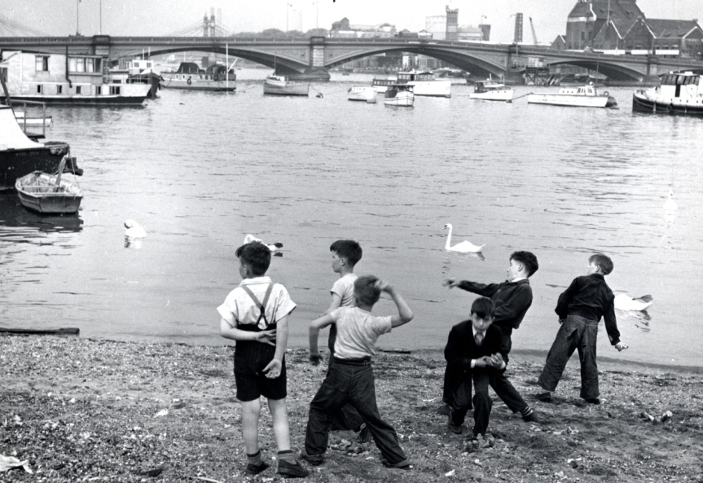
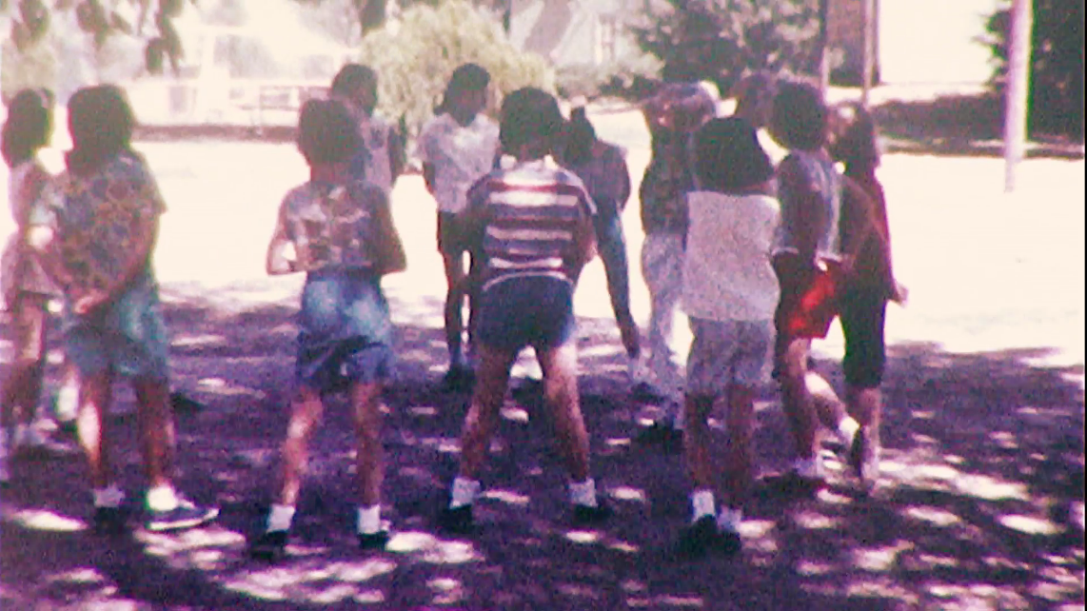
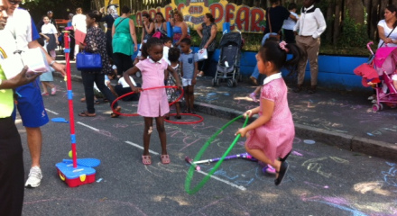
Free Play
All mammals engage in free play.
Social and Emotional Skill (cooperation, calculated risk)
When deprived of free play animals will overact with fear in a novel situation (lash out in aggression)
Largest brains animals need the most play. (Anthropology) In hunter gatherer cultures children play from dawn to dusk.
Why the decline?
Culture’s view of childhood: time of freedom vs. resume building
Irrational fear of dangers (we are safer today than ever, on all measures)
Self-perpetuation: fewer kids outside playing, who’s going out?
Technology: screen time continues to increase.
High pressure to achieve in academics and sports.
Free Play: activities freely chosen and directed by participants and undertaken for it’s own sake, not consciously pursued to achieve the ends that are distinct from the activity itself.

Slide 8
Free Play
All mammals engage in free play.
Social and Emotional Skill (cooperation, calculated risk)
When deprived of free play animals will overact with fear in a novel situation (lash out in aggression)
Largest brains animals need the most play. (Anthropology) In hunter gatherer cultures children play from dawn to dusk.
Why the decline?
Culture’s view of childhood: time of freedom vs. resume building
Irrational fear of dangers (we are safer today than ever, on all measures)
Self-perpetuation: fewer kids outside playing, who’s going out?
Technology: screen time continues to increase.
High pressure to achieve in academics and sports.
Free Play: activities freely chosen and directed by participants and undertaken for it’s own sake, not consciously pursued to achieve the ends that are distinct from the activity itself.
Free play is really the only place children are in control and the only place they learn to get control of their lives. (Problem solving, cooperation, regulating emotions, joy, practicing empathy, getting over narcissism)

Slide 9
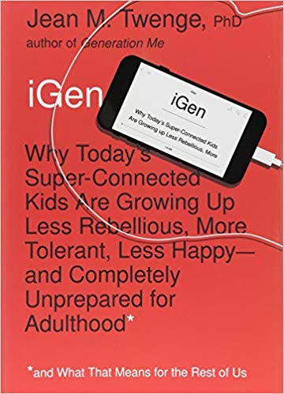
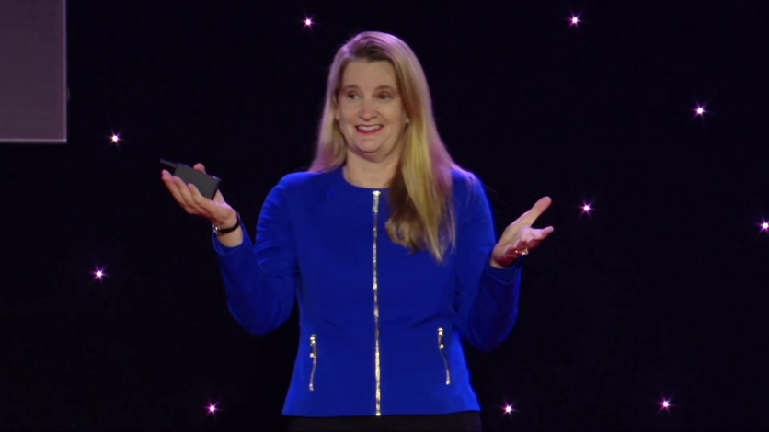
Dr. Jean Twenge
https://www.youtube.com/watch?v=UA8kZZS_bzc
2009
2017

Slide 10
Internal/External Locus of Control
Intrinsic goals: developing competence at an activity that one enjoys, making friends, finding meaning in life, and pursuing a heartfelt religious path are examples.
Extrinsic goals: getting high grades in school, making lots of money, achieving high status, and looking good to others are examples.
Children have less control over extrinsic goals (decreased happiness)
Increases social isolation (extrinsic goals are self-centered)
Greater sense that my life is controlled by “fate, circumstance, or other people”
Not having an internal sense of control sets you up for anxiety
For children it’s free play.
For adolescence it’s a spontaneous adventure.
For teens it’s “just hanging out”.

Slide 11
Summary
Dramatic decline in unstructured free play.
Free play builds social/emotion skills, and internal control.
Increase in external control and external goals. (high achievement for “others”)
Dramatic rise in anxiety, depression, and narcissism.
Social play makes children happy, and its absence makes them unhappy.
(All research studies) indicate that children are, on average, happier in social play with friends than they are in any other situation.
A true diamond: instead of blaming the problem on TECH, Grey is pointing out something that is foundational and positive. So we are not just being “reactive” by setting limits on media, but “proactive” by reinstilling and promoting free play.

Slide 12
Dr. Jean Twenge
https://www.youtube.com/watch?v=UA8kZZS_bzc
2009
2017

Slide 13
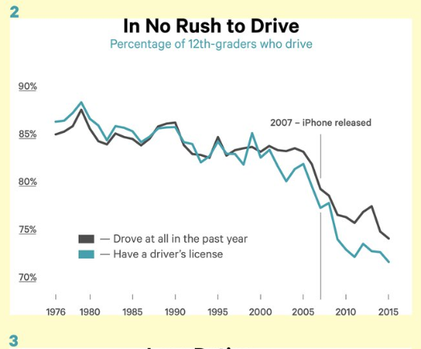

Slide 14
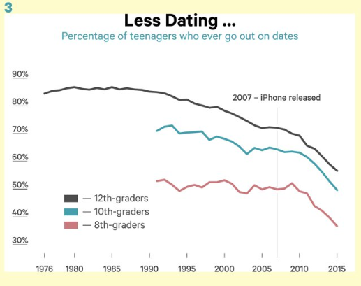

Slide 15
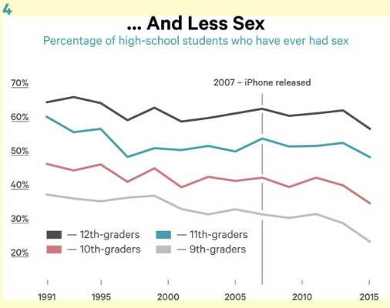

Slide 16
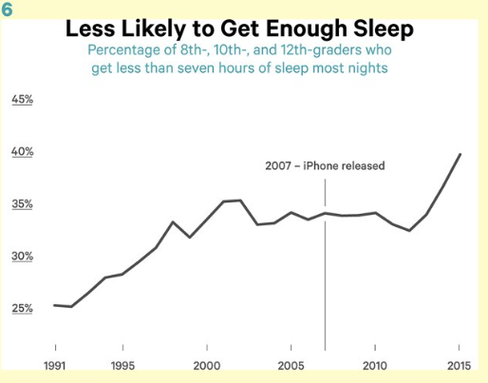

Slide 17
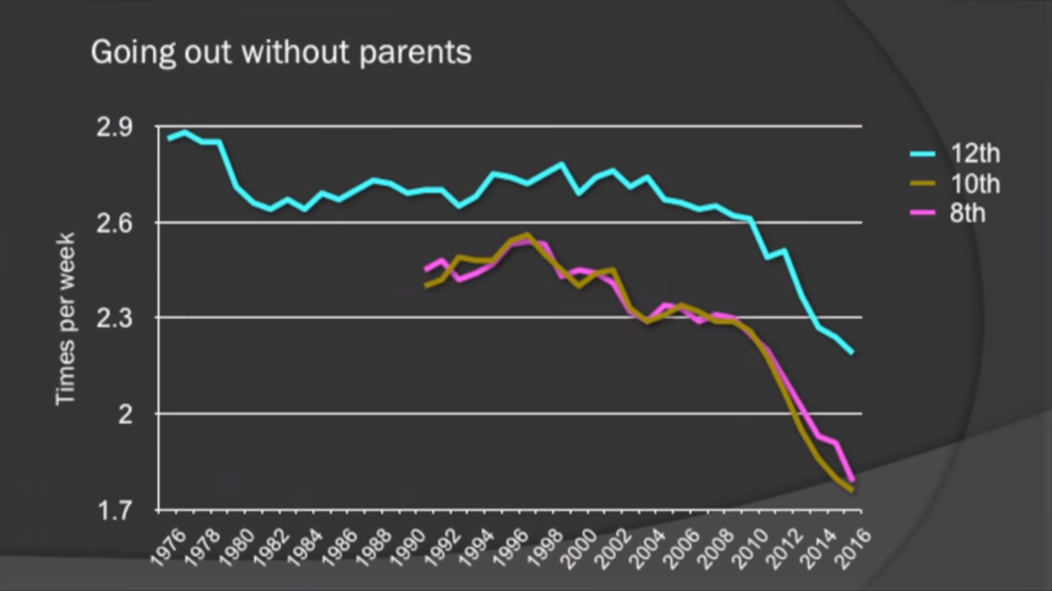

Slide 19
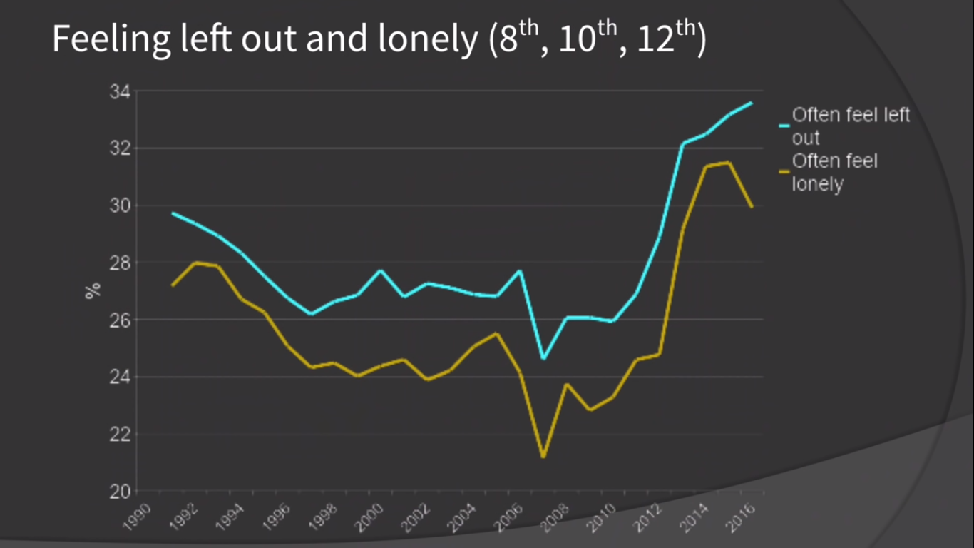
2007- the 6,7,8,9,10, 11 year olds got their iphone
2012-2015- now they are 11-16 year olds. 2012 hit the 50% marker of smartphones

Slide 21
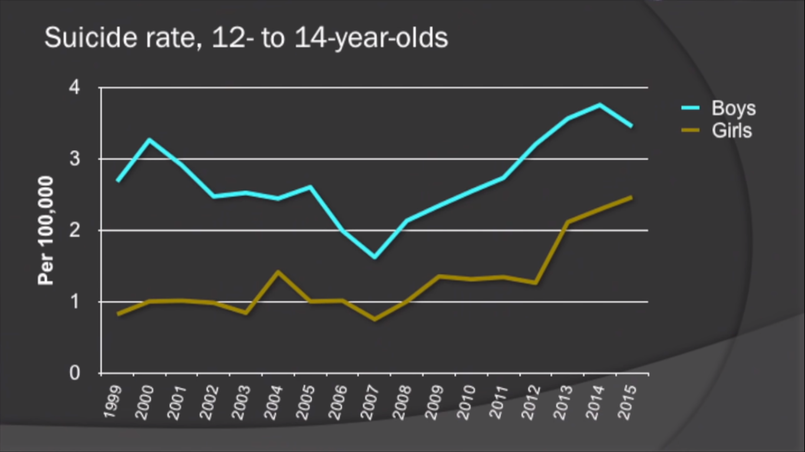

Slide 22
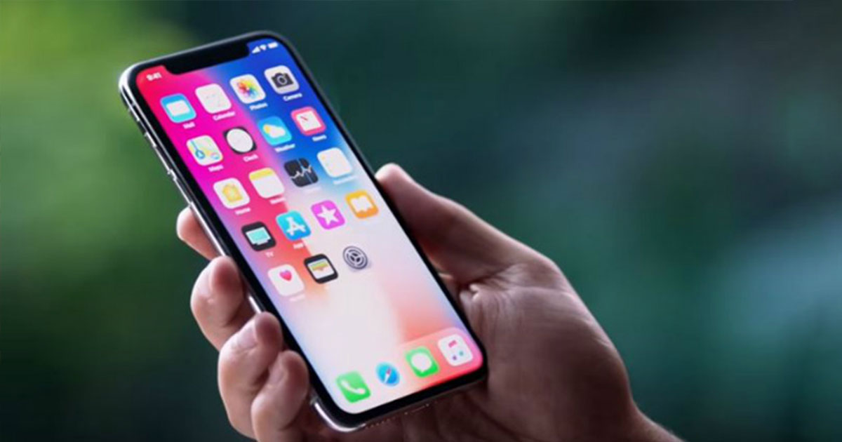
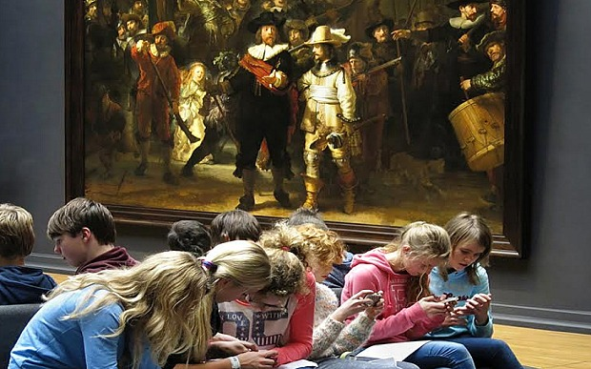
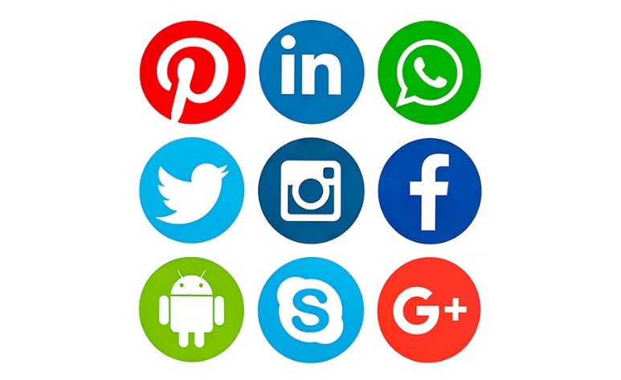
IGen is in a mental health crisis!
This is the generation for the smartphone and social media project.

Slide 23
Anxiety and Depression (recent trends)
The diagnoses of major depression are rising fastest among those under age 35. As a result, diagnoses have gone up 47 percent since 2013 among millennials (ages 18–34). Plus, the rate for adolescents (ages 12–17) has risen 63 percent since 2013—47 percent for boys and 65 percent for girls.
Major Depression: The Impact on Overall Health
Am J Psychiatry. 2018 Jan 1;175(1):28-36.
A study of national trends in depression among adolescents and young adults published in the journal Pediatrics on November 14 found that the prevalence of teens who reported an MDE the previous 12 months jumped from 8.7% in 2005 to 11.5% in 2014. That’s a 37 percent increase!
http://pediatrics.aappublications.org/content/138/6/e20161878

Slide 24
IGen is in a mental health crisis!
(Jean Twenge) Forty-eight percent more girls said they often felt left out in 2015 than in 2010, compared with 27 percent more boys. Girls use social media more often, giving them additional opportunities to feel excluded and lonely when they see their friends or classmates getting together without them. Social media levy a psychic tax on the teen doing the posting as well, as she anxiously awaits the affirmation of comments and likes.
These more dire consequences for teenage girls could also be rooted in the fact that they’re more likely to experience cyberbullying. Boys tend to bully one another physically, while girls are more likely to do so by undermining a victim’s social status or relationships. Social media give middle- and high-school girls a platform on which to carry out the style of aggression they favor, ostracizing and excluding other girls around the clock.
A generation for the smartphone and social media project

Slide 25
IGen is in a mental health crisis!
(Jean Twenge) Teens who spend more time than average on screen activities are more likely to be unhappy, and those who spend more time than average on non-screen activities are more likely to be happy.
(continued) Social-media companies are of course aware of these problems, and to one degree or another have endeavored to prevent cyberbullying. But their various motivations are, to say the least, complex. A recently leaked Facebook document indicated that the company had been touting to advertisers its ability to determine teens’ emotional state based on their on-site behavior, and even to pinpoint “moments when young people need a confidence boost.” Facebook acknowledged that the document was real, but denied that it offers “tools to target people based on their emotional state.”
A generation for the smartphone and social media project
Interviews with Bill Gates, Steve Jobs, and other tech elites consistently reveal that Silicon Valley parents are strict about technology use.
https://www.businessinsider.com/screen-time-limits-bill-gates-steve-jobs-red-flag-2017-10

Slide 26
IGen is in a mental health crisis!
A generation for the smartphone and social media project

Slide 27
Smartphones and social media
Anxiety, Depression, Narcissism
50’s
60’s
70’s
80’s
90’s
00’s
10’s
Free Play
We take away their free play, give them more homework, fill their schedules up, put an iphone in their hand, and say “why aren’t you happy?”

Slide 28
What’s the POSITIVE?
The data is very clear. Get off the screens and get more happiness!
You are in the best position of influence, above all these factors.
To increase free play and intrinsic goals.
Increase social opportunities. (overnights, board game nights, dinners)
Modeling: How much time are you on devices or TV?
Set limits and stick to them. Use IT programs, that take you out of the picture and make it less of a personal battle.
Have meaningful discussion and critique of culture. You can build your child’s self awareness of these issue and help them develop internal convictions.

Slide 29
Discussion
What might cause us to be more lax about tech use with our kids? How can we counter that?
How can we more proactively create a culture of free play? How can we grow and support that within our communities and family?
How much time are we spending in front of a screen ourselves?

