Slide 1
Help for New Moms

Slide 2
Class description
A workshop addressing common concerns of mom and the needs of a baby in the first year. This class hopes to help you build your confidence as a new mom, learn some practical tips and receive encouragement for this big life transition. We'll also discuss changes to anticipate in many of your relationships.

Slide 3
My mission for this workshop...
-For you to experience joy during the first year of your baby's life
-To build your confidence in your ability to parent and your ability to make decisions
-To help with some practical information and resources about babies
-To give you tools to navigate the first year with regards to: marriage, other relationships, time, community, etc

Slide 4
Who the heck am I?
-Amber Liston

Slide 5
Who the heck am I?
-Amber Liston
-I married Ben in 2004

Slide 6
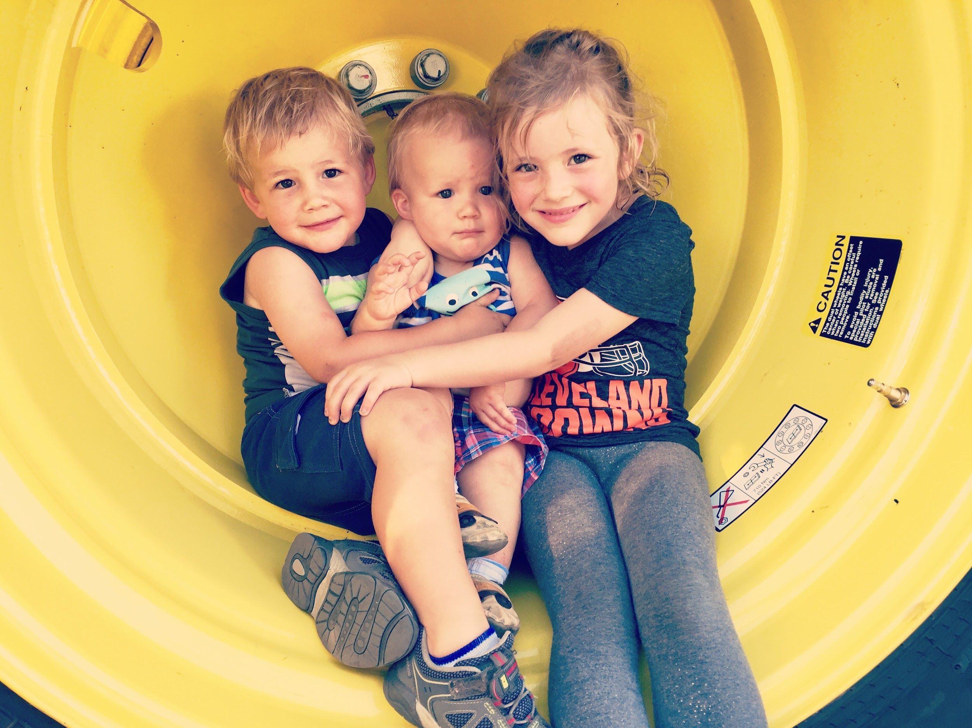
Who the heck am I?
-Amber Liston
-I married Ben in 2004
-We have 3 kids

Slide 7
Who the heck am I?
-Amber Liston
-I married Ben in 2004
-We have 3 kids
-I have a burden for new moms

Slide 8
Where did this burden come from?
-The exact moment I realized my joy was being stolen
-Interactions with new moms

Slide 9
The culture threatens to steal your joy
-Culture says there are certain and specific ways you should be raising your baby
-Other people (strangers, bloggers, friends, family) say there are specific and certain ways you should be raising your baby

Slide 10
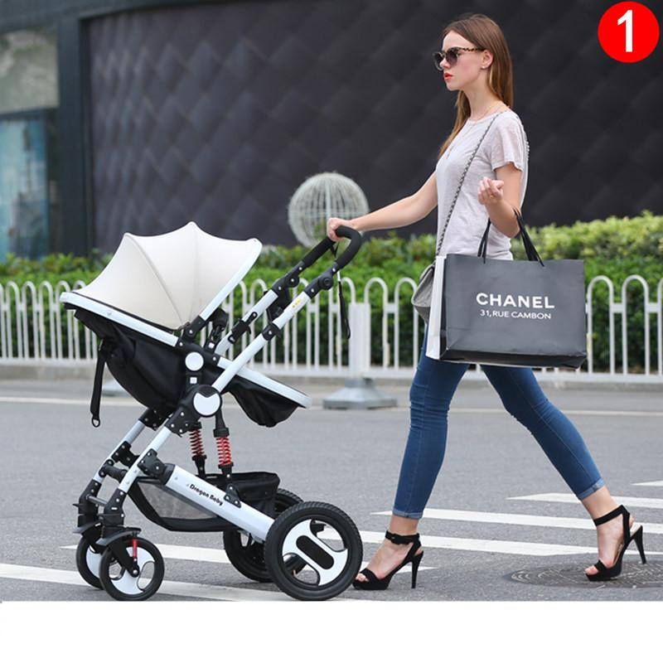
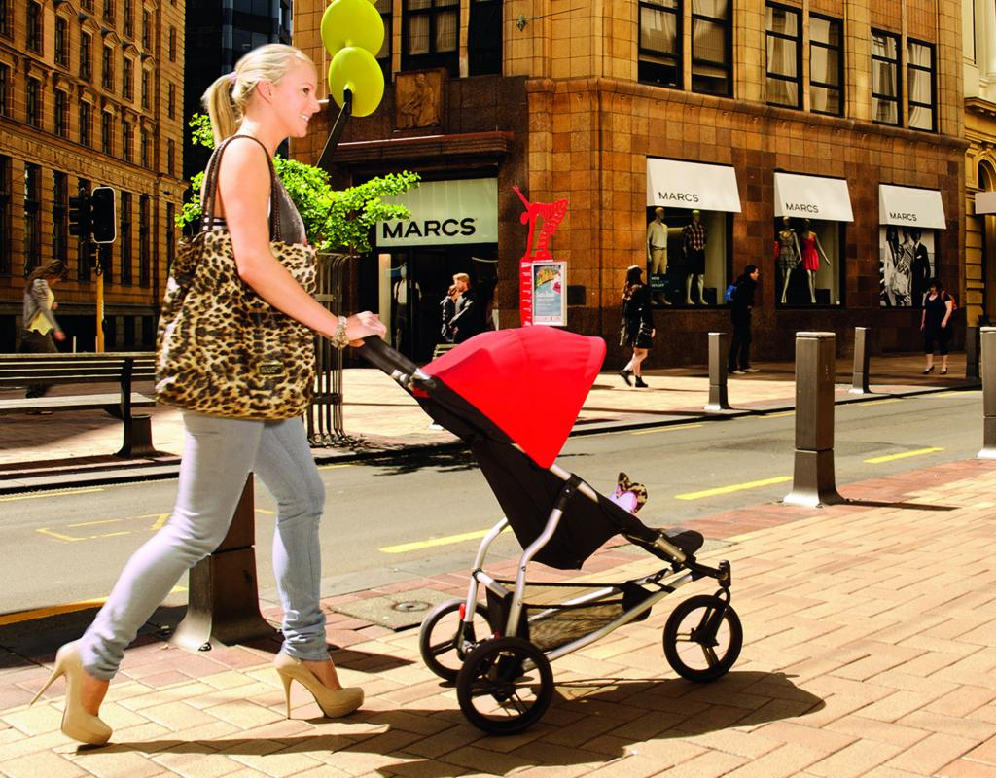

Slide 11
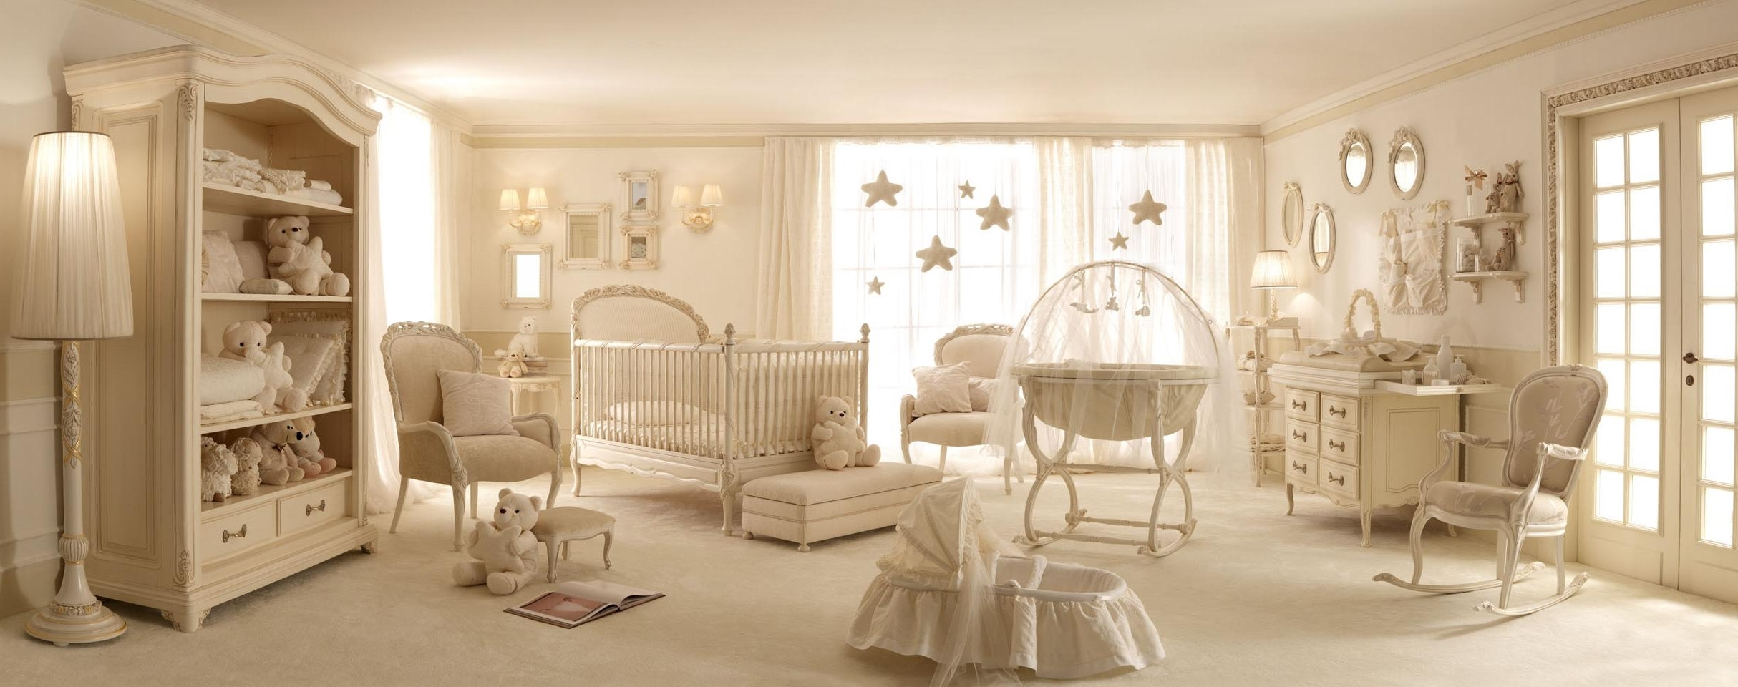

Slide 12
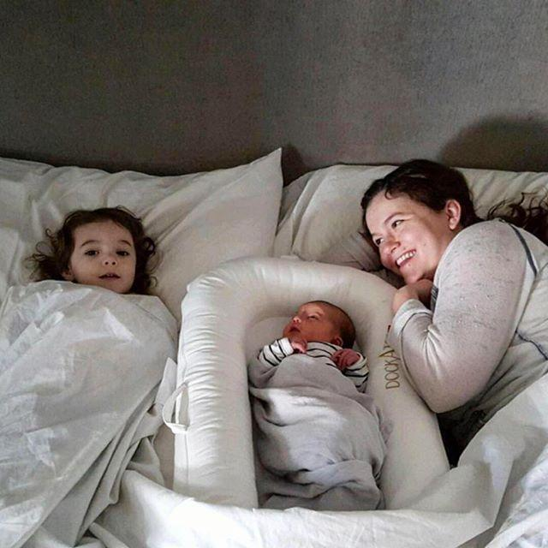

Slide 13
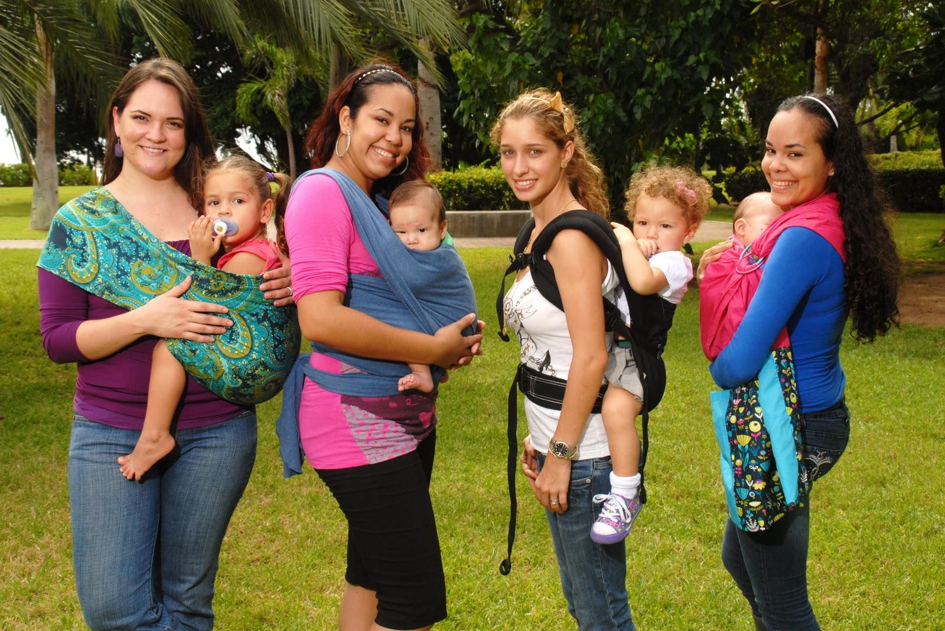

Slide 14
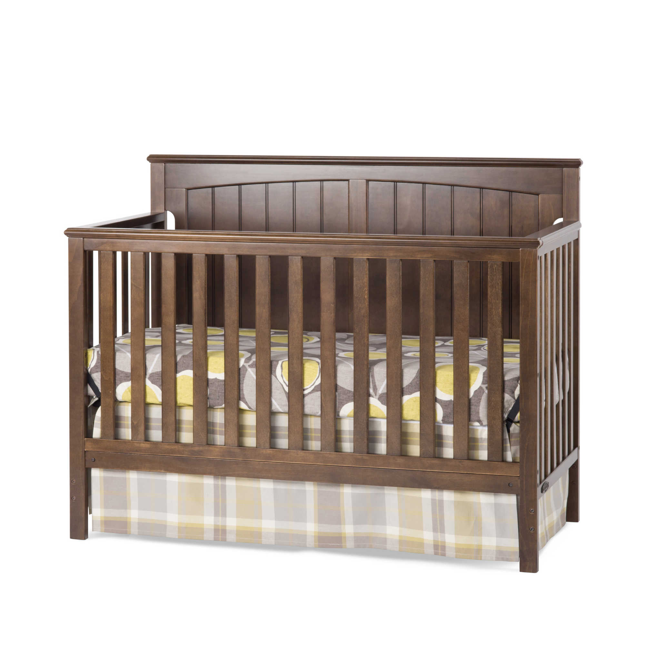

Slide 15
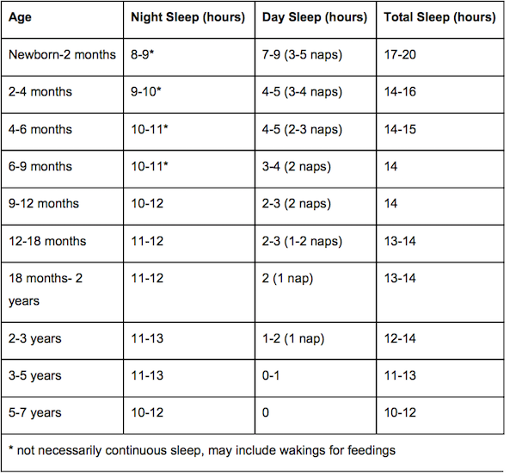
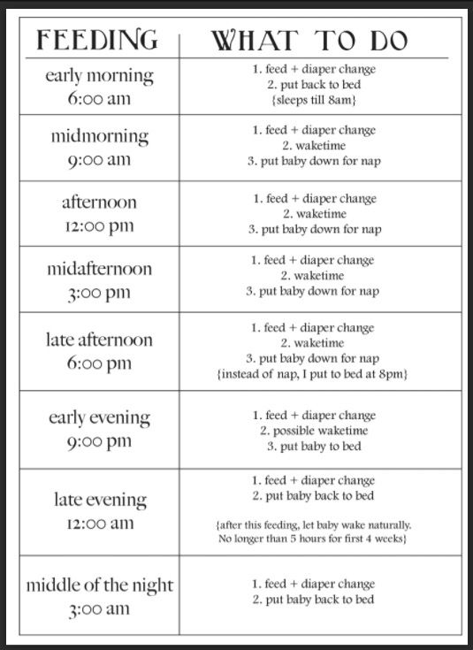

Slide 16
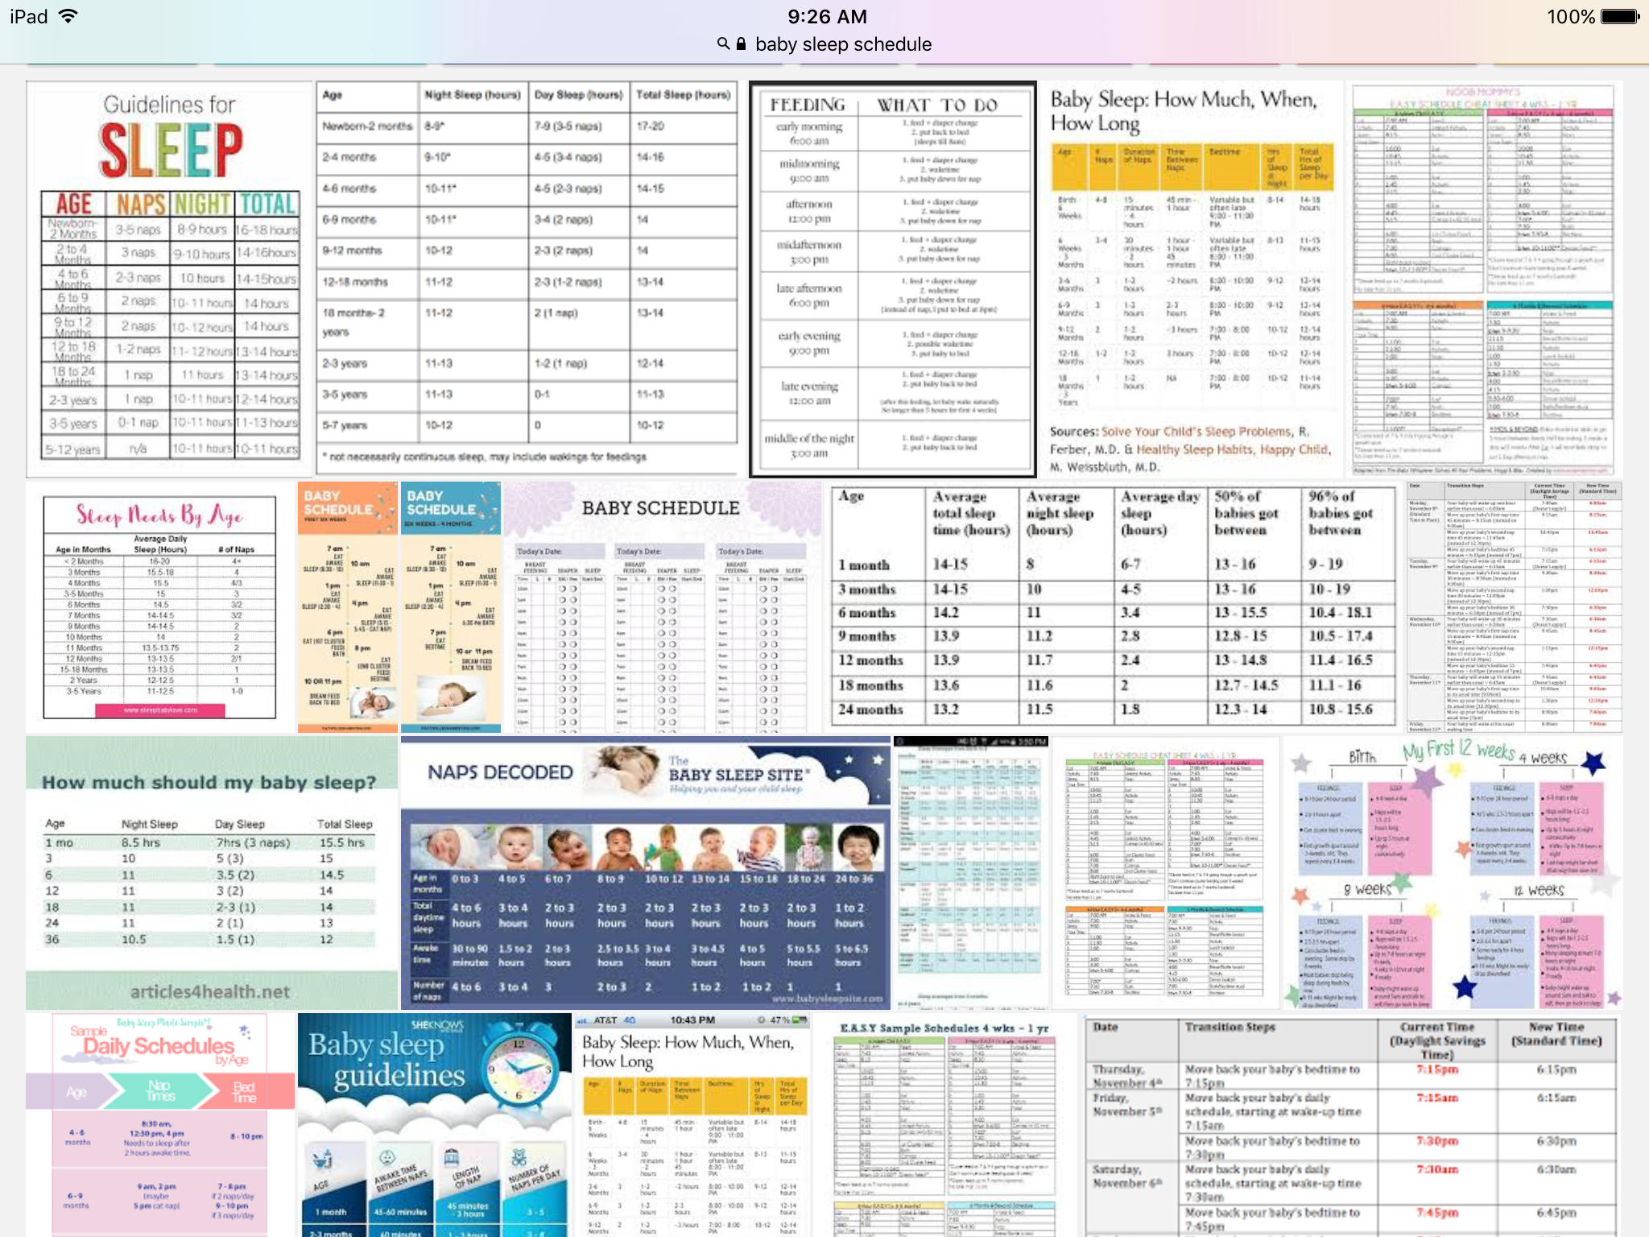

Slide 17
The culture threatens to steal your joy
-You don't have to buy into any of this!
-Don't let the trends of our culture and expectations of other people ruin your joy
-God’s enemy is playing a role here

Slide 18
A brief detour....Satan
-1 Peter 5:8 says, “Stay alert! Watch out for your great enemy, the devil. He prowls around like a roaring lion, looking for someone to devour.”
-He hates God
-He wants to divide you from people and God

Slide 19
You are in charge of YOUR expectations...
-During pregnancy
-For labor
-Right after birth
-Once you get home
-For the entire first year

Slide 20
Do you even know your expectations?
-An expectation has gone unmet when you experience a disappointment
-You have expectations you don't even realize
-New expectations will show up

Slide 21
Discuss...
What are things you envisioned that didn't end up happening?
Or, what did you hope didn’t happen but it did?
How did you respond when it didn't go how you wanted?
How would you counsel someone on this?

Slide 22
What does a baby actually need?
-Interaction
-Touch
-Stable relationships
-Safe, healthy environment
-Communication
-Play, music and reading
-Sleep

Slide 23
A qualification....
-Keep grace in mind as we go through this list
-I'm no expert
-God is in control

Slide 24
A baby needs: Interaction
-Interactions with people and objects are as necessary to the baby as nutrients. The brain is constantly growing and developing.
-The key to interaction is matching the adult’s behavior to the baby’s needs
-Technology use

Slide 25
A baby needs: Touch
-Touch is critical to development
-Touch communicates care and sends signals to the brain to grow
-Massage
-The absence of touch is harmful
-Without touch, development can be stunted

Slide 26
A baby needs: Stable Relationships
-Infants need a loving and trusted adult to interpret life experiences
-Stress makes the brain work harder

Slide 27
A baby needs: A safe and healthy environment
-Create a safe place for an infant
-You'd be surprised what a non-roller can roll off of
-Create a safe place when your baby becomes mobile
-Put up gates, lock chemicals, check for fall hazards
-Health and safety includes food

Slide 28
A baby needs: Communication
-Language acquisition is a complex skill
-A baby’s ability to communicate begins at birth
-It is very important to engage your baby in conversation
-Plasticity of the brain makes learning language possible
-Talk. Talk a lot. Talk all the time.

Slide 29
A baby needs: Play, music, reading
-Play is learning
- “Play is often talked about as if it were a relief from serious learning. But for children play is serious learning. Play is really the work of childhood.” -Fred Rogers
-Music brings play and learning together
-Introduce your kids to books early and often

Slide 30
A baby needs: Sleep
-The most dreaded of all topics!
-Sorry, this is still not a “how to” workshop

Slide 31
Sleep “advice”
“You shouldn’t sleep train at all, before a year, before 6 months, or before 4 months, but if you wait too late, your baby will never be able to sleep without you. College-aged children never need to be nursed, rocked, helped to sleep, so don’t worry about any bad habits. Nursing, rocking, singing, swaddling, etc to sleep are all bad habits and should be stopped immediately.
Naps should only be taken in the bed, never in a swing, car seat, stroller, or when worn. Letting them sleep in the car seat or swing will damage their skulls. If your baby has trouble falling asleep in the bed, put them in a swing, car seat, stroller, or wear them. Use the crib only for sleep and keep it free of distractions. If the baby is having trouble adjusting to the crib, have them play in it first. If the baby wakes up at night and wants to play, put fun toys in the crib to distract them.

Slide 32
Sleep “advice”
Put the baby in a nursery, bed in your room, in your bed. Co-sleeping is the best way to get sleep, except that it can kill your baby, so never, ever do it. If your baby doesn't die, you will need to bed-share until college. Keep the room warm, but not too warm. Swaddle the baby tightly, but not too tightly. Put them on their backs to sleep, but don't let them be on their backs too long or they will be developmentally delayed. Give them a pacifier to reduce SIDS. Be careful about pacifiers because they can cause nursing problems and stop your baby from sleeping soundly. If your baby sleeps too soundly, they’ll die of SIDS.

Slide 33
Sleep “advice”
Don’t let your baby sleep too long, except when they’ve been napping too much, then you should wake them. Never wake a sleeping baby. Any baby problem can be solved by putting them to bed earlier, even if they are waking up too early. If your baby wakes up too early, put them to bed later or cut out a nap. Don’t let them nap after 5 p.m. Sleep begets sleep, so try to get your child to sleep as much as possible. Put the baby to bed awake but drowsy. Don't wake the baby if it fell asleep while nursing. You should start a routine and keep track of everything. Don’t watch the clock. Put them on a schedule. Scheduling will make your life impossible because they will constantly be thrown off of it and you will become a prisoner in your home.

Slide 34
Sleep “advice”
Using the "Cry It Out" method (CIO) will make them think they’ve been abandoned and will be eaten by a lion shortly. It also causes brain damage. Not getting enough sleep will cause behavior and mental problems, so be sure to put them to sleep by any means necessary, especially CIO, which is the most effective form. CIO is cruel beyond belief and the only thing that truly works because parents are a distraction. Formula and solid foods will help the baby sleep longer. Solid foods shouldn’t be given at night because they might wake the baby. Don't stop the baby from nursing when asleep. Be wary of night feeds. If you respond too quickly with food or comfort, your baby is manipulating you. Babies can’t manipulate. Babies older than six months can manipulate.

Slide 35
Sleep “advice”
Sleep when the baby sleeps. Clean when the baby cleans. Don’t worry. Stress causes your baby stress and a stressed baby won't sleep."

Slide 36
Sleep “advice”
Sleep when the baby sleeps. Clean when the baby cleans. Don’t worry. Stress causes your baby stress and a stressed baby won't sleep."

Slide 37
Biblical information about kids
-Children are a gift from the Lord
“Behold, children are a gift of the LORD, The fruit of the womb is a reward. Like arrows in the hand of a warrior, So are the children of one's youth. How blessed is the man whose quiver is full of them; They will not be ashamed When they speak with their enemies in the gate.” ‭‭Psalm‬ ‭127:3-5‬ ‭NASB‬‬

Slide 38
Biblical information about kids
-Children are a gift from the Lord
“Behold, children are a gift of the LORD, The fruit of the womb is a reward. Like arrows in the hand of a warrior, So are the children of one's youth. How blessed is the man whose quiver is full of them; They will not be ashamed When they speak with their enemies in the gate.” ‭‭Psalm‬ ‭127:3-5‬ ‭NASB‬‬

Slide 39
Biblical information about kids
-Children have great use and purpose
“LORD, our Lord, how majestic is your name in all the earth! You have set your glory in the heavens. Through the praise of children and infants you have established a stronghold against your enemies, to silence the foe and the avenger.” ‭‭Psalm‬ ‭8:1-2‬ ‭NIV‬‬

Slide 40
Biblical information about kids
-Children are only children for a short time.
“‬‬But Jacob replied, “You can see, my lord, that some of the children are very young, and the flocks and herds have their young, too. If they are driven too hard, even for one day, all the animals could die. Please, my lord, go ahead of your servant. We will follow slowly, at a pace that is comfortable for the livestock and the children. I will meet you at Seir.” Genesis 13:13-14 NLT

Slide 41
Biblical information about kids
-Children help you awe at God’s creative power
“For You formed my inward parts; You wove me in my mother's womb. I will give thanks to You, for I am fearfully and wonderfully made; Wonderful are Your works, And my soul knows it very well. My frame was not hidden from You, When I was made in secret, And skillfully wrought in the depths of the earth;” ‭‭Psalm 139:13-15‬ ‭NASB‬‬

Slide 42
Biblical information about kids
-Having children is a great privilege
“But Jesus answered and said to them, "You are mistaken, not understanding the Scriptures nor the power of God. For in the resurrection they neither marry nor are given in marriage, but are like angels in heaven.” ‭‭Matthew‬ ‭22:29-30‬ ‭NASB‬‬

Slide 43
The author of the Bible has an enemy
-Satan plays a role in convincing you that parts or all of this is is false
-John 10:10 “The thief comes only to steal and kill and destroy; I came that they may have life and have it abundantly.”

Slide 44
Building confidence
-I have cool tips and tricks, but the point is to prepare and equip you

Slide 45
Building confidence
-I have cool tips and tricks, but the point is to prepare and equip you
-You'll never be the perfect parent and that’s OKAY

Slide 46
Building confidence
-I have cool tips and tricks, but the point is to prepare and equip you
-You'll never be the perfect parent and that’s OKAY
-You'll never know everything and that's OKAY

Slide 47
Building confidence
-I have cool tips and tricks, but the point is to prepare and equip you
-You'll never be the perfect parent and that’s OKAY
-You'll never know everything and that's OKAY
-Babies change many times & in big ways over 12 months. Be flexible where you can & try to go with it
-“Never trust a baby.”

Slide 48
Building confidence
-So many people want to give advice
-Choose your sources wisely

Slide 49
Building confidence
-So many people want to give advice
-Choose your sources wisely
-Decide what to brush off
-“Thanks for the idea. I'll consider it/talk to my spouse/ask my dr.”
-Ask a bunch of questions
-Resources?

Slide 50
Building confidence
-So many people want to give advice
-Choose your sources wisely
-Decide what to brush off
-There has been a shift in receiving parenting info

Slide 51
Building confidence and using common sense
-So many people want to give advice
-Choose your sources
-Decide what to brush off
-There has been a shift in receiving parenting info

Slide 52
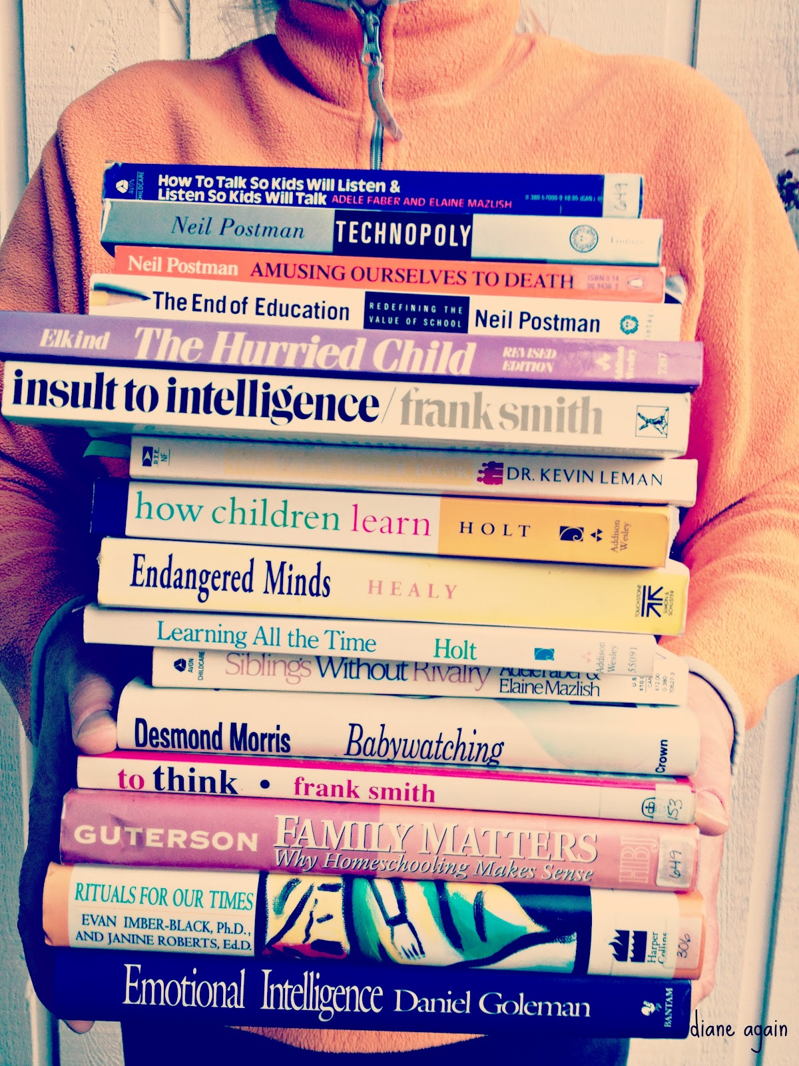
Building confidence
-So many people want to give advice
-Choose your sources
-Decide what to brush off
-There has been a shift in receiving parenting info

Slide 53
Building confidence
-So many people want to give advice
-Choose your sources wisely
-Decide what to brush off
-There has been a shift in receiving parenting info
-There are SO MANY DECISIONS to make and TOO MANY OPTIONS

Slide 54
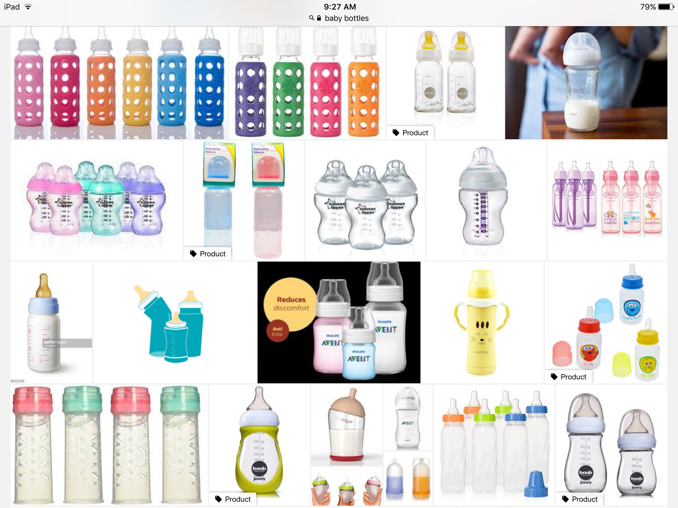
Building confidence
-So many people want to give advice
-Choose your sources wisely
-Decide what to brush off
-There has been a shift in receiving parenting info
-There are SO MANY DECISIONS to make and TOO MANY OPTIONS

Slide 55
Building confidence
-TRUST. YOUR. GUT.

Slide 56
Building confidence
-TRUST. YOUR. GUT.
-It’s also okay to be confused

Slide 57
Building confidence
-TRUST. YOUR. GUT.
-It’s also okay to be confused
-It’s not okay to feel...

Slide 58
Building confidence
-TRUST. YOUR. GUT.
-It’s also okay to be confused
-It’s not okay to feel...
-Are you parenting based on fear or based on what's best for your baby?

Slide 59
Relationships
-You already have so much on your plate!
-Don’t forget Satan

Slide 60
Becoming a parent affects your relationship with: your spouse
Changes are unavoidable
Hormones are REAL

Slide 61
Becoming a parent affects your relationship with: your spouse
Sex

Slide 62
Becoming a parent affects your relationship with: your spouse
Practical tips for dealing with the challenges:
-Some people schedule it
-Change your expectations
- “Just do it”

Slide 63
From a secular resource re: sex after baby...
“This (sex after baby) is more difficult than it sounds. Modern women are trained to shun the wifely duty. If they are in the mood for sex, no problem. Maintenance sex, however, is akin to selling out. It shouldn’t be. There is nothing wrong with sex just for the sake of pleasing your husband, just as there is nothing wrong with romantic gestures just for the sake of husbands pleasing their wives. Marriage is a partnership. Sometimes we do something for our partner just because they are our partner and that would make them happy. Sex is only one of those things. Furthermore, sex for married people is also a way to simply reconnect. With all of the stresses of early parenthood, from baby concerns to family tensions, sex doesn’t have to be the ripped clothes thrown into the corner variety to be a good thing. Sorry for going sappy, but sometimes it is just about physical intimacy.”

Slide 64
Becoming a parent affects your relationship with: your spouse
Sex
Time spent together

Slide 65
Becoming a parent affects your relationship with: your spouse
Practical tips for dealing with the challenges:
-Be selective about your commitments
-Turn off/set down/unplug the technology
-Bond while doing chores
-Make arrangements to leave your baby

Slide 66
Becoming a parent affects your relationship with: your spouse
Sex
Time spent together
Expectations

Slide 67
Becoming a parent affects your relationship with: your spouse
Practical tips for dealing with the challenges:
-Clarify roles and chores
-Normalize this challenge

Slide 68
Becoming a parent affects your relationship with: your spouse
Sex
Time spent together
Expectations
Shifted focus and new priorities

Slide 69
Becoming a parent affects your relationship with: your spouse
Practical tips for dealing with the challenges:
-Remember your husband is your partner in all of this, not just your baby’s dad
-Believe that you and your spouse are the center of your family
-Discuss what things, events, people you will prioritize

Slide 70
Becoming a parent affects your relationship with: your spouse
-Your love for your husband will grow
-You have so many new inside jokes
-You'll see him come through in unexpected ways

Slide 71
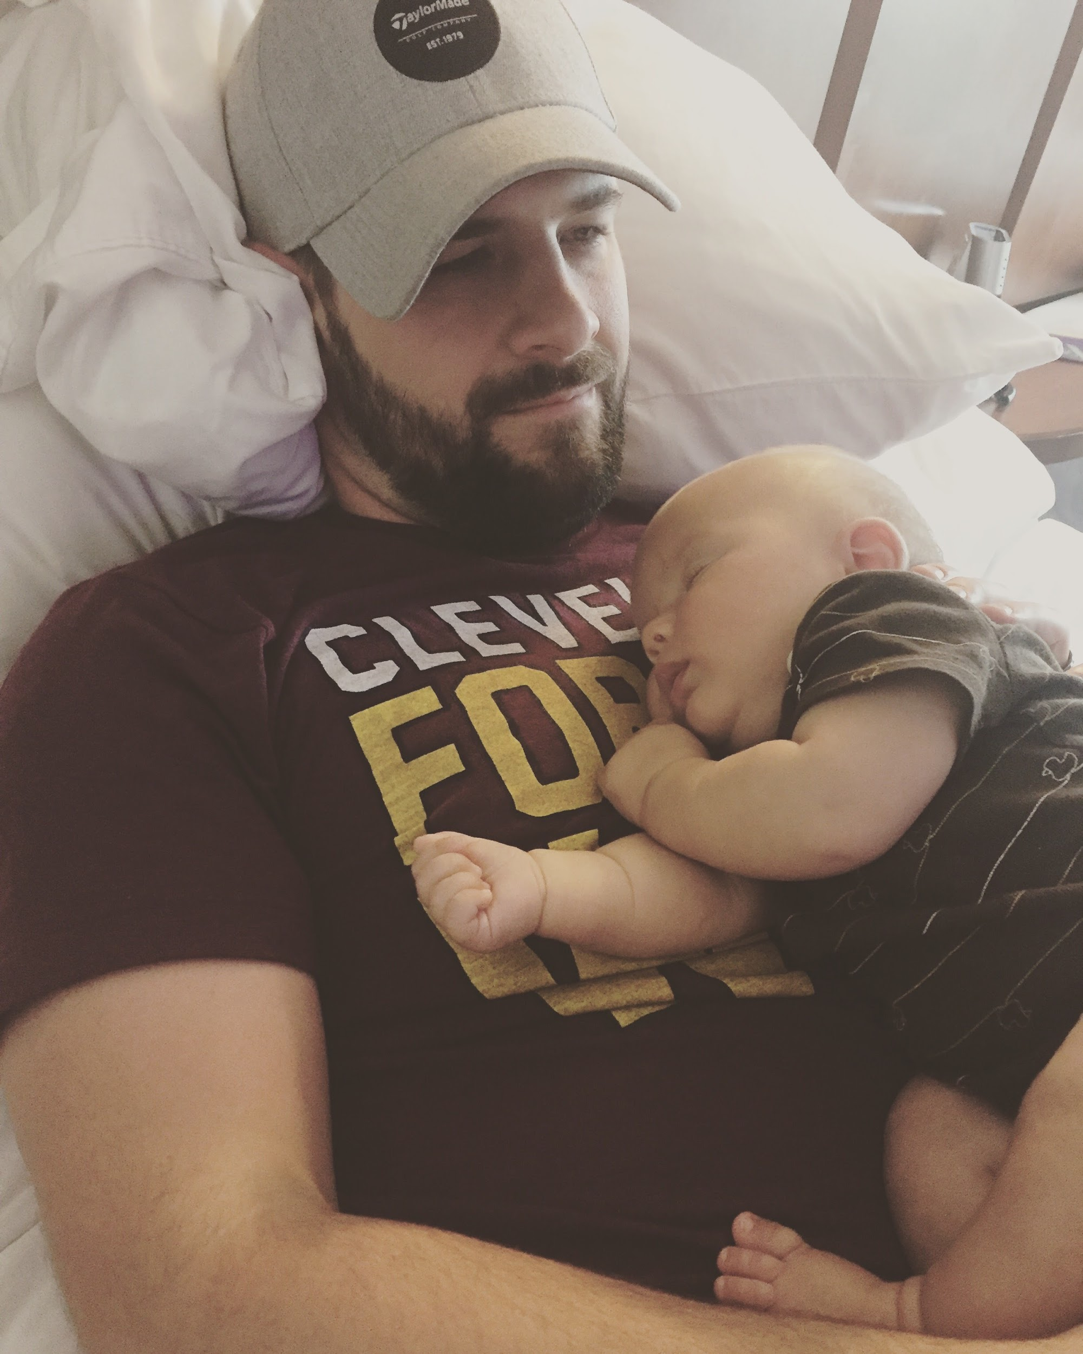
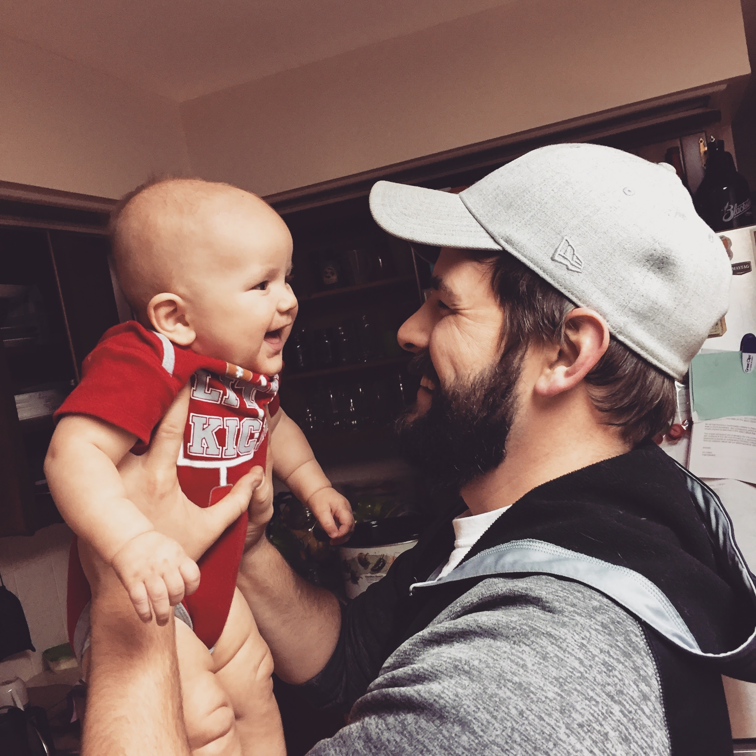
Becoming a parent affects your relationship with: your spouse
-Your love for your husband will grow
-You have so many new inside jokes
-You'll see him come through in unexpected ways

Slide 72
Becoming a parent affects your relationship with: God
-A new level of trust may need to be established...
“I knew you before I formed you in your mother’s womb. Before you were born I set you apart and appointed you as my prophet to the nations.” ‭‭Jeremiah‬ ‭1:5‬

Slide 73
Becoming a parent affects your relationship with: God
-A new level of trust may need to be established...
“I knew you before I formed you in your mother’s womb. Before you were born I set you apart and appointed you as my prophet to the nations.” ‭‭Jeremiah‬ ‭1:5‬
-A new understanding of love you've probably never experienced

Slide 74
Becoming a parent affects your relationship with: God
-A new level of trust may need to be established...
“I knew you before I formed you in your mother’s womb. Before you were born I set you apart and appointed you as my prophet to the nations.” ‭‭Jeremiah‬ ‭1:5‬
-A new understanding of love you've probably never experienced
“Now, most people would not be willing to die for an upright person, though someone might perhaps be willing to die for a person who is especially good. But God showed his great love for us by sending Christ to die for us while we were still sinners.” ‭‭Romans‬ ‭5:7-8‬

Slide 75
Becoming a parent affects your relationship with: God
-A new understanding of how God wants to bless you
“You fathers—if your children ask for a fish, do you give them a snake instead? Or if they ask for an egg, do you give them a scorpion? Of course not! So if you sinful people know how to give good gifts to your children, how much more will your heavenly Father give the Holy Spirit to those who ask him.” ‭‭Luke‬ ‭11:11-13‬ ‭

Slide 76
Becoming a parent affects your relationship with: God
-A new level of compassion and new ways to view people

Slide 77
Becoming a parent affects your relationship with: God
Practical tips for dealing with the challenges:
-Less time, less focus, less energy
-Have a plan
-Find some friends and swap time
-GRACE...be okay with what you can do while also striving for more

Slide 78
Becoming a parent affects your relationship with: God
Practical tips for dealing with the challenges:
-Have a plan
-Find some friends and swap time
-GRACE...be okay with what you can do while also striving for more
-GRACE

Slide 79
Becoming a parent affects your relationship with: God
Practical tips for dealing with the challenges:
-Have a plan
-Find some friends and swap time
-GRACE...be okay with what you can do while also striving for more
-GRACE
-GRACE

Slide 80
Becoming a parent affects your relationship with: friends
-This will look different depending on the friend/friendship
-Less time, more distractions, differing priorities, difficult to get out
-Your friends love your baby!
-Your friend’s kids can be your kid’s friends!

Slide 81
Becoming a parent affects your relationship with: friends
-This will look different depending on the friend/friendship
-Less time, more distractions, differing priorities, difficult to get out
-Your friends love your baby!
-Your friend’s kids can be your kid’s friends!

Slide 82
Becoming a parent affects your relationship with: friends
Practical tips for dealing with the challenges:
-Get creative
-Low expectations for your time
-Make an effort for some kind of regular hangout without children
-Talk about a variety of things!

Slide 83
Becoming a parent affects your relationship with: your family and in-laws
-This will be so different for everyone all the time
-These relationships *are* important
-The way you operate has much to do with history
-Understand that changes are coming
-Boundaries AND love
-A new level of respect for your parents (or your husband's parents)
-A new form of gratitude and appreciation

Slide 84
Becoming a parent affects your relationship with: your family and in-laws
Practical tips for dealing with the challenges:
-Figure out with your husband how to handle issues, holidays, visits, etc
-Realize everyone's tendencies...especially your own
-Decide on your non-negotiables
-Book: Boundaries by Cloud and Townsend

Slide 85
Becoming a parent affects your relationship with: your ministry and church
-You have a new ministry now
-You will not be as available as before
-You will always have a “reason” to not go...
-A whole new field of ministry is open to you

Slide 86
Becoming a parent affects your relationship with: your ministry and church
Practical tips for dealing with the challenges:
-JUST TRY TO GO!!!
-Find ways TO BE available
-Know your tendencies

Slide 87
Raising children in community
-The family unit is not the central feature of the NT
-Community is a place where love happens and where truth is shared
-Oasis is stellar, but that shouldn’t be all of it

Slide 88
Raising children in community
-Put the roots down now
-Find. Mom. Friends.
-Do family stuff with other families
-Let people love you and your baby

Slide 89
Resources
-Minimalistamama.com
-http://www.fresno.ucsf.edu/pediatrics/downloads/edinburghscale.pdf
-Boundaries by Henry Cloud and John Townsend
-http://www.childproofingexperts.com/childproofing-checklist-by-age/
-https://www.realsimple.com/home-organizing/organizing/organizing-tips-techniques/childproofing-checklist
-https://pathways.org/wp-content/uploads/2017/02/Ability_birth-to-6-years_Checklist.pdf

Slide 90
Last things last
-amberliston@gmail.com
-Amy is here
-Veteran moms are here
-Playgroup paper

