Slide 1
Anxiety and Children
Parenting Group November 2016
Amy M. Moreno, LPCC-S

Slide 2
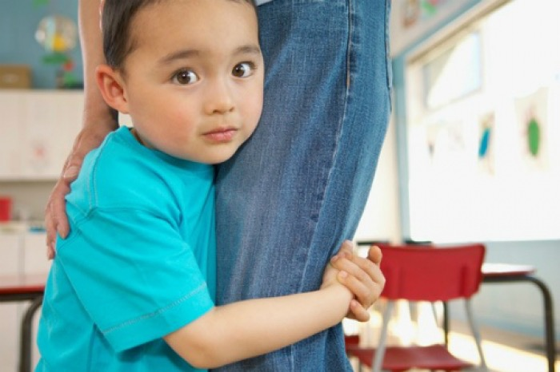
Anxiety and Children

Slide 3
Anxiety and Children
Anxiety disorders affect one in eight children. Research shows that untreated children with anxiety disorders are at higher risk to perform poorly in school, miss out on important social experiences, and engage in substance abuse. (ADAA—Anxiety and Depression Association of America)
5.9% of 13-18 years olds have a severe anxiety disorder.(National Institute of Mental Health)
Excessive fear can cause considerable stress or interference in everyday life. Prevent them from engaging in age-appropriate activities or meeting expected developmental milestones. (Website: Anxiety BC)

Slide 4
Anxiety in Children
AGE | COMMON FEARS | HOW IT CAN MANIFEST
INFANTS/ TODDLERS | Stranger anxiety | Clinging, Crying and/or Tantrums when you separate
PRESCHOOL & YOUNG CHILDREN | Fear of the dark That dog might bite me | Constant reassurance seeking Crying and tantrums when the child is worried
ELEMENTARY AGE | Starting a new school/club/sports Raising a hand in class/Reading out loud Sleep overs My mom might forget to pick me up after school My teacher will yell at me and the kids will laugh What if I throw up at school? What if my Mom or Dad dies? | Excessive shyness, avoiding social situations Complaints of frequent stomachaches or headaches Crying before going to school, and often more difficulty returning to school after weekend

Slide 5
AGE | COMMON FEARS | HOW IT CAN MANIFEST
MIDDLE SCHOOL/ HIGH SCHOOL | Performance anxiety I’ll fail my exam Excessive fear of making mistakes, desire to be “perfect” in appearance and work projects Social fears Current situation Future event | Avoiding situations or places because of fears Lashing out and screaming Academic failure Isolation or failure to join in and make friends Chest pains Sore shoulder muscles Nausea, Dizzy, lightheaded
COLLEGE AGE | Moving out of parent’s house College | Experiencing sudden and frequent panic attacks Trouble going to sleep or staying asleep Feeling foggy—feel detached from oneself Hot or cold feelings Feelngs of a lump in the throat or choking Rapid heart rate Trembling, shaking

Slide 6
Anxiety and Children
Anxiety impacts all | six domains
EMOTION | PYSICAL | BEHAVIORAL | COGNITION | RELATIONSHIP | FUNCTIONING
Tears Anger Fear | Headaches Stomaches Nausea Dizzy Insomnia Sore muscles Eating habits—poor nutrition | Acting out Withdrawing Seeking reassurance Being unable to do routine tasks without crying, tantrums or having continual reminders | Racing thoughts Hard to focus Worry Expect the worst to happen | Dependence on parents Seeking a lot of reassurance Asking parents to do things for them that seem unnecessary Asking the same questions over and over again | Impaired Typically functioning at a lower level than their peers Struggle to get up and ready in the morning Often late to school Forget things at home Appear disorganized, unfocused,

Slide 7
Anxiety impacts all | six domains
EMOTION | PYSICAL | BEHAVIORAL | COGNITION | RELATIONSHIP | FUNCTIONING
Tears Anger Fear |  |  | Having trouble falling asleep due to excessive worries about daily events, getting enough sleep, or staying asleep Viewing themselves as incompetent, unlovable, worthless, ugly, etc. Believing: “I can’t cope,” or “It’s safer to stay home.” | Demand comfort in non- threatening situations | Fail to reach their academic potential Miss important social and recreational activities due to fear Miss opportunities to learn important skills like making friends, dating, asserting oneself, etc. Teens can experience more conflict with the family

Slide 8
Anxiety and Children
Clinical? Anxiety starts to become a “clinical” issue when it impairs functioning in two or more areas. Medication?
Best Practice: It’s much better to try some behavioral techniques, work on family system issues, etc. However, when kids get to the college level and their anxiety is just ramping up—and the say they’ve been anxious since childhood—we start to think about medication a little more.

Slide 9
Anxiety and Children
Joining the Anxiety cycle:
Often times when our kids are anxious—we end up joining the anxiety cycle with them, rather than helping them through it.
Some of the common misguided beliefs that we operate out of:
1. Anxiety is bad and we need to avoid anxiety producing situations.
2. I need to protect my child from feeling anxious by removing stressors.
3. My child can’t handle such and such (Situations that are developmentally and socially appropriate).
4. My child isn’t “old enough” to handle all of this—and the temptation to hover or be overly involved.
5. If we don’t mention it—don’t talk about it, then we won’t get anxious.

Slide 10
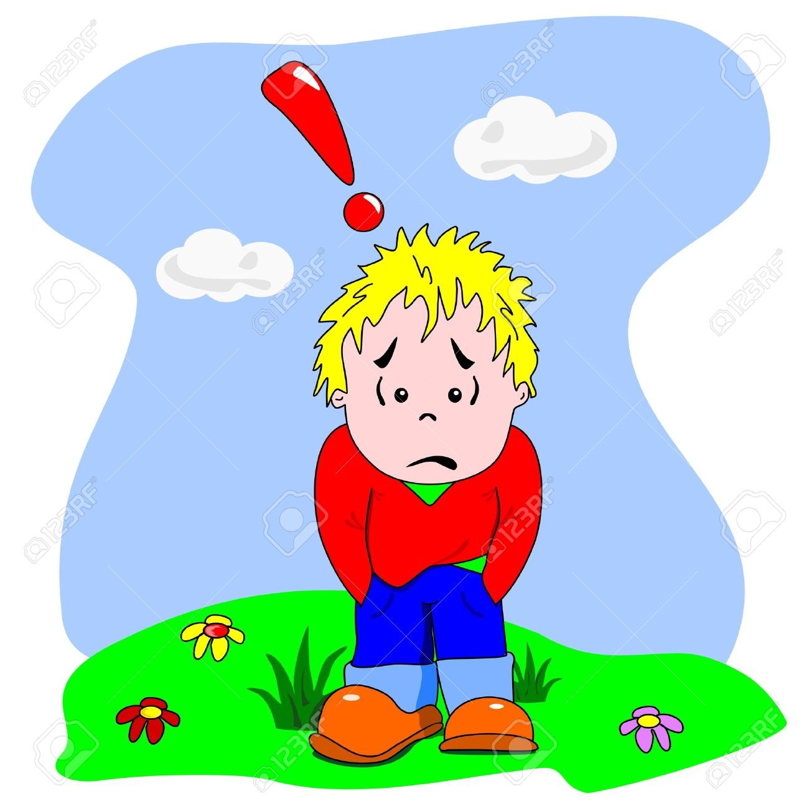
Anxiety and Children
Helpful Pointers
The goal isn't to eliminate anxiety, but to help a child manage it.
None of us wants to see a child unhappy, but the best way to help kids overcome anxiety isn't to try to remove stressors that trigger it.
Learn to tolerate their anxiety and function.
A byproduct—the anxiety will decrease or fall away over time.

Slide 11
Anxiety and Children
2. Don't avoid things just because they make a child anxious.
Helping children avoid the things they are afraid of will make them feel better in the short term, but it reinforces the anxiety over the long run. If a child in an uncomfortable situation gets upset, starts to cry—and her parents whisk her out of there, or remove the thing she's afraid of, she's learned that the best way to handle my anxiety is to get rid of the stressor.
Avoidance is habit-forming, unhelpful way of coping with stress.
3. Express positive—but realistic—expectations. You can't promise a child that her fears are unrealistic—that she won't fail a test, that she'll have fun ice skating, or that another child won't laugh at her during show & tell. But you can express confidence that she's going to be okay, she will be able to manage it, and that, as she faces her fears, the anxiety level will drop over time.

Slide 12
Anxiety and Children
4. Respect feelings, but don't empower them.
Understand that validation doesn't always mean agreement.
Example: Child is terrified about going to the doctor for a shot.. don't want to belittle her fears, but also don't amplify them.
Listen and be empathetic. Understand her anxiety, Encourage her to face her fears.
"I know you're scared, and that's okay, and I'm here, and I'm going to help you get through this.”
What we want our kids to learn? God is trustworthy and will help them and make them adequate to handle whatever.

Slide 13
Anxiety and Children
Biblical Verses
1 Peter 5:7 Cast all your anxiety on him because he cares for you.
Psalm 27:1 The Lord is my light and my salvation, whom shall I fear? The Lord is the stronghold of my life—of whom shall I be afraid?
2 Corinthians 12:9 My grace is sufficient for you, for my power is made perfect in weakness.
Romans 8:31 If God is for us, who can be against us? He who did not spare his own Son, but gave him up for us all—how will he not also graciously give us all things?

Slide 14
Helpful Pointers continued
5. Don't ask leading questions.
Encourage your child to talk about her feelings, but try not to ask leading questions— "Are you anxious about the big test? Are you worried about the science fair?" To avoid feeding the cycle of anxiety, just ask open-ended questions: "How are you feeling about the science fair?”
6. Don't reinforce the child's fears.
What you don't want to do with your tone of voice or body language: "Maybe this is something that you should be afraid of." If a child has had a negative experience with a dog. Next time she's around a dog, you might be anxious about how she will respond, and you might unintentionally send a message that she should, indeed, be worried.

Slide 15
Anxiety and Children
7. Encourage the child to tolerate anxiety.
Let your child know that you appreciate the work it takes to tolerate anxiety. It's encouraging them to engage and let the anxiety take its natural curve. Called the "habituation curve”—anxiety will drop over time with continued contact of the stressor. It might not drop to zero, or quickly, but it will diminish over time.
8. Try to keep the anticipatory period short.
When we're afraid of something, the hardest time is before we do it. Helpful to eliminate or reduce the anticipatory period. If a child is nervous about going to a doctor's appointment, you don't want to launch into a discussion about it two hours before you go; that's likely to get your child more keyed up. So just try to shorten that period to a minimum.

Slide 16
Anxiety and Children
9. Think things through with the child.
Sometimes it helps to talk through what would happen if a child's fear came true—how would they handle it? A child who's anxious about separating from parents might worry about what would happen if they didn't come to get them.
10. Model healthy ways of handling anxiety.
Multiple ways you can help kids handle anxiety by letting them see how you cope with anxiety yourself. Kids are perceptive, and they're going to take it in if you keep complaining on the phone to a friend that you can't handle the stress of your life. Not pretending that you don't have stress and anxiety, but let kids hear or see you managing it calmly, tolerating it, feeling good about getting through it.

Slide 17
Anxiety and Children
CONCLUSION
Best things we can do to help with anxiety
PREPARE—Whether they are 1 or 21, it’s helpful to talk through it ahead of time and let them know what to expect. Let them ask questions, imagine how they might handle it.
ENCOURAGE—knowing that you believe in them. “You got this.” “I know it’s going to work out.” “You’re stronger than you know.” “God is with you and will help you.”

Slide 18
Anxiety and Children
REASSURE—Letting them know that your heart is in this with them and what you’re thinking about them. “I’ll be back in 1 hour.” “I will be so excited to see you and hear all about it.” “I’m praying for you every step of the way.” “Call me and let me know everything.”
PROCESS—spending some time after the event to think it through a little bit. “What was it like?” “What did you learn?” “Would you do it again?” “How did God help you?” “What would make it less anxious next time?”

Slide 19
Anxiety and Children
Importance of your relationship with child:
As a parent, remember that you are the most important person in your child’s life. Although it can be frustrating for the entire family to deal with an anxious child, your child needs a loving, encouraging parent to help support through the process of learning to cope and conquer the anxiety. (ABCs of Anxiety)How to respect feelings without empowering fears By Clark Goldstein, PhD Goldstein, PhD, is a clinical psychologist in the New York area.Updated: August 24, 2015)

Slide 20
Anxiety and Children
SCENARIOS —Discussion Groups
You’re trying to drop your toddler off to a friend and she is screaming, crying, and clinging to you. What’s helpful for your child?
Your elementary age child is begging you to let them stay home from school tomorrow because they’re terrified to take their math test or perform in the play? Do you let them? How do you handle it?
Your teenager is consistently complaining of headaches, and stomaches, and not sleeping well and you wonder what’s up? What do you do?
Your college kid calls you everyday to come get them because they’ve had another panic attack? How do you handle this?

Slide 21
Anxiety and Children
Reflective Questions: Discussion Groups
Are there ways that I am contributing to my child’s anxiety?
What has been helpful in decreasing my child’s anxiety?
When does my child’s anxiety stress me out?
What are helpful ways to talk to my child about their anxiety?
Any good books I’ve read on this topic?

