Slide 1
ARE THE FIRST AMONG US?
XSI 2022: ACCESS MINISTRY

Slide 2
WHY WE ARE HERE…
^{Matthew 19: 30} But many who are first will be last, and many who are last will be first.
^{Mark 8:35} For whoever wants to save their life will lose it, but whoever loses their life for me and for the gospel will save it.
^{Luke 9:48} Then he said to them, “Whoever welcomes this little child in my name welcomes me; and whoever welcomes me welcomes the one who sent me. For it is the one who is least among you all who is the greatest.”

Slide 3
DEFINITION OF DISABILITY
In the body: any lack of capacity to do something required to participate in activities considered important or typical in your society
In the world: attitudes, environments and policies that exclude people with differing abilities from participating in those activities
In other words: disability is both, part of a person and created by the environment.

Slide 4
ARE THERE SPIRITUAL LESSONS WE CAN ALL LEARN FROM SERVING INDIVIDUALS WITH DISABILITIES? WE BELIEVE SO.
MISSION
MINISTRIES
SPIRITUAL GROWTH
Missional possibilities for Special Needs Ministry
Overview of how we do it at Dwell Community Church.
Live panel from those who have served.
Open time for discussion.

Slide 5
MISSION
Matthew 28:18-20
Then Jesus came to them and said, “All authority in heaven and on earth has been given to me. Therefore, go and make disciples of all nations, baptizing them in the name of the Father, and of the Son and of the Holy Spirit, and teaching them to obey everything I have commanded you. And surely I am with you always, to the very end of the age.

Slide 6
“ PEOPLE WITH DISABILITY ARE A PEOPLE GROUP WHOSE CONTEXT IS RARELY ENGAGED BY THE CHURCH, BUT THE POWERFUL PRESENCE OF GOD IN HIS MISSION CAN BE PROFOUNDLY EXPERIENCED IN SPECIAL NEEDS MINISTRY.” (BAUGHMAN)

Slide 7
MISSION
“Most of the families [with disabilities] are not coming, because life is just too hard….and we are not reaching them because we do not yet see.” (Beates)
“When we take into account the caretakers and other members of their families, there are a great many people in our neighborhoods who need to hear the gospel but cannot because they are unable to come to our churches. In many ways, people with families of people with disabilities are an unreached people group who live next door.” (Baughman)

Slide 8
STATS
FCBDD is planning to serve 7,231 individuals. Also, Delaware CBDD is near to the Dwell main campus and they serve 2,500 individuals and families.
In the area of spiritual growth and development individuals with developmental disabilities are a large under-reached, under-engaged people group. Families and caregivers are also often on the fringe of body life due to the challenges of finding a place within the body of Christ for the individual with developmental disabilities.

Slide 9
MINISTRIES
The Dwell Access Ministry exists to create and improve accessibility to the Gospel for people with disabilities by providing specific support to adults, students, and children with disabilities, as well as their families, in several distinctive ways.

Slide 10
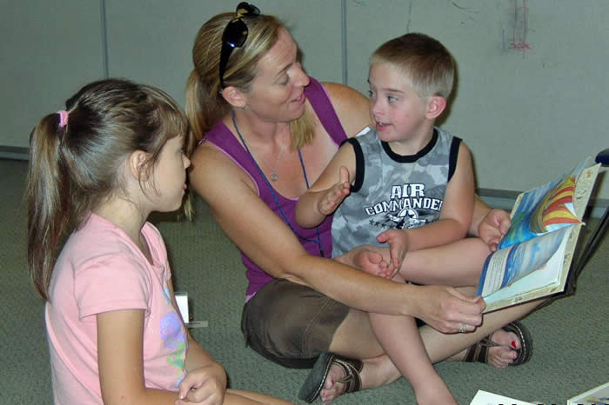
OASIS ACCESS PROGRAM

Slide 11
OASIS ACCESS PROGRAM
The Oasis Access mission is to create and provide an environment where all children can learn about, experience, respond to, and grow in the truth and love of Jesus Christ. The Oasis Access Program is designed to supplement that goal by providing individualized support to those children who need it. There are two facets to this program: Oasis Classroom Support and the HUB Classroom.
This program provides classroom support to children who need additional assistance in the Oasis classroom. All Access workers are certified through the same screening process as other Oasis workers and have expressed an interest in working in a classroom supporting a child with special needs. Workers may be an adult or student volunteers, who commit to providing support either weekly or every other week for one year. In addition to helping a child learn about God’s plan through the Oasis curriculum and classroom activities, workers facilitate positive interactions with the child’s Oasis classmates.

Slide 12
OASIS ACCESS PROGRAM
The HUB allows Oasis Access directors a quiet place to get to know a child, while obtaining classroom support and a classroom that best fits the child’s needs. While our goal is to include all children in the Oasis experience, we recognize that some parents may desire to have a less stimulating environment for their child. The HUB is staffed with screened volunteers who have expressed an interest in serving children beyond the traditional Oasis classroom. The HUB offers a variety of adaptive toys and games, as well as music and Bible stories.

Slide 13
SATURDAY NIGHT BIBLE STUDY

Slide 14
SATURDAY NIGHT BIBLE STUDY
A place to learn God's word at Dwell. The Young Adult Home Church is a gathering of high school students and older. They use a variety of ways to study and teach the Bible, and grow in their relationship with Christ and each other, or to transition into adult home groups as individuals desire.

Slide 15
AMERICAN SIGN LANGUAGE (ASL)

Slide 16
AMERICAN SIGN LANGUAGE (ASL)
The Interpreting Team ministry provides quality ASL services to deaf patrons, who attend various meetings and events held weekly at Dwell Community Church.

Slide 17
RESOURCES
FOR HOME CHURCHES
Home Group Liaison:
Home groups are the heart of Dwell and the Adult Home Group Liaison helps adults with disabilities find accessible Bible study opportunities by contacting home groups and facilitating their inclusion.
Student Ministry Liaison:
Visit the meetings, and work directly with leadership teams to help provide resources to best include the individual in community and fellowship. (Example: High school Home church visit.)
Quarterly Zoom Sessions:
Access Leaders will meet with any group that wants prayer or coaching on how to best love individuals within their groups.

Slide 18
SPIRITUAL GROWTH
Panel

Slide 19
CONTACT INFO:
Email us at :
accessministry@dwellcc.org

