Slide 1
[Xenos Parenting] Moral Compass – East Engagement
How does my Child's Moral Compass
Impact Relationships?
Beth Himsworth May, 2016

Slide 2
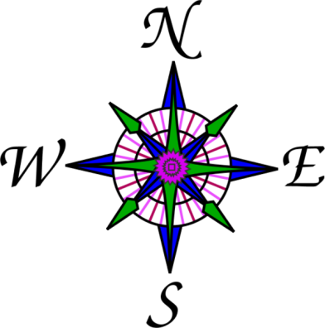
North: God as the ultimate reference point
Identity – a place in the universe
Vision – Being a part of the narrative of history
Security – A clear understanding of Grace and Works
Notes:
Identity – a place in the universe
Vision – Being a part of the narrative of history
Security – A clear understanding of Grace and Works
What keeps me on this path? Maintains my security and sense of self? – grace alone

Slide 3
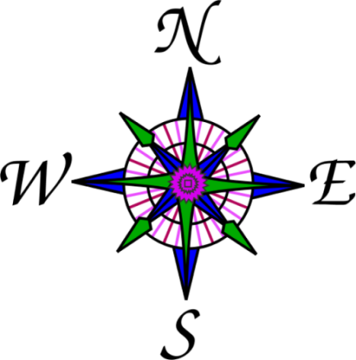
East: Engagement
Created to connect
All moral development depends on empathy

Slide 4
South: Suffering
How we define suffering matters
How we face suffering and disappointment may be the most important gift we give our children

Slide 5
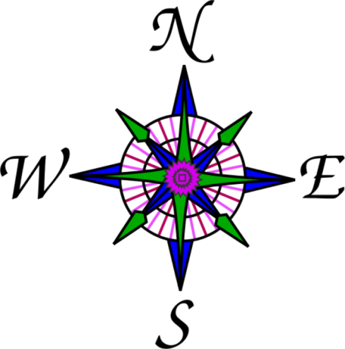
West: Wealth and Work
In the image of God …
Meaningful work
Provision for self and others

Slide 6
Compass Point - East
The Bible is profoundly and above all else, a relational book
“Bear with one another…” “Turn the other cheek…” “be devoted to one another…” “So far as it depends on you, be at peace…” “stop passing judgment on one another”
TODAY: What makes us ABLE to treat others well?

Slide 7
How does my Child's Moral Compass Impact Relationships?
RELATIONAL RESILIENCE
VS.
“SUPERMODEL” EMOTIONAL LIFE

Slide 8
RESILIENCE
The ability to maintain healthy sense of self when in conflict or hurt/slighted by another
“SUPERMODEL” LIFE
The expectation that a feeling of happiness and well-being is normal - conflict or being hurt or slighted by another is very bad & to be avoided or compensated

Slide 9
RESILIENCE
“SUPERMODEL” LIFE
I am a valuable person, loved by God
What I have, I receive with gratitude
My life has some things I want and some things I don’t want
I am the most important person, everyone should love me
I deserve to receive the best
I should demand what I want, avoid what I don’t want

Slide 10
They may have identical life circumstances but …
One will be always looking for more and be
unhappy when life doesn’t feel “Perfect”
What does this have to do with “Moral Compass” ?
Most of the ways we violate our conscience have to do with feeling dissatisfied or “owed”

Slide 11
Hurt vs Harm
Resilience vs Reactivity
Feelings and Reality

Slide 12
HURT VS. HARM
Painful – short term experience
Damaging – long term impact

Slide 13
RESILIENCE vs REACTIVITY
How others respond to my circumstance or experience teaches me how to respond and how to perceive
We are always developing either greater maturity for engagement or self-protection

Slide 14
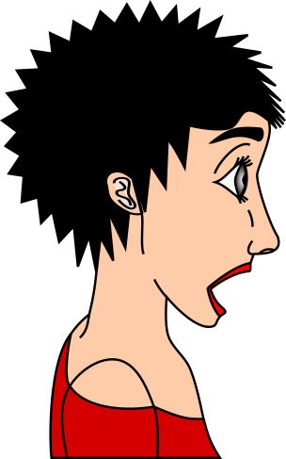
How we respond to our children or others, helps them to form their expectations and sense of what is normal.

Slide 15
FEELINGS and REALITY
Our feelings don’t define reality
The difference between: Thoughts or Beliefs and Feelings

Slide 16
Discussion question: what examples have I seen of hurt vs harm? How can I help see to it that hurt does not produce harm relationally? Discussion question: how do my reactions to my child’s painful experiences help to form their life expectations ? Discussion question: what are some situations in which my feelings have changed significantly without a change in situation? How did that happen?

