Slide 1
CARE GROUP NOVEMBER 2014
Rob Smith
PARENTING IN A
SPORT-CRAZED
WORLD

Slide 2
CARE GROUP NOVEMBER 2014
Background in Sport
ATHLETE
COACH
EDUCATOR

Slide 3
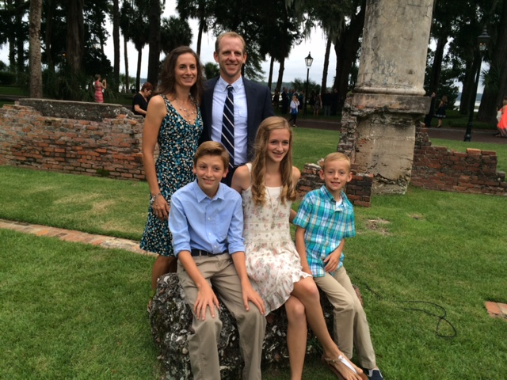
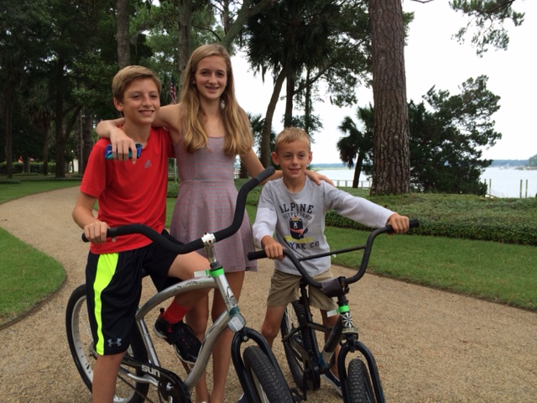
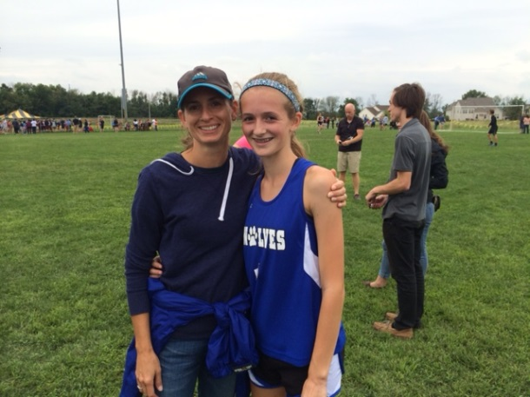
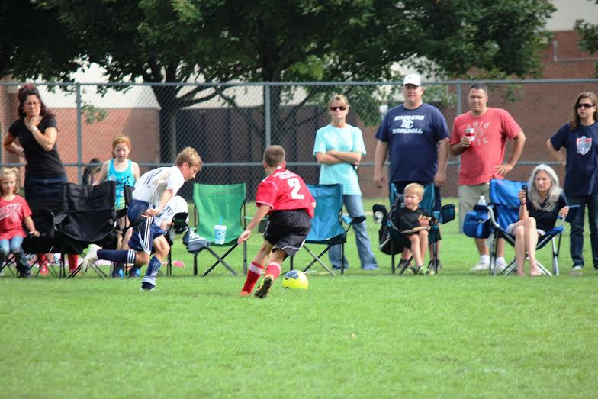
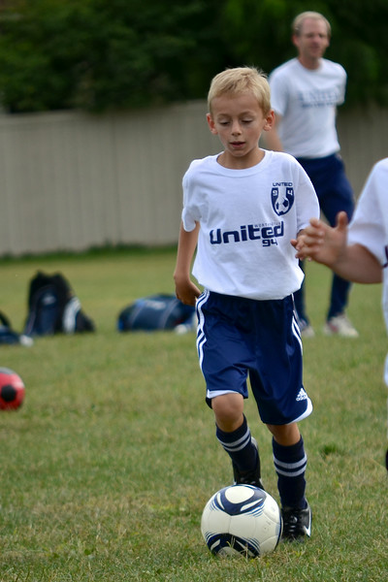
CARE GROUP NOVEMBER 2014
Background in Sport
DAD

Slide 4
What is sport?
sport (n). early 15c., "pleasant pastime," shortening of disport "activity that offers amusement or relaxation; entertainment, fun" (c.1300), also "a pastime or game; flirtation; pleasure taken in such activity" (late 14c.), from Anglo-French disport, Old French desport, deport "pleasure, enjoyment, delight; solace, consolation; favor, privilege," related to desporter, deporter "to divert, amuse, please, play"

Slide 5
FACTS: THE GOOD (numerous studies!)
BODY: healthy bones, muscles, joints; helps control weight/ reduces fat; prevents/ delays the development of high blood pressure.

Slide 6
FACTS: THE GOOD (numerous studies!)
BRAIN: helps improve academic achievement… Further, such activity can affect cognitive skills, attitudes and academic behavior, including enhanced concentration, attention, and improved classroom behavior.

Slide 7
FACTS: THE GOOD (numerous studies!)
SOCIAL: can positively affect aspects of personal development among young people, such as self-esteem, goal-setting, and leadership… however evidence indicates that the quality of coaching is a key factor.

Slide 8
FACTS: THE BAD
BODY: more than 3.5 million children under age 14 receive medical treatment for sports injuries annually. Overuse injuries are responsible for nearly half of all sports injuries to middle and high school students.

Slide 9
FACTS: THE BAD
BRAIN: emergency department visits for concussions sustained during organized team sports doubled among 8-13 year olds between 1997 and 2007 and nearly tripled among older youth.

Slide 10
FACTS: THE BAD
SOCIAL: …at age 9 -- when children often develop a self-concept of whether or not they are an athlete -- physical activity rates begin to drop sharply. By age 15, moderate-to-vigorous physical activity declines 75 percent…

Slide 11
FACTS: THE STATE OF YOUTH SPORTS
http://espn.go.com/video/clip?id=10640360
Respond:
Please share your thoughts…

Slide 12
WHAT HAS HAPPENED?
The Race to Nowhere in
Youth Sports
http://changingthegameproject.com/the-race-to-nowhere-in-youth-sports/

Slide 13
CARE GROUP NOVEMBER 2014
The Bible and sports?
some more of my story…
The Start
The Race

Slide 14
3 Verses
Revelation 3:20 Look! I stand at the door and knock. If you hear my voice and open the door, I will come in, and we will share a meal together as friends.
Ephesians 2:10 For we are God’s masterpiece. He has created us anew in Christ Jesus, so we can do the good things he planned for us long ago.
John 10:10 The thief comes only to steal and kill and destroy; I came that they may have life, and have it abundantly.

Slide 15
Be careful of the pull of the “World” – what John O’Sullivan is sharing in his article regarding sports.
ROMANS 12:2 And do not be conformed to this world, but be transformed by the renewing of your mind, so that you may prove what the will of God is, that which is good and acceptable and perfect.

Slide 16
athletic references…
Self-Control and Discipline
1Corinthians 9:24-27 Do you not know that in a race all the runners run, but only one receives the prize? So run that you may obtain it. Every athlete exercises self-control in all things. They do it to receive a perishable wreath, but we an imperishable. So I do not run aimlessly; I do not box as one beating the air. But I discipline my body and keep it under control, lest after preaching to others I myself should be disqualified.

Slide 17
athletic references…
Endurance
Hebrews 12:1 Therefore, since we are surrounded by so great a cloud of witnesses, let us also lay aside every weight, and sin which clings so closely, and let us run with endurance the race that is set before us,

Slide 18
So… WHAT CAN I DO AS A PARENT?
THINK/ASK/GET INFORMED
What does I look like if I don’t promote any physical activity in my home?

Slide 19
So… WHAT CAN I DO AS A PARENT?
THINK/ASK/GET INFORMED
Count the costs before getting involved (time, $, energy, long view of what I want my child to learn through sports).

Slide 20
So… WHAT CAN I DO AS A PARENT?
THINK/ASK/GET INFORMED
Can my child be active without “select sports”? Without any formal sports? Trying different sports and activities?
What’s this look like?

Slide 21
So… WHAT CAN I DO AS A PARENT?
*Take some time to have a conversation and pray with your family (and friends!) about sport participation.
**Be careful of saying “yes” blindly or without thinking through. Ask for help.
Proverbs 12:15 ”Fools think their own way is right, but the wise listen to others.”

Slide 22
So… WHAT CAN I DO AS A PARENT?
***Generate ideas today!
****Consider that your choices can please God:
A relationship with Him, your child’s relationship with Him, and talking to Him about this part of your family’s life.

Slide 23
CARE GROUP NOVEMBER 2014
Rob Smith
PARENTING IN A
SPORT-CRAZED
WORLD
QUESTIONS/
COMMENTS

Slide 24
CARE GROUP NOVEMBER 2014
Rob Smith
PARENTING IN A
SPORT-CRAZED
WORLD
QUESTIONS/
COMMENTS

