Slide 1
Dealing with Tragedies: small & large; present & future

Slide 2
Tragedy
A very sad, unfortunate, or upsetting situation; something that causes strong feelings of sadness; a disastrous event; misfortune

Slide 3
Tragedy
1. Dealing with Tragedy Yourself
“Modeling goes on all the time, not just when you are in “parenting” mode. It occurs basically anytime you are in eyesight or earshot of the child. Many a mother is dismayed when she finds her children doing what she does, not what she says: “I taught them right from wrong!” she’ll exclaim. And she may have, but often her child has figured out early in the game how his mother’s (or father’s) beliefs fit in with her actions.” - Cloud & Townsend

Slide 4
Dealing with Tragedy Yourself
“Who shall separate us from the love of Christ? Shall tribulation, distress, or persecution, or famine, or nakedness, or danger, or sword?...No, in all these things we are more than conquerors through him who loved us.”
– Romans 8:36a,37

Slide 5
Dealing with Tragedy Yourself
“But we do not want you to be uninformed, brothers, about those who are asleep, that you may not grieve as others do who have no hope.”
- 1 Thessalonians 4:13

Slide 6
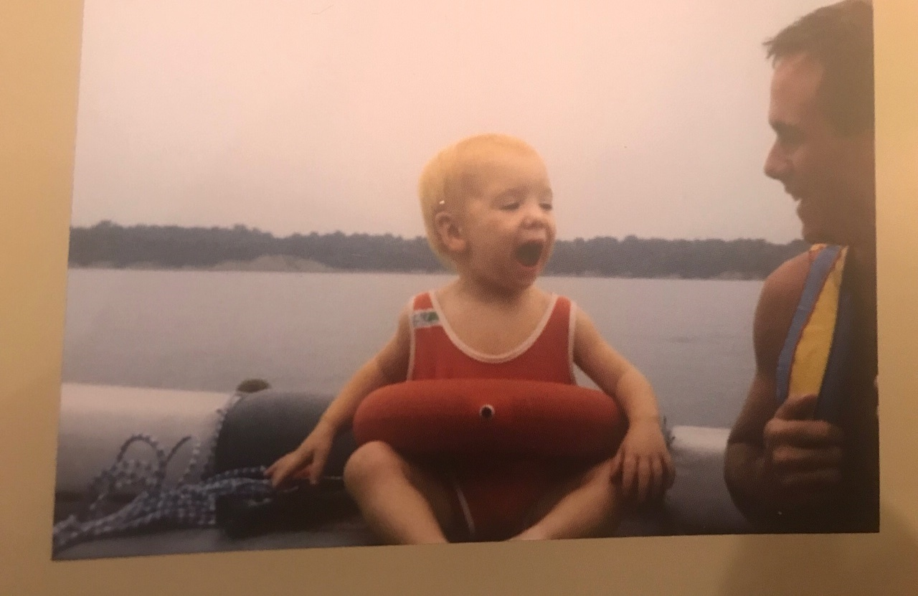
John
Dealing with Tragedy Yourself
“But we do not want you to be uninformed, brothers, about those who are asleep, that you may not grieve as others do who have no hope.”
- 1 Thessalonians 4:13
“He answered, ‘While the baby was alive, I fasted and wept because I thought, “Who knows? The LORD may be gracious to me and let him live.” But now that he is dead, why should I fast? Can I bring him back again? I'll go to him, but he will never return to me.’" - 2 Samuel 12:22-23

Slide 7
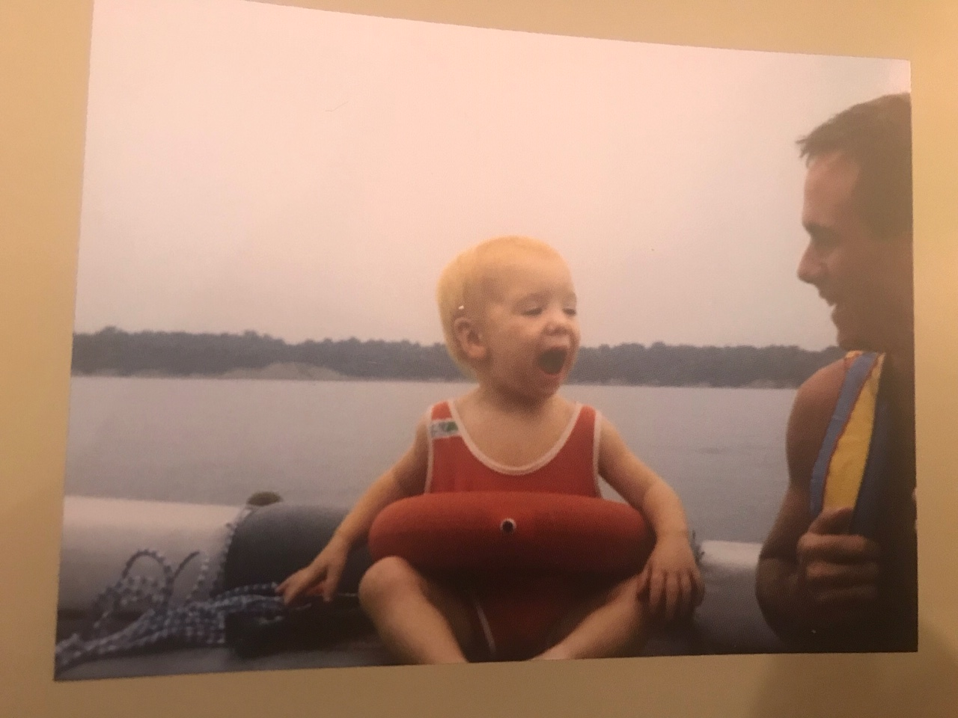
John
Dealing with Tragedy Yourself
“But we do not want you to be uninformed, brothers, about those who are asleep, that you may not grieve as others do who have no hope.”
- 1 Thessalonians 4:13
“Now concerning the resurrection of the dead, haven't you read what was spoken to you by God:
‘I AM the God of Abraham and the God of Isaac and the God of Jacob?’ He is not the God of the dead, but of the living.” - Matthew 22:31-32

Slide 8
John
Dealing with Tragedy Yourself
“But we do not want you to be uninformed, brothers, about those who are asleep, that you may not grieve as others do who have no hope.”
- 1 Thessalonians 4:13
“Jesus said to her, ‘I AM the resurrection and the life. The one who believes in me, even if he dies, will live. Everyone who lives and believes in me will never die. Do you believe this?’" - John 11:25-26

Slide 9
John
Dealing with Tragedy Yourself
“But we do not want you to be uninformed, brothers, about those who are asleep, that you may not grieve as others do who have no hope.”
- 1 Thessalonians 4:13
“...we also rejoice in our afflictions, because we know affliction produces endurance, endurance produces proven character, and proven character produces hope. This hope will not disappoint us, because God's love has been poured out in our hearts through the Holy Spirit who was given to us.” - Romans 5:3-5

Slide 10
John
Dealing with Tragedy Yourself
“But we do not want you to be uninformed, brothers, about those who are asleep, that you may not grieve as others do who have no hope.”
- 1 Thessalonians 4:13
Hope changes perspective about what is:
P–ermanent P–ervasive P–ersonal
“ABC” = A-dversity B-elieve C-onclusion
http://web.stanford.edu/class/msande271/onlinetools/LearnedOpt.html

Slide 11
John
Dealing with Tragedy Yourself
“But we do not want you to be uninformed, brothers, about those who are asleep, that you may not grieve as others do who have no hope.”
- 1 Thessalonians 4:13
Key Parenting Skill? Learning to lament:
“I have told you these things, so that in me you may have peace. In this world you will have trouble. But take heart! I have overcome the world.” - John 16:33

Slide 12
John
Dealing with Tragedy Yourself
“But we do not want you to be uninformed, brothers, about those who are asleep, that you may not grieve as others do who have no hope.”
- 1 Thessalonians 4:13
Key Parenting Skill? Learning to lament:
“Even when I go through the darkest valley, I fear no danger, for you are with me; your rod and your staff ​-- ​they comfort me.“ - Psalm 23:4

Slide 13
John
Dealing with Tragedy Yourself
“But we do not want you to be uninformed, brothers, about those who are asleep, that you may not grieve as others do who have no hope.”
- 1 Thessalonians 4:13
Our 5 Big Fears:
Death
Outsider
Future
Chaos
Meaninglessness
Our 5 Big Needs:
Security
Community
Clarity
Control
Purpose

Slide 14
John
Dealing with Tragedy Yourself
“But we do not want you to be uninformed, brothers, about those who are asleep, that you may not grieve as others do who have no hope.”
- 1 Thessalonians 4:13
Key Parenting Skill:
Who you are when you’re with your kids is more important than what you say or do…

Slide 15
Tragedy
Dealing with Tragedy Yourself
2. Training your Child

Slide 16
Training your Child Biblical Worldview
“Train a child in the way he should go, and when he is old he will not turn from it.”
Proverbs 22:6

Slide 17
Training your Child Biblical Worldview
Teach
“Dear friends, do not be surprised at the painful trial you are suffering, as though something strange were happening.”
- 1 Peter 4:12

Slide 18
Training your Child Biblical Worldview
Teach
Good and bad co-exists
God is Sovereign
Conflict resolution skills
Delayed gratification skills

Slide 19
Training your Child Biblical Worldview
Teach
Model

Slide 20
Training your Child Biblical Worldview
Teach
Model
Help your Child Internalize

Slide 21
Help your Child Internalize
Encourage healthy expression of emotion
Help them reflect on God’s truth
Pray with them: “God I feel…but your word says…”
Set & hold healthy boundaries to increasingly train them to take responsibility for their part
Anticipate & celebrate with them the ability to do the “hard” thing with God’s power

Slide 22
When Tragedy does Strike
Be honest about what is happening
Remember they see/hear everything
Encourage them to talk/write/draw feelings
Pray with them
Keep as much routine as possible
Encourage them to take opportunities for fun
Ask for help

Slide 23
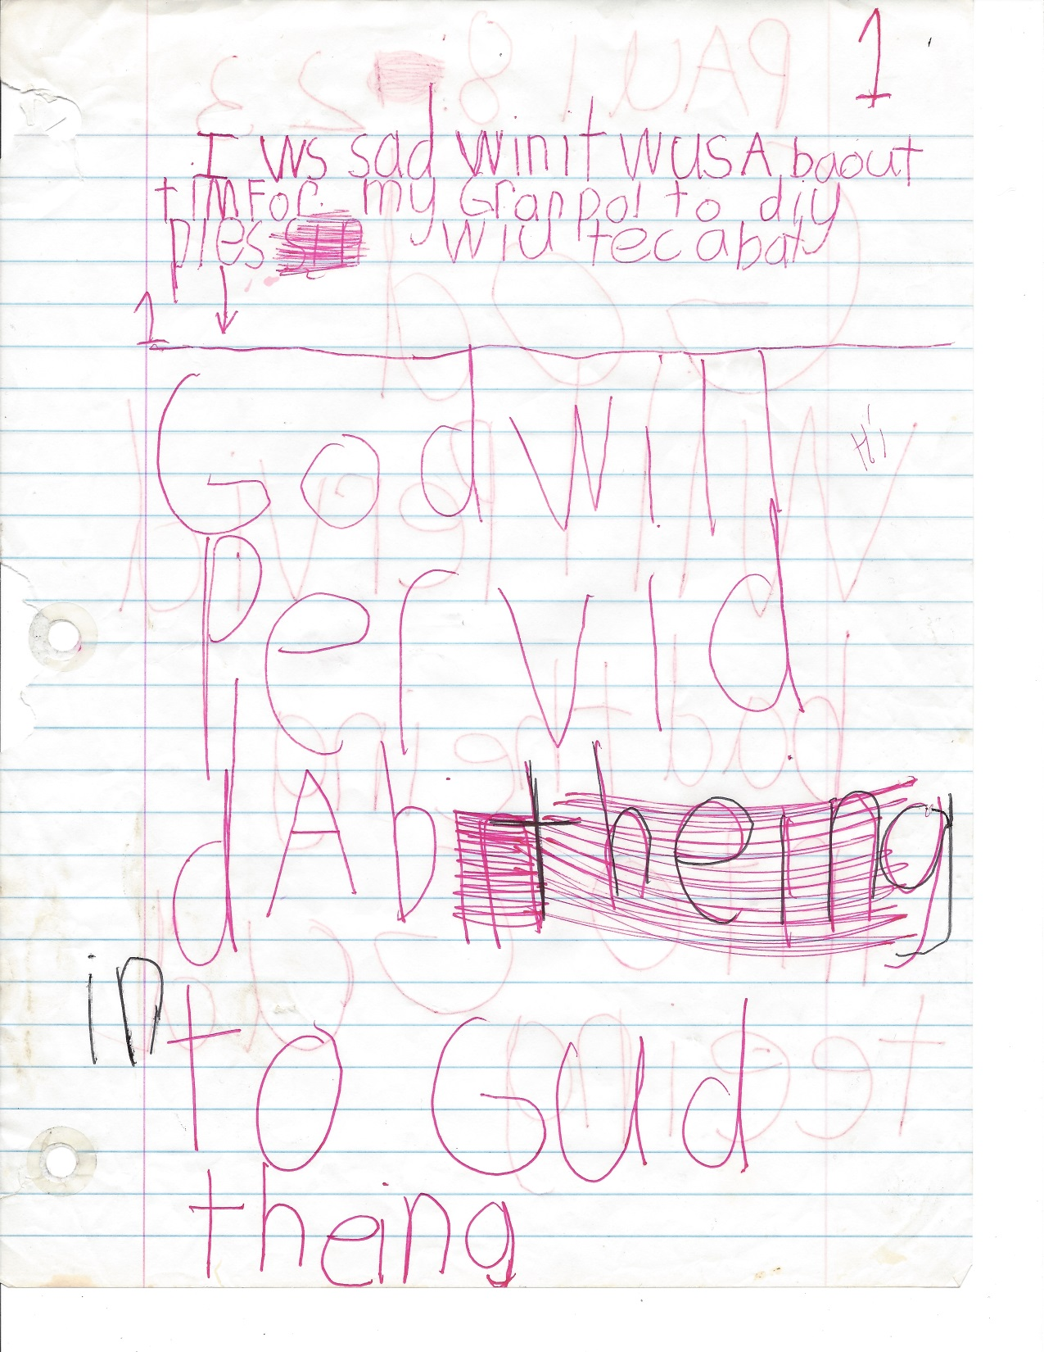
When Tragedy does Strike
Be honest about what is happening
Remember they see/hear everything
Encourage them to talk/write/draw feelings
Pray with them
Keep as much routine as possible
Encourage them to take opportunities for fun
Ask for help

Slide 24
Dealing with Tragedy: small & large; present & future
Questions?
Comments?
Experiences?

