Slide 1
Filling your child’s love tank

Slide 2
Children are a gift from the Lord, they are a reward from Him.
Psalm 127:3 NLT
Notes:
This verse is always a good reminder to me, especially with trying to figure out how to parent in a pandemic when emotions are high and circumstances are more challenging. God has given us a gift in our children, and with that we have a responsibility to be good stewards of this gift. Our responsibility as parents is meet the needs of our children. Not just physically (food, clothing, shelter) but also emotionally

Slide 3
A child is the most needy person in our society and the greatest need is love.
How to Really Love Your Child by Ross Campbell, M.D.
Notes:
Children cannot meet their own needs and the greatest of these needs is love. This is arguably this is the most important thing we can do for our kids, make them feel loved. The best toys, a nice house, cool clothes, these things are fine, but love is the need! When this need isn't met in a child, they usually act in ways that are undesirable, acting unloving is often a sign a child feels unloved.

Slide 4
Every child has an emotional tank, a place of emotional strength that can fuel him through the challenging days of childhood and adolescence. Just as cars are powered by reserves in the gas tank, our children are fueled from their emotional tanks. We must fill our children’s emotional tanks for them to operate as they should and reach their potential.
The 5 Love Languages of Children
By Dr. Gary Chapman and Ross Campbell, M.D.
Notes:
This is crucial for our children’s growth and well being. Going along with the car analogy, if the gas tank is empty, what happens to the car? It doesn’t work! If a child’s love tank isn't full they will not grow and develop as they should. There is an abundance of evidence that supports loving touch and interaction as being essential for a child's brain to develop properly. This is a big job, but this is also the most important job you can have!

Slide 5
How do we fill our child’s emotional love tank?
Unconditional love shows love to a child no matter what. We love regardless of what the child looks like; regardless of her assets, liabilities, or handicaps; regardless of what we expect her to be; and, most difficult of all, regardless of how she acts. This does not mean that we like all of her behavior. It does mean that we give and show love to our child all the time, even when her behavior is poor.
5 Love Languages of Children
Unconditional love
No Matter What! (looks, abilities, disabilities, behavior)
This doesn’t mean we always like their behavior
Not spoiling your child
Think of the alternative: Conditional love
Notes:
Unconditional love
-No matter what! We love our kids no matter what their downfalls are and no matter what their giftings are, no matter their behavior
-we don't always like their behavior. When my son back talks me, I don't like it, but i still love him and I try to draw near him instead of punish him for doing something I didn't like
-this is not giving your child anything they want, this is not setting aside discipline, unconditional love actually set the stage for more effective discipline
-conditional love is confusing to a child, they will not understand why they are show love one min and then not the next. They will feel like are not good enough, or unloveable.
1st Quote
This is unconditional love

Slide 6
How do we fill our child’s emotional love tank?
A child who does not feel genuinely loved and accepted, however, has real difficulty identifying with parents and their values. Without a strong, healthy love-bond, a child reacts to parental guidance with anger, hostility, and resentment. He or she views each parental request (or command) as an imposition and learns to resist it. In severe cases, a child learns to consider each parental request with such resentment that the child’s total orientation to parental (and eventually to all) authority is one of doing exactly the opposite of what is expected. How to Really Love Your Child
If I love them only when they meet my requirements or expectations, they will feel incompetent and will believe it is pointless to do their best, since it is never enough. They will always be plagued by insecurity, anxiety, low self-esteem, and anger. To guard against this, I need to often remind myself of my responsibility for their total growth.
The 5 Love Languages of Children
If I love my child only when they please me (conditional love)...they will not feel genuinely loved. This in turn will make them insecure, damage their self image, and actually prevent them from moving on to better self control and more mature behavior.
How to Really Love Your Child
Conditional love
Confusing and causes insecurity
Anxiety and emotional problems
How has this affected you?
We will lose our voice in our kids lives
Notes:
Conditional love
Confusing- do they love me or not, Im not good enough, are they going to love me after the find out what I did?
Anxiety- our culture is riddled with anxiety. I want to raise emotionally healthy children. I don't have total control over that, but I can build a frame work of unconditional love that can help them on the right path. Conditional causes anxiety and worry bc a child is confused about if they are loved or now.
How has this impacted you?

Slide 7
Love is patient and kind. Love is not jealous or boastful or proud or rude. It does not demand its own way. It is not irritable, and it keeps no record of being wronged. It does not rejoice about injustice but rejoices whenever the truth wins out. Love never gives up, never loses faith, is always hopeful, and endures through every circumstance.
1 Corinthians 13:4-7 NLT
Notes:
Biblical love is unconditional, this is the Love that we have been shown by Jesus, when he died for us even when we had rejected him. He moved towards us and showed us patient, kind, hopeful, enduring love.
Our kids need this kind of love from us, we won't do it perfectly, and that’s ok, we do this under God’s grace and by his power.
Let look at some practicals.

Slide 8
How do we fill our child’s emotional love tank?
It seems that the most obvious way of conveying love to a child is by physical contact. Surprisingly, studies show that most parents touch their children only when necessity demands it… These parents don't know the fantastic opportunities they are missing. Within their hands, they have a way of assuring their children’s emotional security and their own success as parents.
...giving your child full, undivided attention in such a way that the child feels without doubt completely loved; that the child is valuable enough in his or her own right to warrant parents’ undistracted watchfulness, appreciation and uncompromising regard.
How to Really Love Your Child
Eye Contact
The more a parent makes eye contact with a child as a means of expressing love, the more the child is nourished with love and the fuller the child’s emotional tank is.
Physical Contact
Focused attention
Notes:
Eye contact- looking your child in the eyes to express love- only using eye contact when we are upset send the message of conditional love. This also means we need to put down or phones, and look at our children
Physical contact- I am not a super touchy person, and I remember when i read this book as a new mom this point really stuck out to me. When my boys were small, I found it relatively easy to do this. Cuddle and read books, or sing, hugging, and wrestling. Now at ages 8 and 6 I have to try a little bit harder. This book actually helped me to be more conscious about making sure I have some physical contact with my boys everyday. Pat on the back, touching their arm when I’m talking to them, we still do some wrestling games, and even sometimes they will still cuddle with me as we read or watch a movie.
Focused attention- arguably the most important and the one that takes the most sacrifice. There is no way to fulfill this need except with our time. When our kids are small and not in school, this is a very demanding need, and pray that our kids will learn to play by themselves or with a sibling. When our kids are in school this takes more intention.

Slide 9
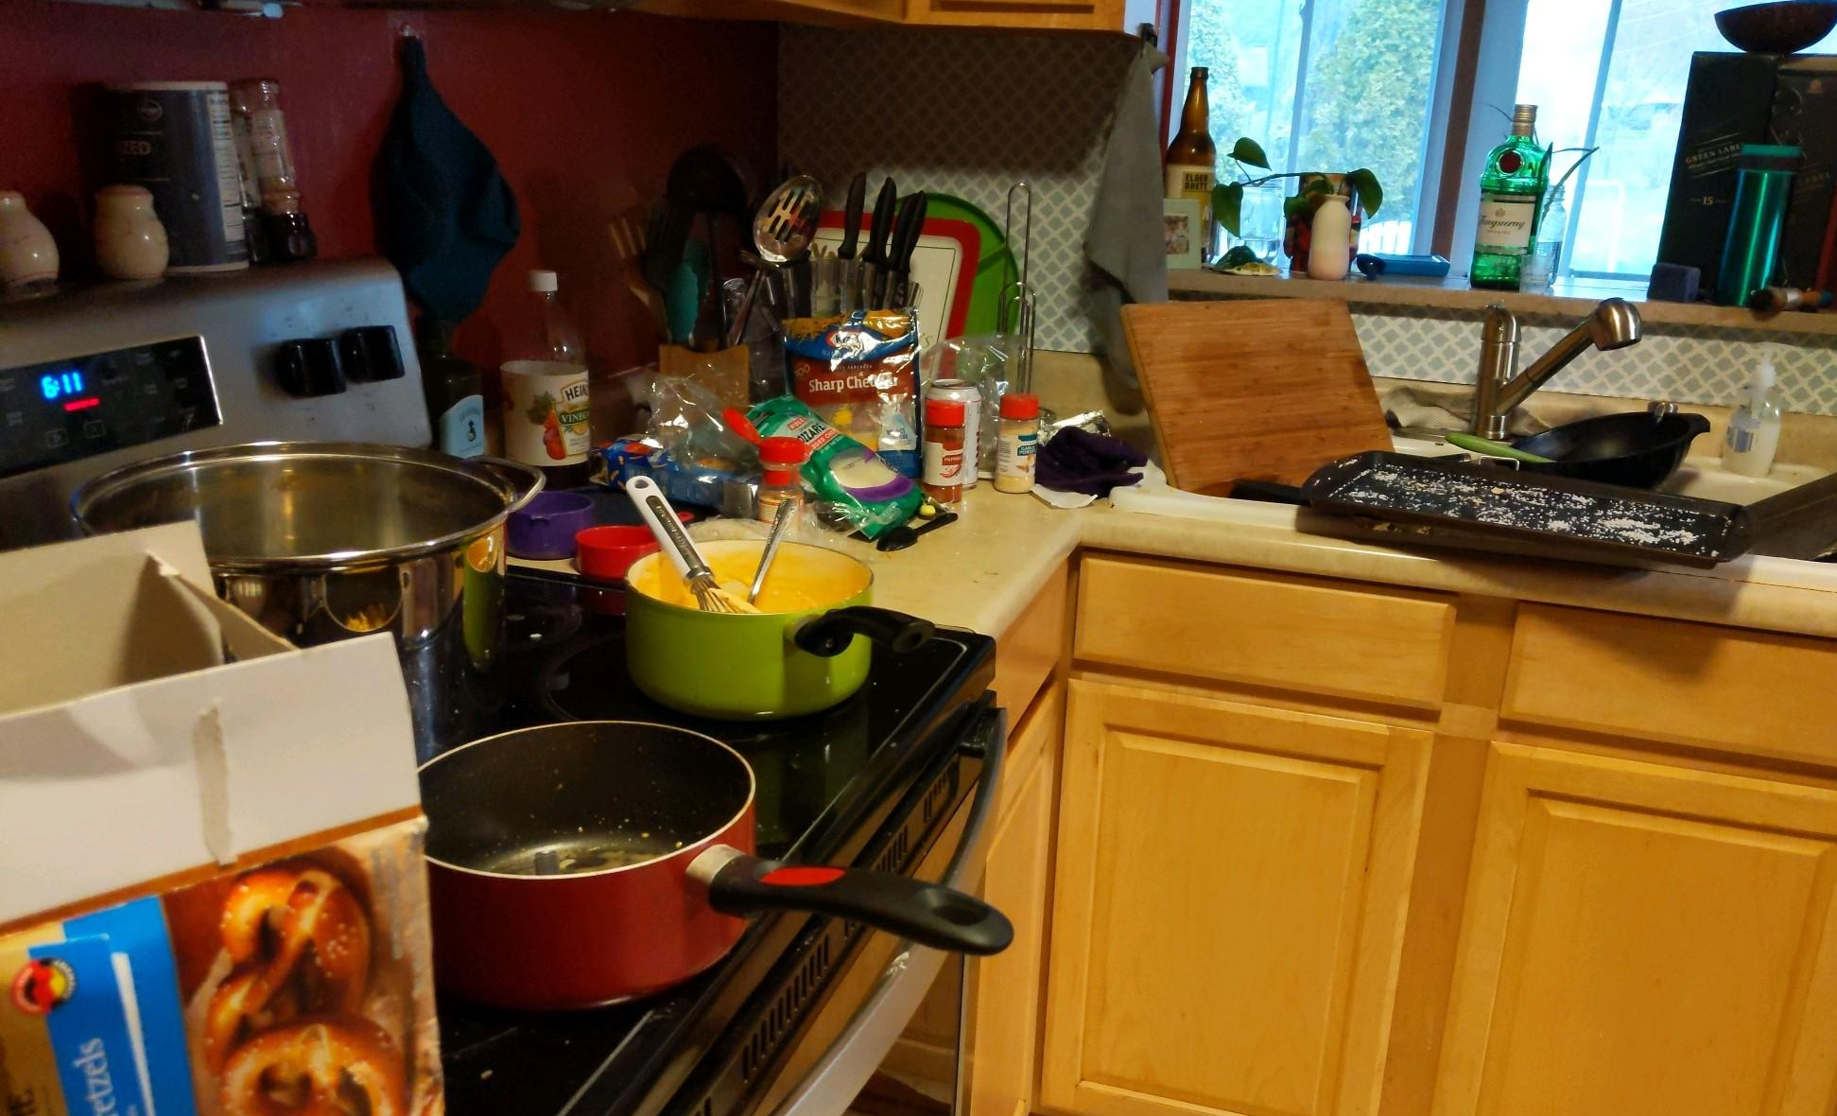
How do we fill our child’s emotional love tank?
One on one time ideas:
Get ice cream and take a walk
Throw the football or shoot hoops
Paint nails, let your child paint yours!
Do something your child is really into (legos, barbies, music, arts and crafts)
Read books and talk about them
Explore new places (parks, forests, creeks)
Pet store/book store
Fishing
Drink hot chocolate and play games
Watching trains
Don’t be a victim of the urgent. In the long run, much of what seems so pressing right now won’t even matter. What you do with your children will matter forever.
Focused attention
Tyranny of the Urgent
One on one time
Put down your phone
Notes:
Tyranny of urgent- we have so much to do, we are so busy! Work, laundry, dishes, this problem over here, oh now there is another problem over here, I need a show! Quote- this has helped to reset my priorities (show picture) if i have a sink full of dishes, it’s that not that big a deal, but kids who need me are.
One on one time- This shows our children that they are important to us. That we value them individually. This is how we get to know them, and sets the stage for having bigger conversations with them as they get older.
this has been a challenge for us, especially since having our 3rd. I think we have a new system finally figured out. But this is so important for each child to feel and know they are important to you. Here are some ideas
Phone: This is has been a struggle for me! I have felt at times like i need to respond to a text right away, or answer my phone as soon as it rings. Our kids notice when our phone becomes more important than them. When we are willing to interrupt time with them for our phone, but not vice versa.

Slide 10
How do we fill our child’s emotional love tank?
5 Love Languages of a Child
Every child has a special way of perceiving love. There are five ways children (indeed, all people) speak and understand emotional love. They are physical touch, words of affirmation, quality time, gifts, and acts of service.
Notes:
The 5 love languages are a tool we can use to figure out what makes our child tick. Understanding how our kids feel loved takes observation, investment, and prayer. I like starting with the three mentioned in How to really love your child and as your child grows you will learn more about what really speaks to them.
Handout attached from more in depth info on the 5 love languages

Slide 11
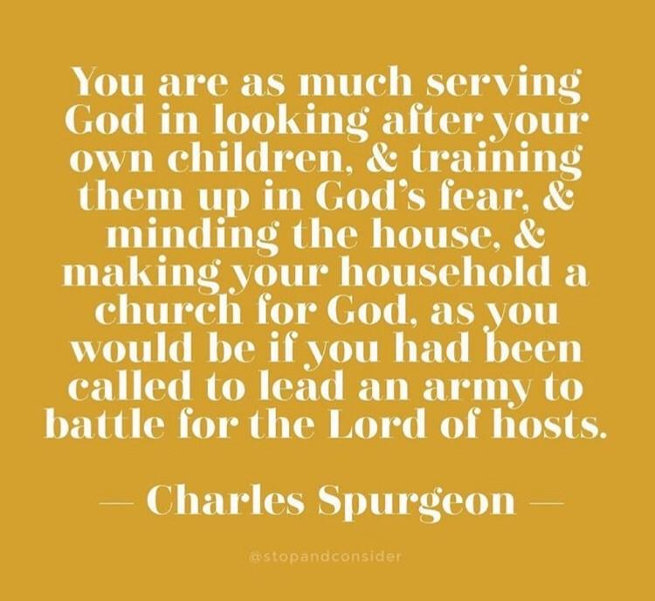
Our Goal:
To meet our Children’s emotional needs, under grace and with God’s power
Provide the best framework (not a quick fix or guarantee) for our kids to grow and succeed
Are you being filled?
Remember the importance of what you are doing!

Slide 12
Resources
How to Really Love Your Child by Ross Campbell M.D.
The 5 Love Languages of Children by Gary Chapman and Ross Campbell M.D.

Slide 13
