Slide 2
Introduction
When God met Moses several months ago, he made him a promise…
(Ex. 3:12) God told Moses, “I will be with you, and this is your sign that I am the one who has sent you:
When you have brought the people out of Egypt,
you will worship Me at this very mountain.”

Slide 3
(Ex. 19:1) On the first day of the third month after the Israelites left Egypt they came to the Desert of Sinai.
² After they set out from Rephidim, they entered the Desert of Sinai, and Israel camped there in the desert in front of the mountain.

Slide 4
(Ex. 19:3) Then Moses went up to God, and the Lord called to him from the mountain.

Slide 5
(Ex. 19:4) God said, “You yourselves have seen what I did to Egypt, and how I carried you on eagles’ wings and brought you to myself.
⁵ Now if you obey me fully and keep my covenant, then out of all nations you will be my treasured possession.
⁶ Although the whole earth is mine, you will be for me a kingdom of priests and a holy nation.”

Slide 6
(Ex. 19:4) God said, “You yourselves have seen what I did to Egypt, and how I carried you on eagles’ wings and brought you to myself.
⁵ Now if you obey me fully and keep my covenant, then out of all nations you will be my treasured possession.
⁶ Although the whole earth is mine, you will be for me a kingdom of priests and a holy nation.”
Not religion!
Do versus done!

Slide 7
(Ex. 19:4) God said, “You yourselves have seen what I did to Egypt, and how I carried you on eagles’ wings and brought you to myself.
⁵ Now if you obey me fully and keep my covenant, then out of all nations you will be my treasured possession.
⁶ Although the whole earth is mine, you will be for me a kingdom of priests and a holy nation.”
Not religion!
Do versus done!

Slide 8
(Ex. 19:4) God said, “You yourselves have seen what I did to Egypt, and how I carried you on eagles’ wings and brought you to myself.
⁵ Now if you obey me fully and keep my covenant, then out of all nations you will be my treasured possession.
⁶ Although the whole earth is mine, you will be for me a kingdom of priests and a holy nation.”

Slide 9
(Ex. 19:4) God said, “You yourselves have seen what I did to Egypt, and how I carried you on eagles’ wings and brought you to myself.
⁵ Now if you obey me fully and keep my covenant, then out of all nations you will be my treasured possession.
⁶ Although the whole earth is mine, you will be for me a kingdom of priests and a holy nation.”
God chose Israel to bless the nations, not to suppress the nations.
Genesis 12:1-3

Slide 10
(Ex. 19:7) So Moses went back and summoned the elders of the people and set before them all the words the Lord had commanded him to speak.
⁸ The people all responded together,
“We will do all the Lord has said!”
So Moses brought their answer back to the Lord.
They agreed before even hearing the contract…
Exodus 32

Slide 11
(Ex. 19:9) The Lord said to Moses,
“I am going to come to you in a dense cloud, so that the people will hear me speaking with you and will always put their trust in you.
¹⁰ Go to the people and consecrate them today and tomorrow.”
“Consecrate” (qādaš)
“Prepare,” “dedicate,” or “set apart.”
Thomas E. Mccomiskey, Theological Wordbook of the Old Testament (Chicago: Moody Press, 1999), 786.

Slide 12
(Ex. 19:11) “Have them wash their clothes and be ready by the third day, because on that day the Lord will come down on Mount Sinai in the sight of all the people.”

Slide 13
(Ex. 19:12) “Put limits for the people around the mountain and tell them,
‘Be careful that you do not approach the mountain or touch the foot of it.
Whoever touches the mountain
is to be put to death.’”

Slide 14
(Ex. 19:13) “‘They are to be stoned or shot with arrows. Not a hand is to be laid on them. No person or animal shall be permitted to live.’
Only when the ram’s horn sounds a long blast may they approach the mountain.”

Slide 15
(Ex. 19:14) After Moses had gone down the mountain to the people, he consecrated them, and they washed their clothes.
¹⁵ Then he said to the people,
“Prepare yourselves for the third day.
Abstain from sexual relations.”

Slide 16
(Ex. 19:14) After Moses had gone down the mountain to the people, he consecrated them, and they washed their clothes.
¹⁵ Then he said to the people,
“Prepare yourselves for the third day.
Abstain from sexual relations.”
Why all the restrictions?
Wash your clothes
Rare in the desert!
Shows that they needed to be clean to come to God.
Don’t touch the mountain
Shows separation (Isa. 59:2).
No sex
Shows that God is more important to focus on than sex! (1 Cor. 7:5; 1 Sam. 21:4-5; 2 Sam. 11:11).

Slide 17
(Ex. 19:14) After Moses had gone down the mountain to the people, he consecrated them, and they washed their clothes.
¹⁵ Then he said to the people,
“Prepare yourselves for the third day.
Abstain from sexual relations.”
Why all the restrictions?
Wash your clothes
Rare in the desert!
Shows that they needed to be clean to come to God.
Don’t touch the mountain
Shows separation (Isa. 59:2).
No sex
Shows that God is more important to focus on than sex! (1 Cor. 7:5; 1 Sam. 21:4-5; 2 Sam. 11:11).
They are about to encounter God for the first time!

Slide 18
(Ex. 19:16) On the third day there was thunder and lightning.
There was a thick cloud over the mountain, and a very loud trumpet blast.

Slide 19
(Ex. 19:16) On the third day there was thunder and lightning.
There was a thick cloud over the mountain, and a very loud trumpet blast.
Everyone in the camp trembled!

Slide 20
(Ex. 19:17) Then Moses led the people out of the camp to meet with God,
and they stood at the foot of the mountain.

Slide 21
(Ex. 19:18) Mount Sinai was covered with smoke, because the Lord descended on it in fire.
The smoke billowed up from it like smoke from a furnace, and the whole mountain trembled violently.
¹⁹ As the sound of the trumpet grew louder and louder, Moses spoke and the voice of God answered him.

Slide 22
(Ex. 19:20) The Lord descended to the top of Mount Sinai and called Moses to the top of the mountain.
²¹ The Lord said to Moses,
“Go down and warn the people so they do not force their way through to see the Lord and many of them perish.”

Slide 23
(Ex. 19:22) “Even the priests, who approach the Lord, must consecrate themselves, or the Lord will break out against them.”
²³ Moses said to the Lord,
“The people cannot come up Mount Sinai, because you yourself warned us, ‘Put limits around the mountain and set it apart as holy.’”

Slide 24
(Ex. 19:24) The Lord replied,
“Go down and bring Aaron up with you. But the priests and the people must not force their way through to come up to the Lord,
or he will break out against them.”
²⁵ So Moses went down to the people and told them.

Slide 25
What is God showing us?
(1) We are naturally scared of God, but also drawn to Him.
The people “trembled” at God’s presence.
Exodus 19:16
Yet, they were drawn to God.
Exodus 19:21, 24

Slide 26
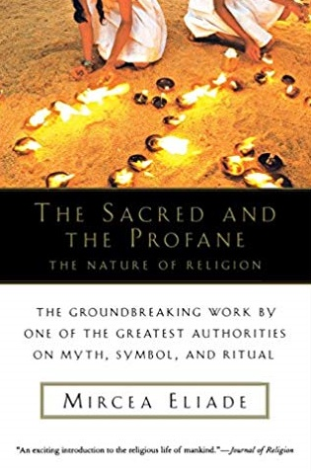
Mircea Eliade
(Historian of Religion—University of Chicago)
Mircea Eliade, The Sacred and the Profane (Orland, FL: Harcourt, 1957), 9-10
[Regarding religious experience…]
[Rudolph] Otto [set] himself to discover the characteristics of this frightening and irrational experience.

Slide 27
Mircea Eliade
(Historian of Religion—University of Chicago)
Mircea Eliade, The Sacred and the Profane (Orland, FL: Harcourt, 1957), 9-10
He finds the feeling of terror before the sacred, before the awe-inspiring mystery … that emanates an overwhelming superiority of power.

Slide 28
Mircea Eliade
(Historian of Religion—University of Chicago)
Mircea Eliade, The Sacred and the Profane (Orland, FL: Harcourt, 1957), 9-10
mysterium tremendum et fascinans
Confronted with it, man senses his profound nothingness, feels that he is only a creature.

Slide 29
Mircea Eliade
(Historian of Religion—University of Chicago)
Mircea Eliade, The Sacred and the Profane (Orland, FL: Harcourt, 1957), 9-10
mysterium tremendum et fascinans
Have you ever been in the presence of human greatness?
(You’re intrigued, but also sense your own inadequacy…)
Confronted with it, man senses his profound nothingness, feels that he is only a creature.

Slide 30
What is God showing us?
(1) We are naturally scared of God, but also drawn to Him.
(2) This is a graphic picture of our separation from God.
The people couldn’t even “touch” the mountain.
Exodus 19:12
Even the priests couldn’t come into God’s presence.
Exodus 19:22

Slide 31
What is God showing us?
(1) We are naturally scared of God, but also drawn to Him.
(2) This is a graphic picture of our separation from God.
(3) No one can come to God based on their own merits.

Slide 32
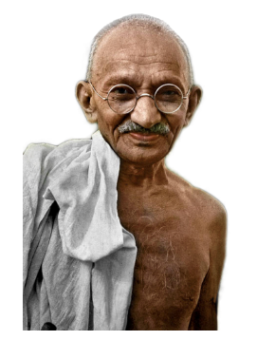
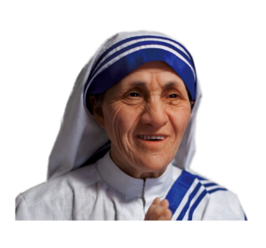
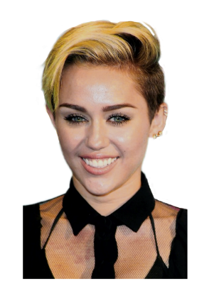
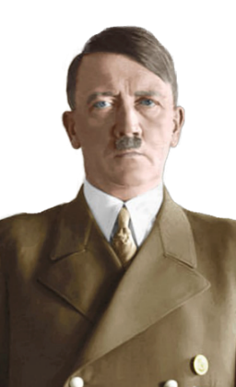
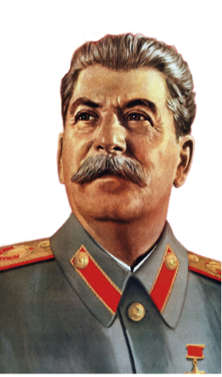

Slide 33
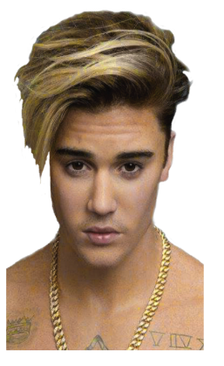

Slide 34
Me
You

Slide 35
You
Me

Slide 36
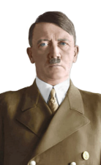
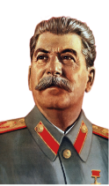
Me
You

Slide 37
Me
You

Slide 38
We need a mediator between us and God!
Me
You

Slide 39
What is God showing us?
(1) We are naturally scared of God, but also drawn to Him.
(2) This is a graphic picture of our separation from God.
(3) No one can come to God based on their own merits.

Slide 40
What is God showing us?
(1) We are naturally scared of God, but also drawn to Him.
(2) This is a graphic picture of our separation from God.
(3) No one can come to God based on their own merits.
We need a mediator between us and God!
But even Moses was afraid!
Deuteronomy 9:19; Hebrews 12:21

Slide 41
(Heb. 12:18) You have not come to a physical mountain, to a place of flaming fire, darkness, gloom, and whirlwind, as the Israelites did at Mount Sinai.
¹⁹ For they heard an awesome trumpet blast and a voice so terrible that they begged God to stop speaking.

Slide 42
(Heb. 12:20) They staggered back under God’s command: “If even an animal touches the mountain, it must be stoned to death.”
²¹ Moses himself was so frightened at the sight that he said, “I am terrified and trembling.”

Slide 43
(Heb. 12:22) No, you have come to Mount Zion, to the city of the living God, the heavenly Jerusalem, and to countless thousands of angels in a joyful gathering.

Slide 44
(Heb. 12:23) You have come to the assembly of God’s firstborn children, whose names are written in heaven.
You have come to God himself, who is the judge over all things. You have come to the spirits of the righteous ones in heaven who have now been made perfect.

Slide 45
(Heb. 12:24) You have come to Jesus, the one who mediates the new covenant between God and people, and to the sprinkled blood,
which speaks of forgiveness.

Slide 46
Which do you want?
Moses as your mediator?
(e.g. law, fear, trembling, exclusion)
Jesus as your mediator?
(e.g. forgiveness, security, gratitude, inclusion)

